Slide 1
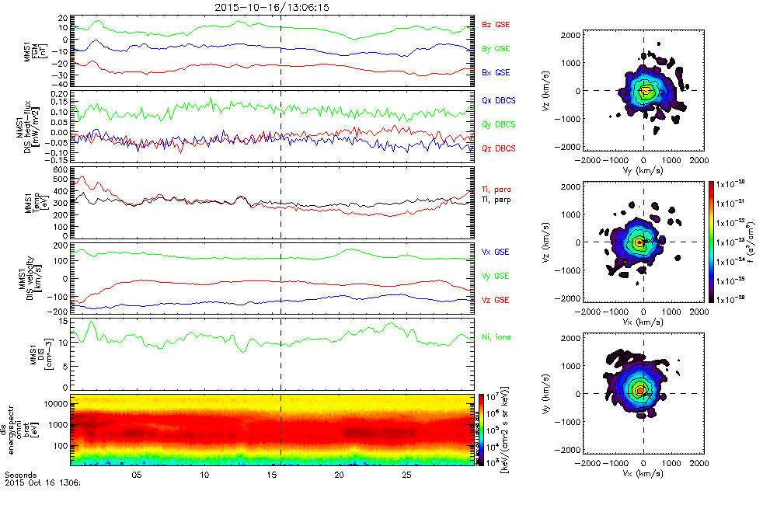
MMS plug-ins for SPEDAS
Eric Grimes (egrimes@igpp.ucla.edu)
MMS Community Workshop, June 11, 2018

Slide 2
Overview
What's New / Plug-in Status
Getting Started
Loading and Plotting Data
Analysis Tools
Getting Help

Slide 3
What’s New / Plug-in Status
What's New / Plug-in Status
Getting Started
Loading and Plotting Data
Analysis Tools
Getting Help
New features
- Create MMS orbit plots (mms_orbit_plot.pro)
- Create a series of images with line/spectra plots + 2D/1D cuts of distributions (mms_flipbookify.pro)
- Send MMS data to CDF files and Autoplot
- MMS wrapper for 2D slices (mms_part_slice2d.pro)
- Updates to mms_part_getspec
— Bulk velocity subtraction
— Subtract FPI distribution error, spin-tone
— Add B-field / spacecraft RAM direction to phi/theta spectrograms
— 'multipad' option, with mms_part_getpad (create a PAD for different energy ranges very quickly)
- mirror_data_dir keyword in mms_init (load data from a local network mirror instead of SDC/SPDF)
- flatten_spectra (quickly create line plots of spectra at specific times by clicking time varying spectra plots)
New example scripts
Poynting flux crib sheet (mms_poynting_flux_crib.pro)
Plasma beta crib sheet (mms_plasma_beta_crib.pro)
Webinar scripts now in mms/examples/webinars folder
Important bugfix:
- HPCA distribution code bug fix

Slide 4
Getting Started
Requirements
What's New / Plug-in Status
Getting Started
Loading and Plotting Data
Analysis Tools
Getting Help
Windows, Linux, OS X, or Solaris
IDL 8.4+
IDL CDF Library 3.6.3+

Slide 5
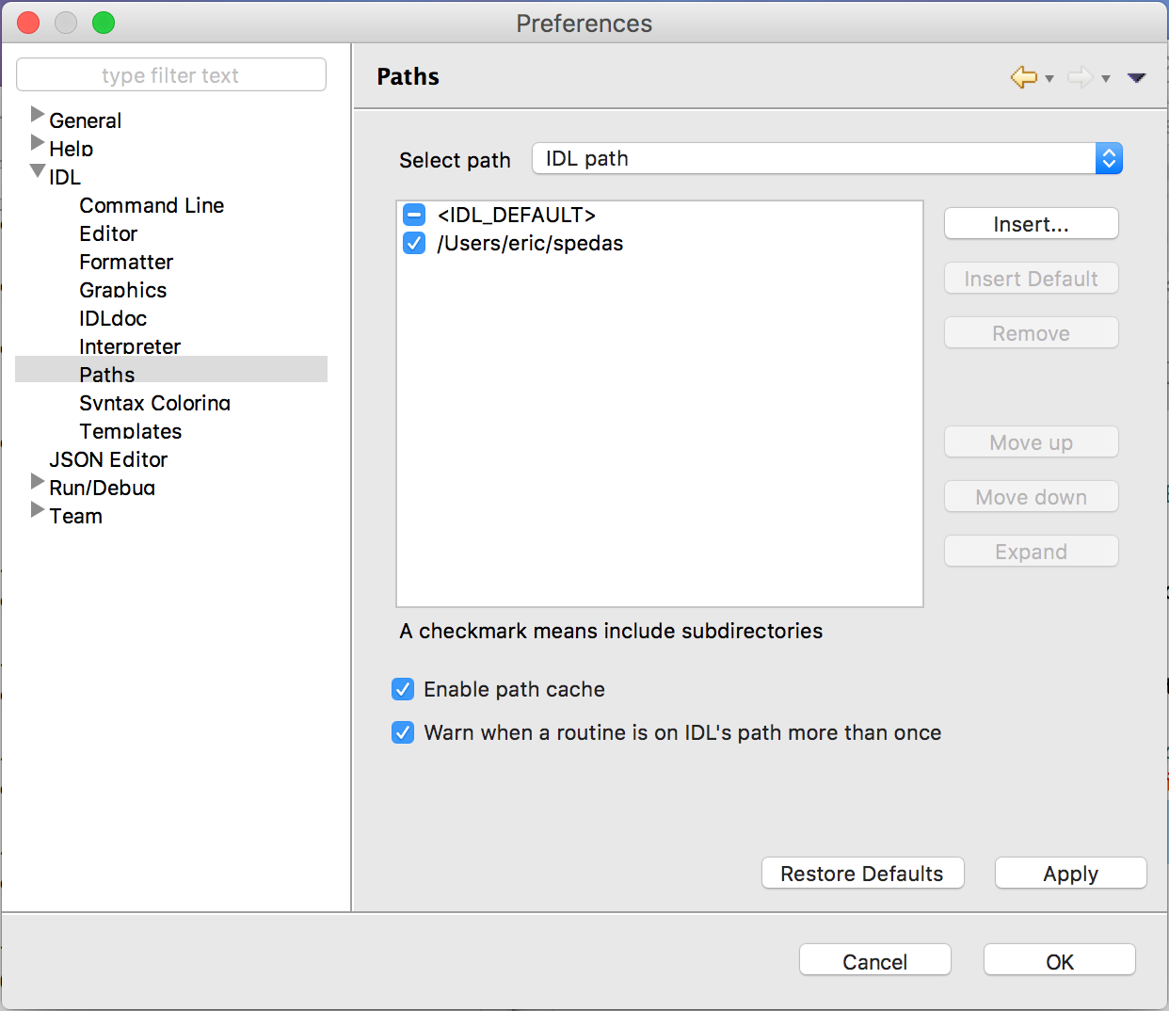
Getting Started
Installing SPEDAS
What's New / Plug-in Status
Getting Started
Loading and Plotting Data
Analysis Tools
Getting Help
http://spedas.org/wiki/index.php?title=Downloads_and_Installation

Slide 6
Getting Started
Organization
What's New / Plug-in Status
Getting Started
Loading and Plotting Data
Analysis Tools
Getting Help
spedas_gui: Components of the SPEDAS Graphical User Interface (GUI)
external: Code developed externally, but distributed with SPEDAS (CDAWeb, Geopack, etc.)
projects: Mission specific code
general: General science analysis tools

Slide 7
Getting Started
MMS Load Routines
What's New / Plug-in Status
Getting Started
Loading and Plotting Data
Analysis Tools
Getting Help
mms_load_fgm | Fluxgate Magnetometer
mms_load_scm | Search-coil Magnetometer
mms_load_fsm | L3 combined FGM+SCM data products
mms_load_mec | Ephemeris and Coordinates
mms_load_fpi | Fast Plasma Investigation
mms_load_hpca | Hot Plasma Composition Analyzer
mms_load_eis | Energetic Ion Spectrometer
mms_load_feeps | Fly’s Eye Energetic Particle Sensor
mms_load_edp | Electric-field Double Probe
mms_load_edi | Electron Drift Instrument
mms_load_dsp | Digital Signal Processor
mms_load_aspoc | Active Spacecraft Potential Control
mms_load_tetrahedron_qf | Tetrahedron Quality Factor
mms_load_fast_segments | Fast survey intervals
mms_load_brst_segments | Burst intervals
See folder: /projects/mms/

Slide 8
Getting Started
Standard Keywords
What's New / Plug-in Status
Getting Started
Loading and Plotting Data
Analysis Tools
Getting Help
trange
probes
level
data_rate
datatype
trange=['2015-10-16', '2015-10-17']
probes=[1, 2, 3, 4]
level='l2'
data_rate='srvy'
datatype=['des-moms', 'dis-moms']

Slide 9
Getting Started
Standard Keywords
What's New / Plug-in Status
Getting Started
Loading and Plotting Data
Analysis Tools
Getting Help
suffix
time_clip
no_update
spdf
tplotnames
suffix='_burst_mode'
/time_clip
/no_update
/spdf
tplotnames=tvarnames

Slide 10
Getting Started
Standard Keywords
What's New / Plug-in Status
Getting Started
Loading and Plotting Data
Analysis Tools
Getting Help
local_data_dir
mirror_data_dir
cdf_filenames
cdf_version
min_version
latest_version
local_data_dir='/Users/eric/mydata/'
mirror_data_dir='/path/to/network/drive/'
cdf_filenames=data_file_list
cdf_version='3.0.0'
min_version='3.0.0'
/latest_version

Slide 11
Getting Started
Standard Keywords
What's New / Plug-in Status
Getting Started
Loading and Plotting Data
Analysis Tools
Getting Help
For a complete list of keywords and their descriptions, see the header for the load routine you’re interested in, e.g.,
; PROCEDURE:
; mms_load_fpi
;
; PURPOSE:
; Load data from the Fast Plasma Investigation (FPI) onboard MMS
;
; KEYWORDS:
; trange: time range of interest [starttime, endtime] with the format
; ['YYYY-MM-DD','YYYY-MM-DD'] or to specify more or less than a day
; ['YYYY-MM-DD/hh:mm:ss','YYYY-MM-DD/hh:mm:ss']
; probes: list of probes, valid values for MMS probes are ['1','2','3','4'].
; If no probe is specified the default is probe '3'
; level: indicates level of data processing. FPI levels currently include 'l2',
; 'l1b', 'sitl', 'ql'.
; datatype: valid datatypes are:
; Quicklook: ['des', 'dis']
; SITL: '' (none; loads both electron and ion data from single CDF)
; L1b/L2: ['des-dist', 'dis-dist', 'dis-moms', 'des-moms']
; data_rate: instrument data rates for MMS FPI include 'fast', 'brst'.
; local_data_dir: local directory to store the CDF files; should be set if
; you're on *nix or OSX, the default currently assumes Windows (c:\data\mms\)
; source: specifies a different system variable. By default the MMS mission system
; variable is !mms
; get_support_data: load support data (defined by support_data attribute in the CDF)
; tplotnames: returns a list of the names of the tplot variables loaded by the load routine
; no_color_setup: don't setup graphics configuration; use this keyword when you're
; using this load routine from a terminal without an X server running
; time_clip: clip the data to the requested time range; note that if you do not use
; this keyword you may load a longer time range than requested

Slide 12
Getting Started
SDC Data Availability
What's New / Plug-in Status
Getting Started
Loading and Plotting Data
Analysis Tools
Getting Help
Browse the status of the data:
https://lasp.colorado.edu/mms/sdc/public/about/processing/
Browse the data files:
https://lasp.colorado.edu/mms/sdc/public/data/
Search for data files:
https://lasp.colorado.edu/mms/sdc/public/search/
Browse the quicklook plots at the SDC:
https://lasp.colorado.edu/mms/sdc/public/quicklook/

Slide 13
Getting Started
Simple Example
What's New / Plug-in Status
Getting Started
Loading and Plotting Data
Analysis Tools
Getting Help
; load the MMS1 FGM data for October 16, 2015
mms_load_fgm, probe=1, data_rate='srvy', trange=['2015-10-16', '2015-10-17']
; list the tplot variables loaded
tplot_names
; get the data out of a tplot variable
get_data, 'mms1_fgm_b_gsm_srvy_l2_bvec', data=bgsm_vec, dlimits=bgsm_metadata
; get basic info on the IDL vars that hold the B-field data
help, bgsm_vec ; structure, x: times, y: data (x, y, z)
help, bgsm_metadata ; plotting and file metadata
; store the data into a different tplot variable
store_data, 'new_var_with_b_gsm', data=bgsm_vec, dlimits=bgsm_metadata
; plot the newly created variable
tplot, 'new_var_with_b_gsm'

Slide 14
Loading and Plotting Data
FGM
What's New / Plug-in Status
Getting Started
Loading and Plotting Data
Analysis Tools
Getting Help
; load 10 minutes of burst-mode FGM data for probe 1 on October 16, 2015
mms_load_fgm, probe=1, data_rate='brst', trange=['2015-10-16/13:00', '2015-10-16/13:10'], /time_clip
; remove gaps
tdegap, ['mms1_fgm_b_gsm_brst_l2_bvec', 'mms1_fgm_b_gsm_brst_l2_btot'], /overwrite
; plot the vector and magnitude
tplot, ['mms1_fgm_b_gsm_brst_l2_bvec', 'mms1_fgm_b_gsm_brst_l2_btot']
; save the plot to a postscript file
tprint, 'mms1_fgm_b_gsm_brst_l2', /landscape
https://lasp.colorado.edu/mms/sdc/public/datasets/fields/

Slide 15
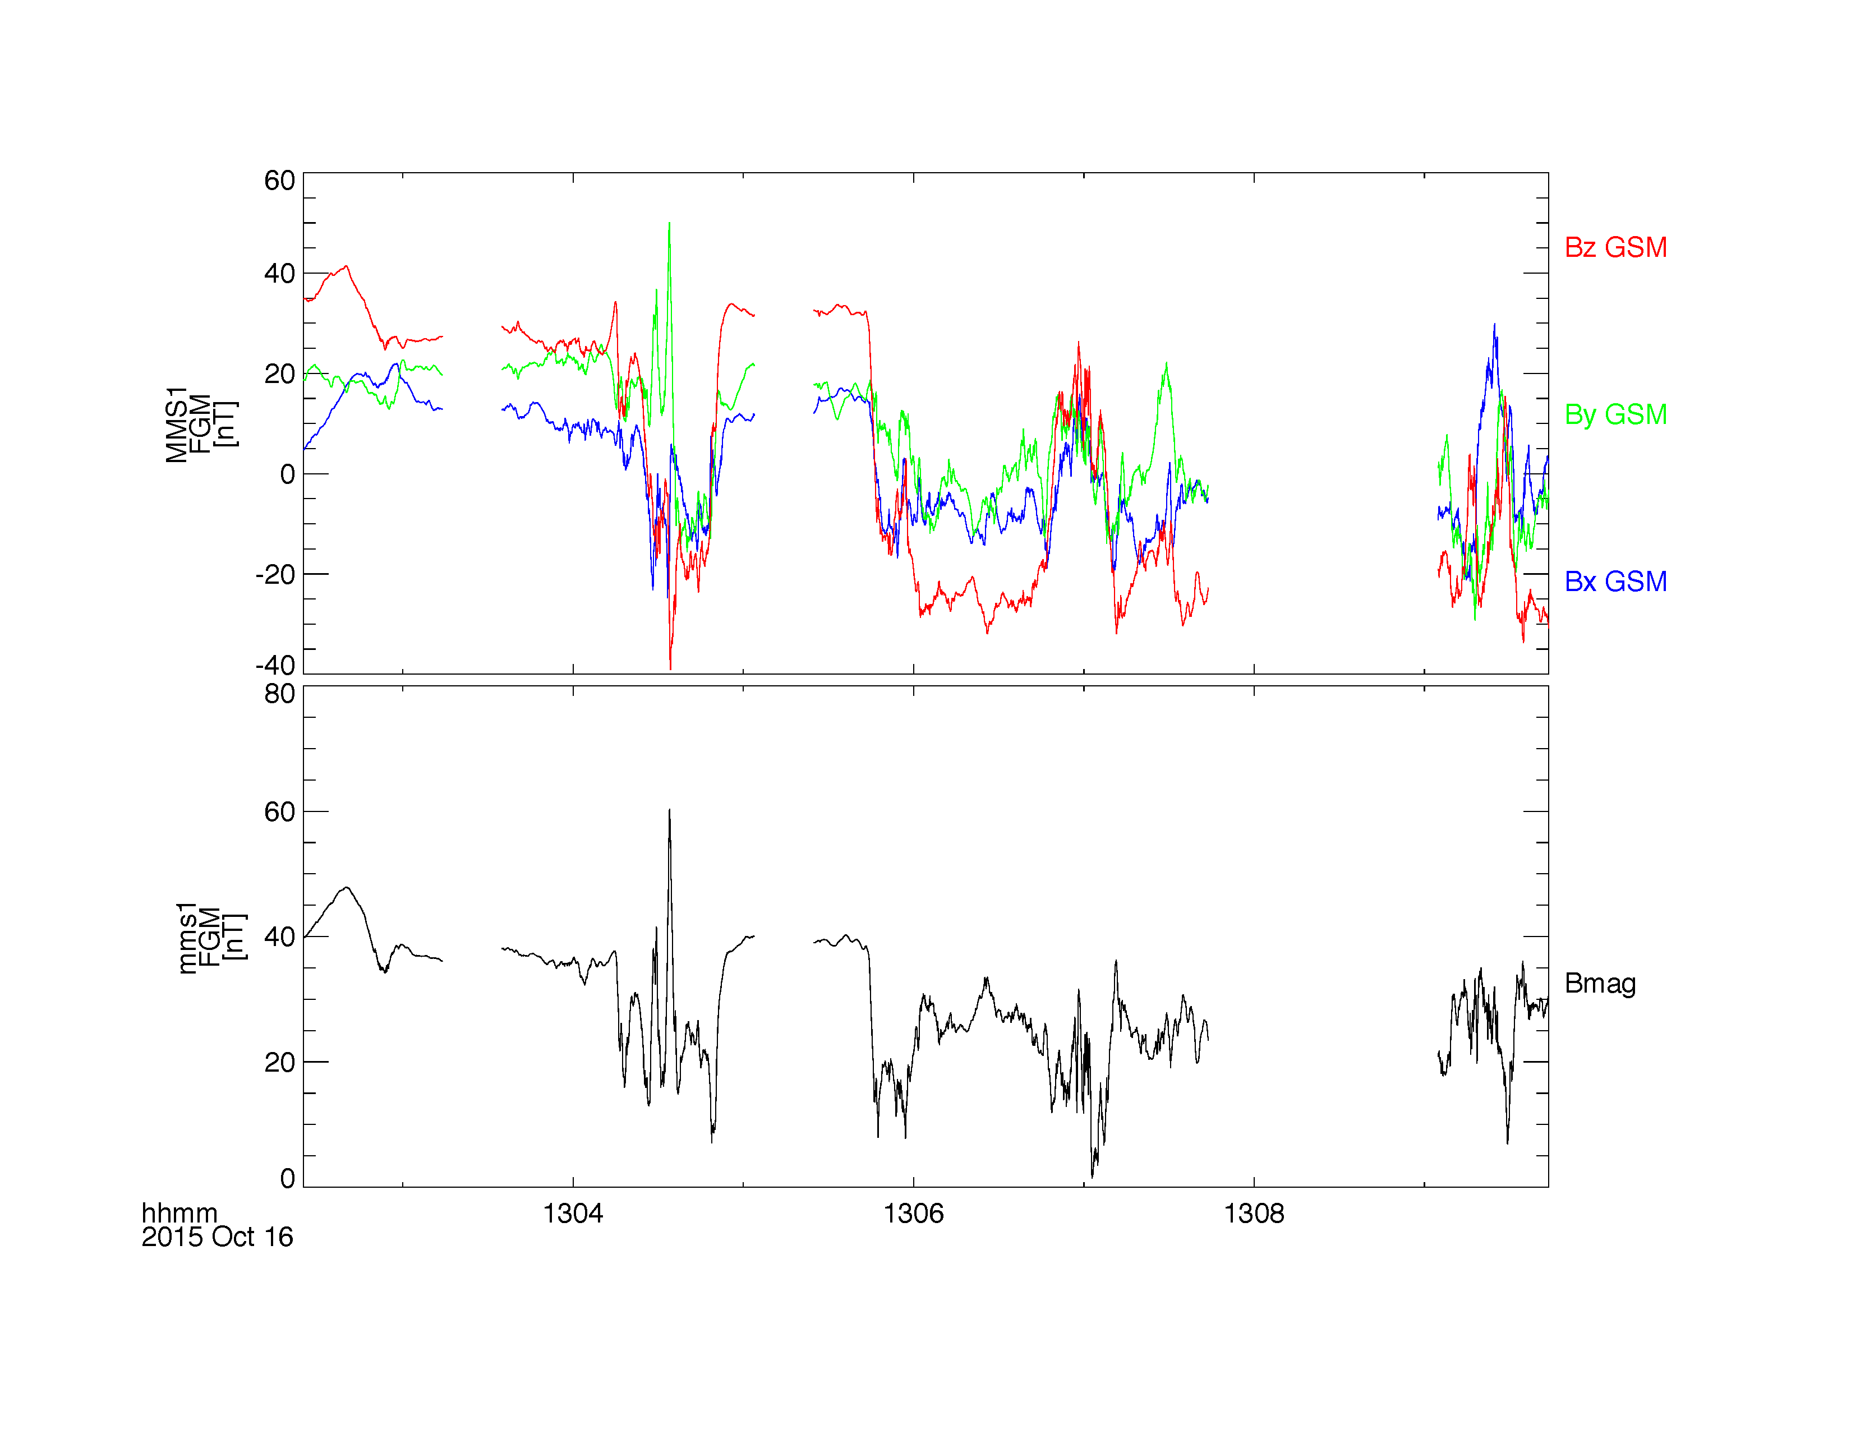
Loading and Plotting Data
FGM
What's New / Plug-in Status
Getting Started
Loading and Plotting Data
Analysis Tools
Getting Help

Slide 16
Loading and Plotting Data
FGM
What's New / Plug-in Status
Getting Started
Loading and Plotting Data
Analysis Tools
Getting Help
; add burst segments bar to the top of the figure
mms_load_brst_segments, trange=['2015-10-16/13:00', '2015-10-16/13:10']
tplot, 'mms_bss_burst', /add
; save the plot as a postscript file
tprint, 'mms1_fgm_b_gsm_brst_l2_with_burstbar', /landscape

Slide 17
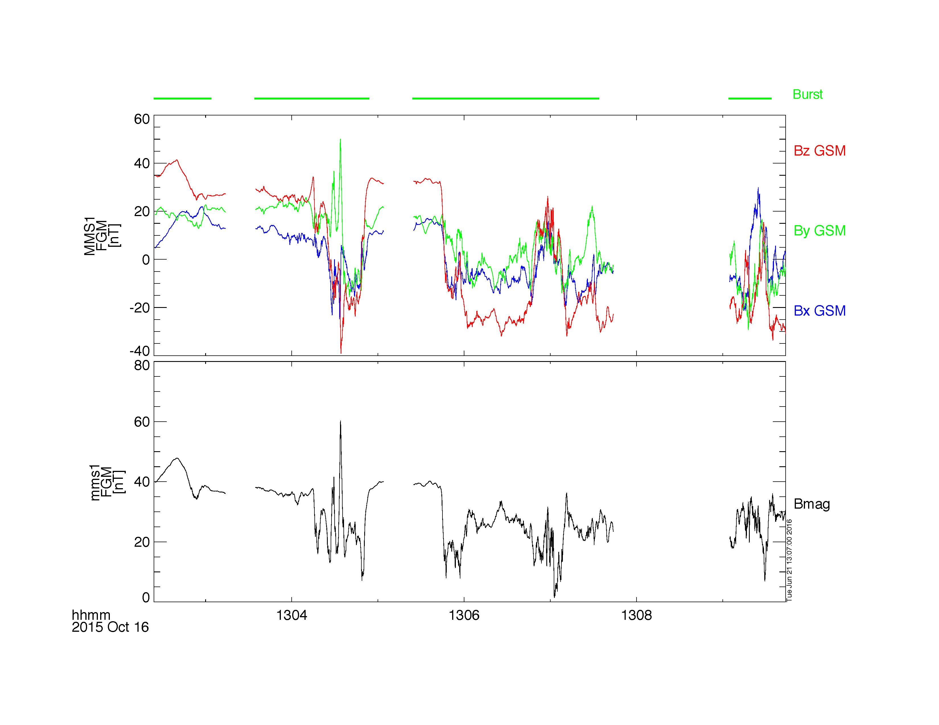
Loading and Plotting Data
FGM
What's New / Plug-in Status
Getting Started
Loading and Plotting Data
Analysis Tools
Getting Help

Slide 18
Loading and Plotting Data
SCM
What's New / Plug-in Status
Getting Started
Loading and Plotting Data
Analysis Tools
Getting Help
; load 10 minutes of burst-mode SCM data for probe 2 on October 16, 2015
mms_load_scm, probe='2', data_rate='brst', trange=['2015-10-16/13:00', '2015-10-16/13:10'], /time_clip
; plot the data
tplot, 'mms2_scm_acb_gse_scb_brst_l2'
; zoom into a few seconds after 13:07
tlimit, ['2015-10-16/13:07:00', '2015-10-16/13:07:02']
; save the plot to a postscript file
tprint, 'mms2_scm_acb_gse_scb_brst_l2', /landscape
https://lasp.colorado.edu/mms/sdc/public/datasets/fields/

Slide 19
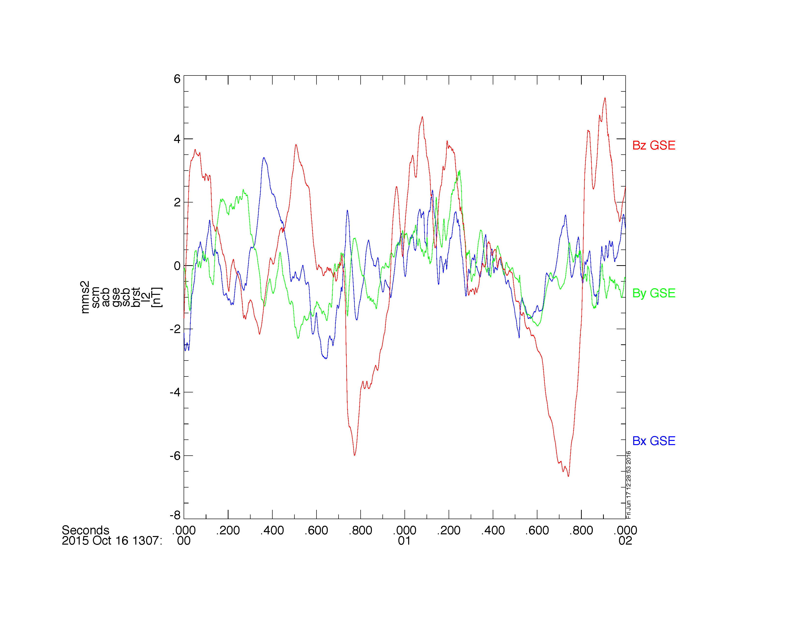
Loading and Plotting Data
SCM
What's New / Plug-in Status
Getting Started
Loading and Plotting Data
Analysis Tools
Getting Help

Slide 20
Loading and Plotting Data
EDP
What's New / Plug-in Status
Getting Started
Loading and Plotting Data
Analysis Tools
Getting Help
mms_load_edp, probe=1, level='l2', datatype='dce', trange=['2015-10-16', '2015-10-17'], /latest_version
; plot the E-field data
tplot, 'mms1_edp_dce_gse_fast_l2'
; save the plot to a postscript file
tprint, 'mms1_edp_dce_gse_fast_l2', /landscape
https://lasp.colorado.edu/mms/sdc/public/datasets/fields/

Slide 21
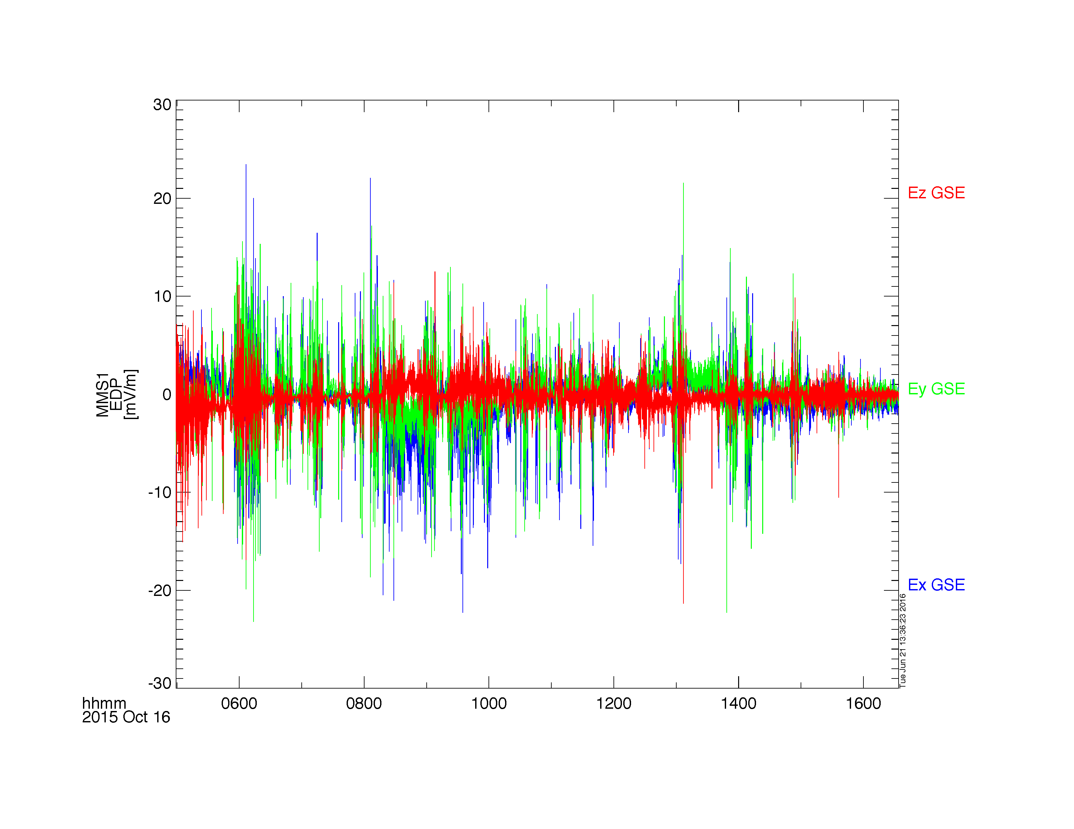
Loading and Plotting Data
EDP
What's New / Plug-in Status
Getting Started
Loading and Plotting Data
Analysis Tools
Getting Help

Slide 22
Loading and Plotting Data
FPI
What's New / Plug-in Status
Getting Started
Loading and Plotting Data
Analysis Tools
Getting Help
; load the FPI electron moments data for October 16, 2015
mms_load_fpi, probe=3, data_rate='fast', trange=['2015-10-16', '2015-10-17'], datatype='des-moms'
; plot the omni-directional electron energy spectra and pitch angle distribution
tplot, ['mms3_des_energyspectr_omni_avg', 'mms3_des_pitchangdist_avg']
; save the plot to a postscript file
tprint, 'mms3_des_spec_and_pad', /landscape
https://lasp.colorado.edu/mms/sdc/public/datasets/fpi/

Slide 23
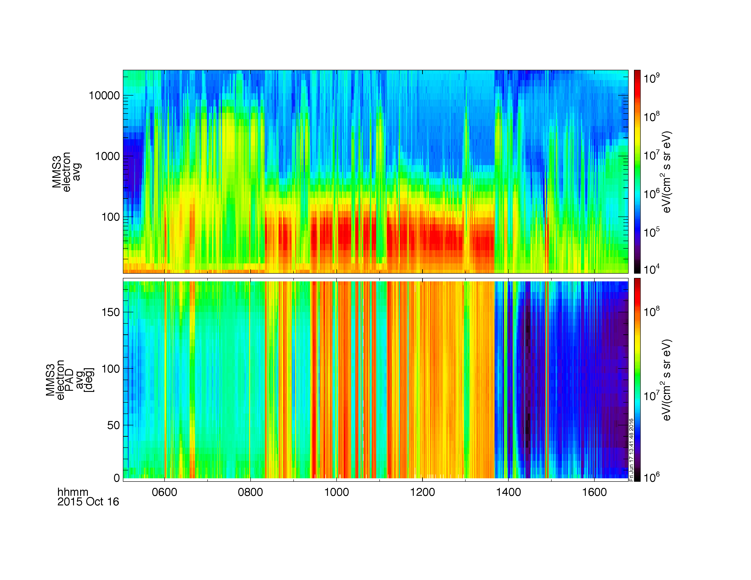
Loading and Plotting Data
FPI
What's New / Plug-in Status
Getting Started
Loading and Plotting Data
Analysis Tools
Getting Help

Slide 24
Loading and Plotting Data
FPI
What's New / Plug-in Status
Getting Started
Loading and Plotting Data
Analysis Tools
Getting Help
; we can also plot the FPI density, bulk velocity
; first, we need to combine the velocity into a single tplot variable (Vx, Vy, Vz)
join_vec, ['mms3_des_bulkx_dbcs_fast', 'mms3_des_bulky_dbcs_fast', 'mms3_des_bulkz_dbcs_fast'], 'mms3_des_bulk_vel_dbcs_fast'
; plot the electron density and flow velocity
tplot, ['mms3_des_bulk_vel_dbcs_fast', 'mms3_des_numberdensity_dbcs_fast']
; save the plot to a postscript file
tprint, 'mms3_des_vel_density', /landscape
https://lasp.colorado.edu/mms/sdc/public/datasets/fpi/

Slide 25
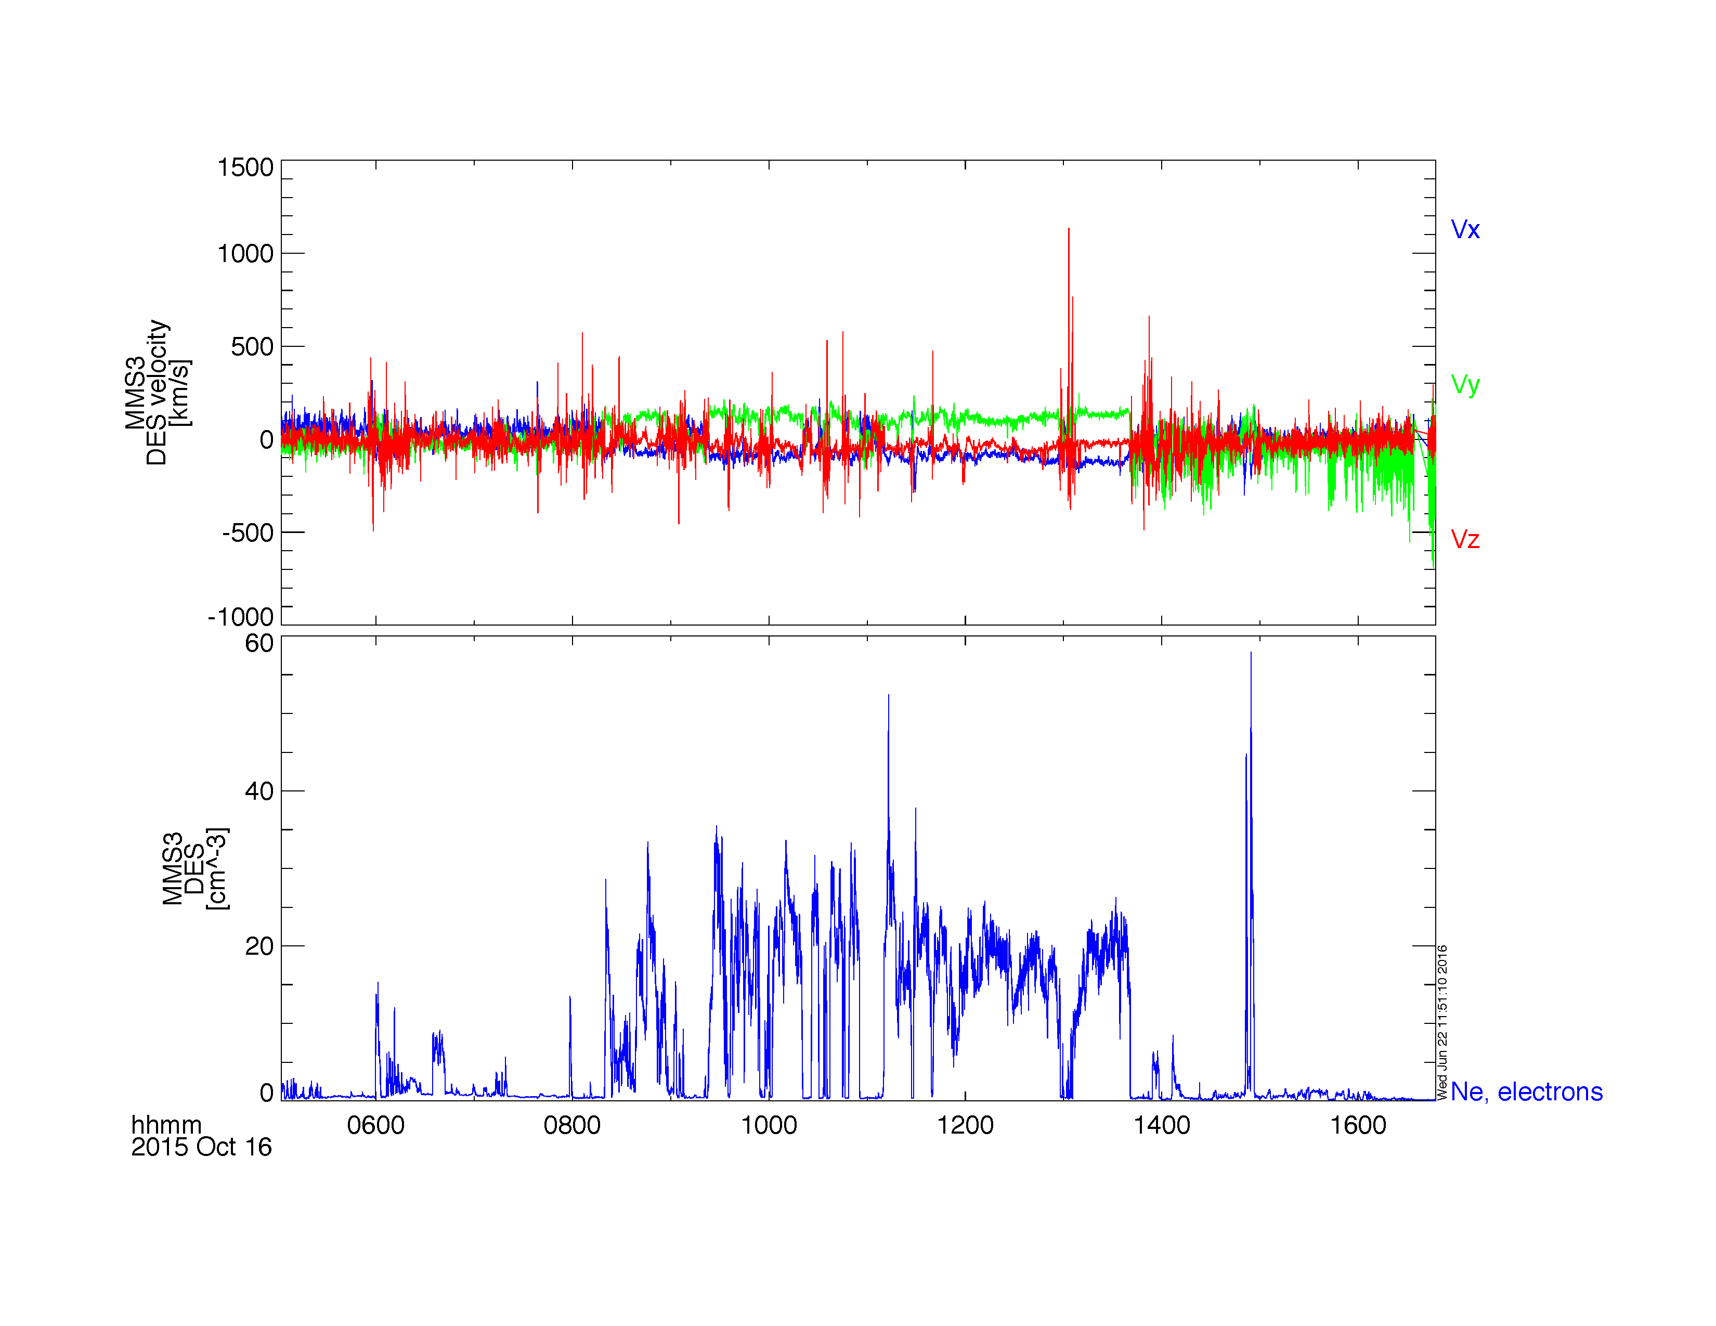
Loading and Plotting Data
FPI
What's New / Plug-in Status
Getting Started
Loading and Plotting Data
Analysis Tools
Getting Help

Slide 26
Loading and Plotting Data
HPCA
What's New / Plug-in Status
Getting Started
Loading and Plotting Data
Analysis Tools
Getting Help
; load the HPCA moments data for October 16, 2015
mms_load_hpca, probe=4, data_rate='srvy', trange=['2015-10-16', '2015-10-17'], datatype='moments'
; plot the H+ density, temperature and bulk velocity
tplot, ['mms4_hpca_hplus_number_density', 'mms4_hpca_hplus_scalar_temperature', 'mms4_hpca_hplus_ion_bulk_velocity']
; save the plot to a postscript file
tprint, 'mms4_hpca_hplus_moments', /landscape
https://lasp.colorado.edu/mms/sdc/public/datasets/hpca/

Slide 27
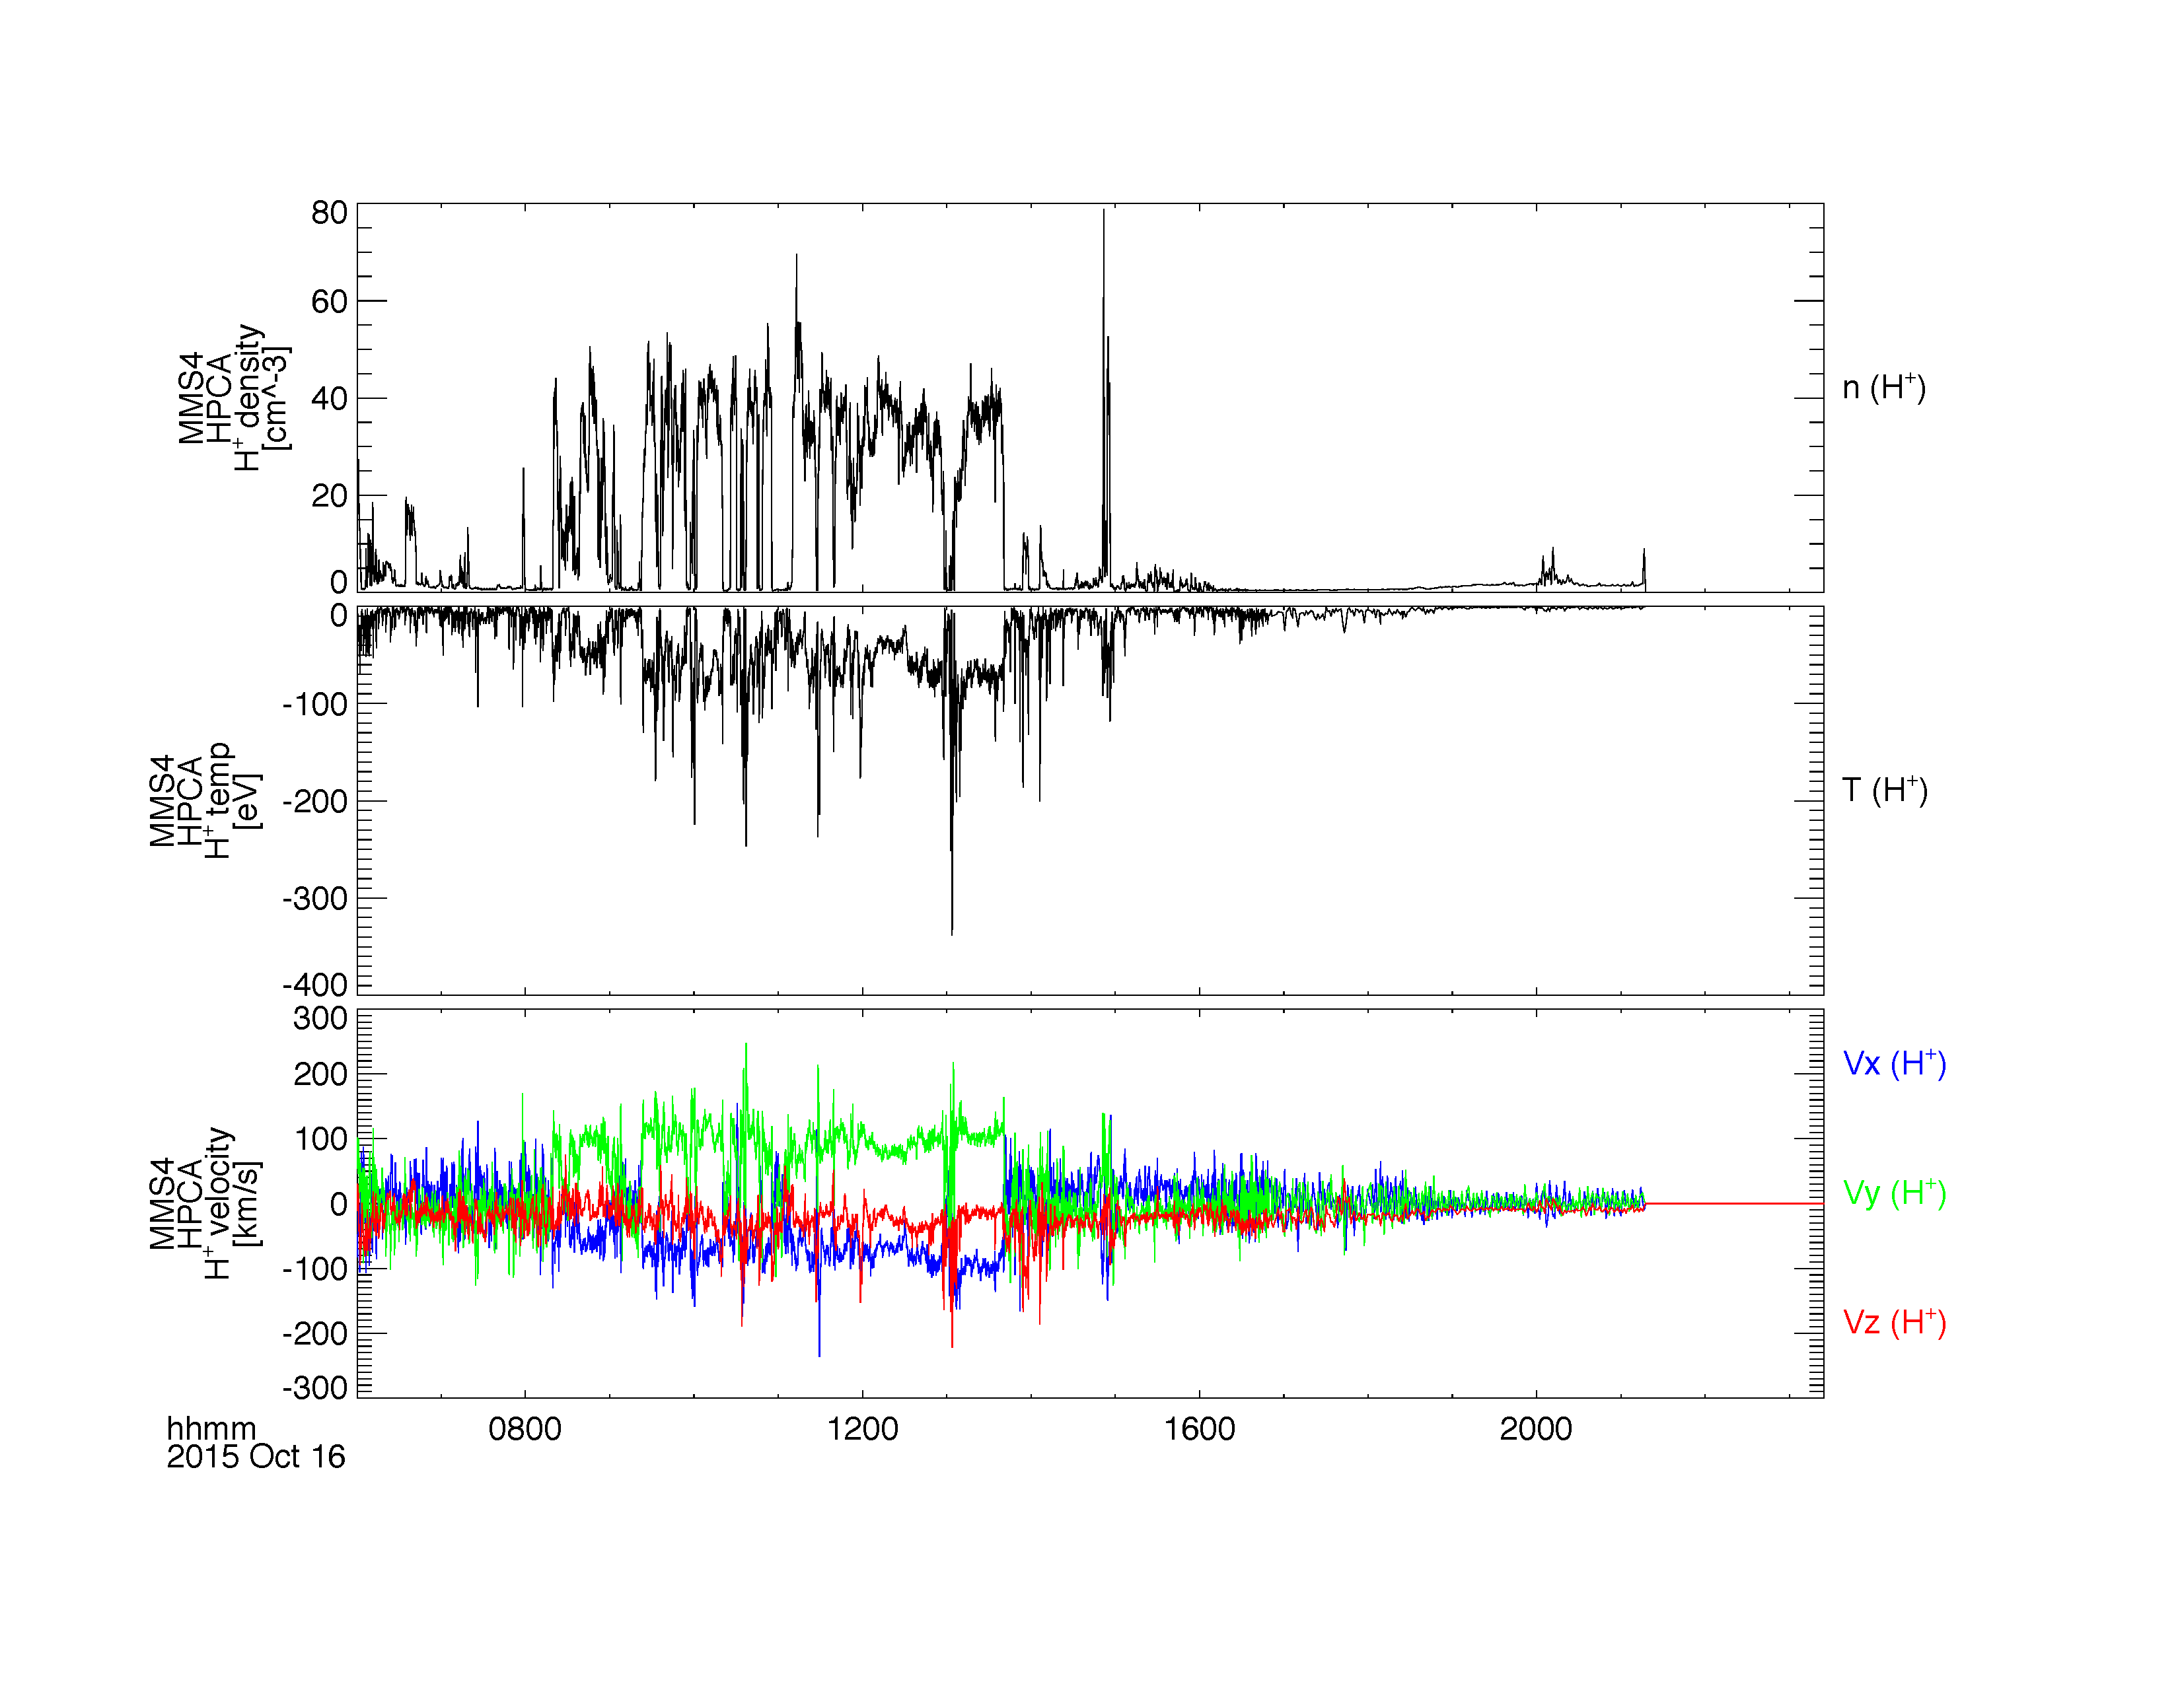
Loading and Plotting Data
HPCA
What's New / Plug-in Status
Getting Started
Loading and Plotting Data
Analysis Tools
Getting Help

Slide 28
Loading and Plotting Data
HPCA
What's New / Plug-in Status
Getting Started
Loading and Plotting Data
Analysis Tools
Getting Help
; load the HPCA ion data for October 16, 2015
mms_load_hpca, probe=4, data_rate='srvy', trange=['2015-10-16', '2015-10-17'], datatype='ion'
; calculate the omni-directional flux by averaging over the anodes for the full field of view
mms_hpca_calc_anodes, fov=[0, 360]
mms_hpca_spin_sum, probe=4
; plot the H+ and O+ spectra
tplot, [‘mms4_hpca_hplus_flux_elev_0-360_spin', $
‘mms4_hpca_oplus_flux_elev_0-360_spin']
; save the plot to a postscript file
tprint, 'mms4_hpca_hplus_flux_fullFoV', /landscape
https://lasp.colorado.edu/mms/sdc/public/datasets/hpca/

Slide 29
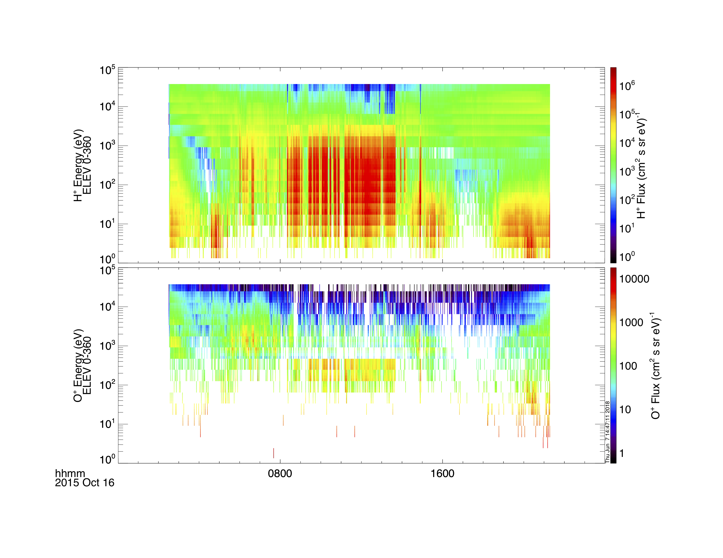
Loading and Plotting Data
HPCA
What's New / Plug-in Status
Getting Started
Loading and Plotting Data
Analysis Tools
Getting Help

Slide 30
Loading and Plotting Data
EPD EIS
What's New / Plug-in Status
Getting Started
Loading and Plotting Data
Analysis Tools
Getting Help
; load the EIS energy x time of flight (ExTOF) ion data for MMS1
mms_load_eis, probe=1, data_rate='srvy', datatype='extof', trange=['2015-10-16', '2015-10-17']
; calculate the EIS pitch angle distribution
mms_eis_pad, probe=1, data_rate='srvy', datatype='extof'
; plot the spin-averaged energy spectra and pitch angle distribution
tplot, ['mms1_epd_eis_extof_proton_flux_omni_spin', 'mms1_epd_eis_extof_0-1000keV_proton_flux_omni_pad_spin']
; save the plot to a postscript file
tprint, 'mms1_epd_eis_extof_protons', /landscape
https://lasp.colorado.edu/mms/sdc/public/datasets/epd/

Slide 31
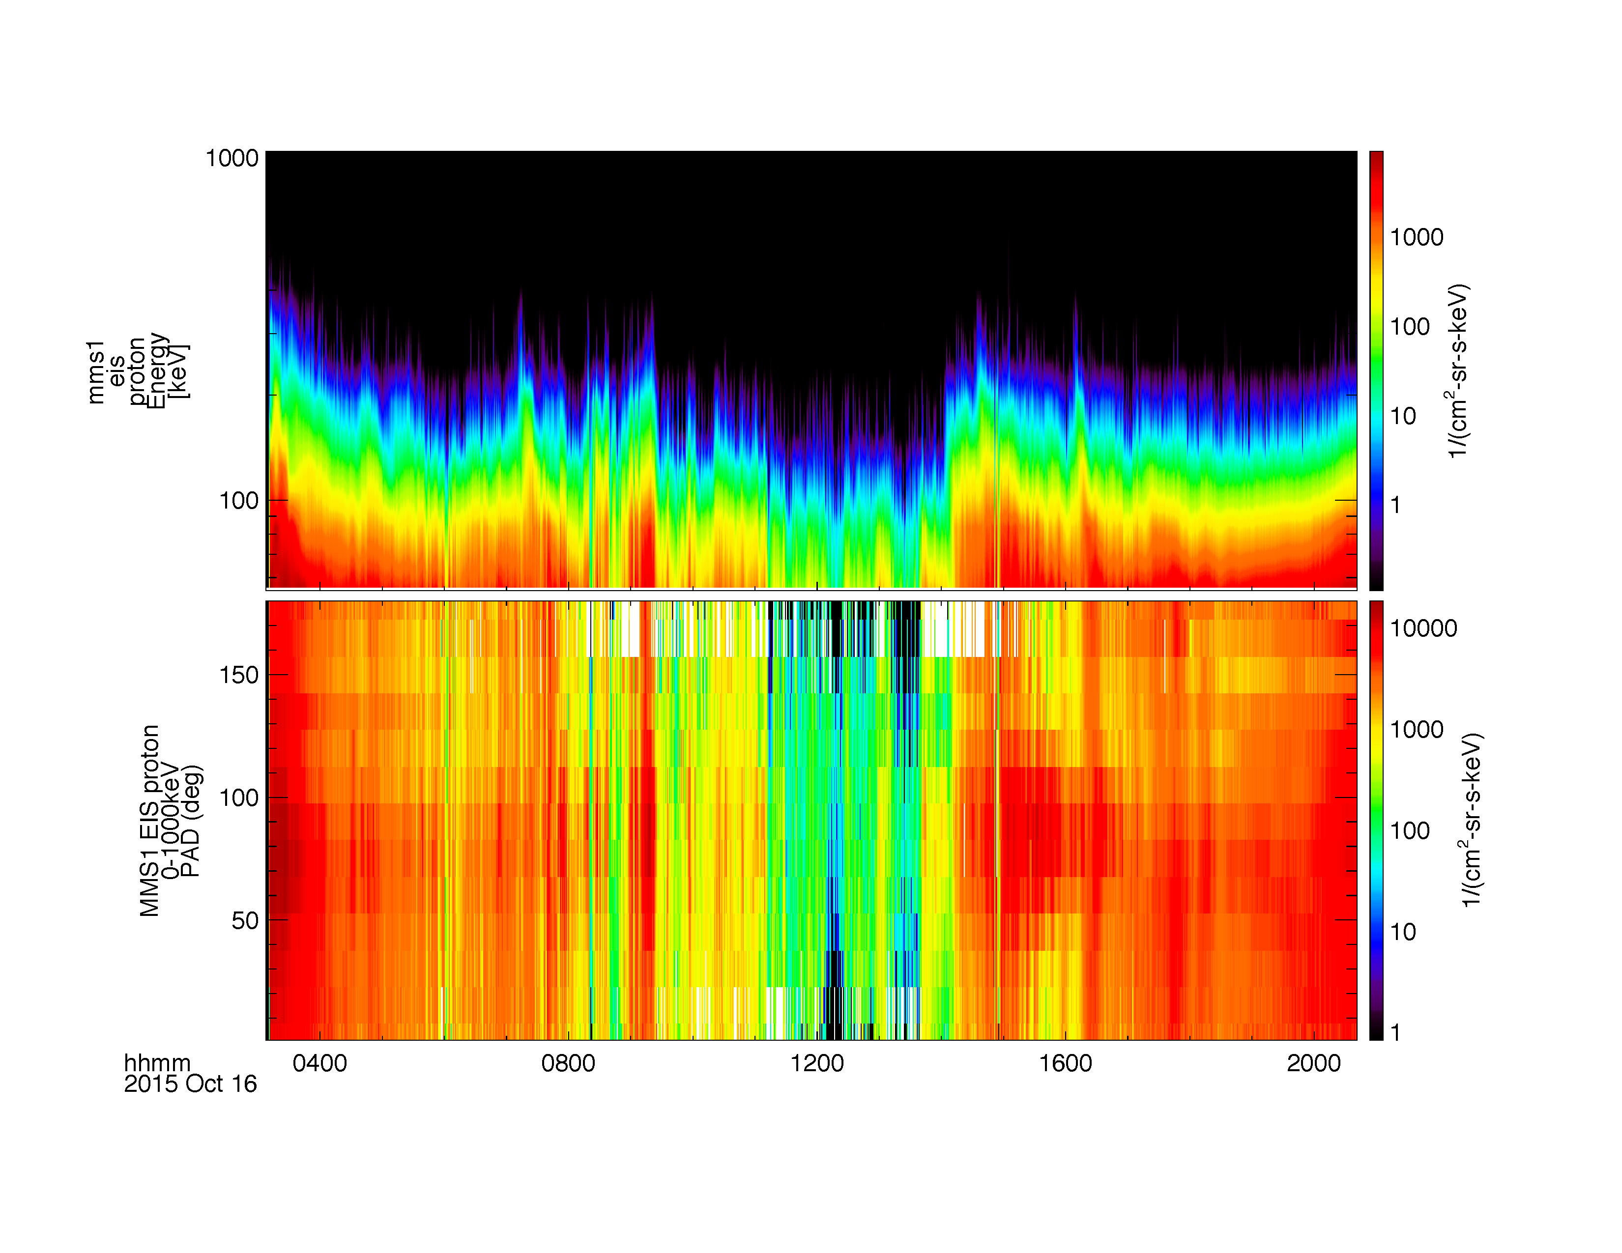
Loading and Plotting Data
EPD EIS
What's New / Plug-in Status
Getting Started
Loading and Plotting Data
Analysis Tools
Getting Help

Slide 32
Loading and Plotting Data
EPD FEEPS
What's New / Plug-in Status
Getting Started
Loading and Plotting Data
Analysis Tools
Getting Help
; load the FEEPS electron data for MMS2
mms_load_feeps, probe=2, data_rate='srvy', datatype='electron', trange=['2015-10-16', '2015-10-17']
; calculate the FEEPS pitch angle distribution
mms_feeps_pad, probe=2, data_rate='srvy', datatype='electron'
; plot the spin averaged electron spectra and pitch angle distribution
tplot, ['mms2_epd_feeps_electron_intensity_omni_spin', ‘mms2_epd_feeps_0-1000keV_pad_spin']
; save the plot to a postscript file
tprint, 'mms2_epd_feeps_electrons', /landscape
https://lasp.colorado.edu/mms/sdc/public/datasets/epd/

Slide 33
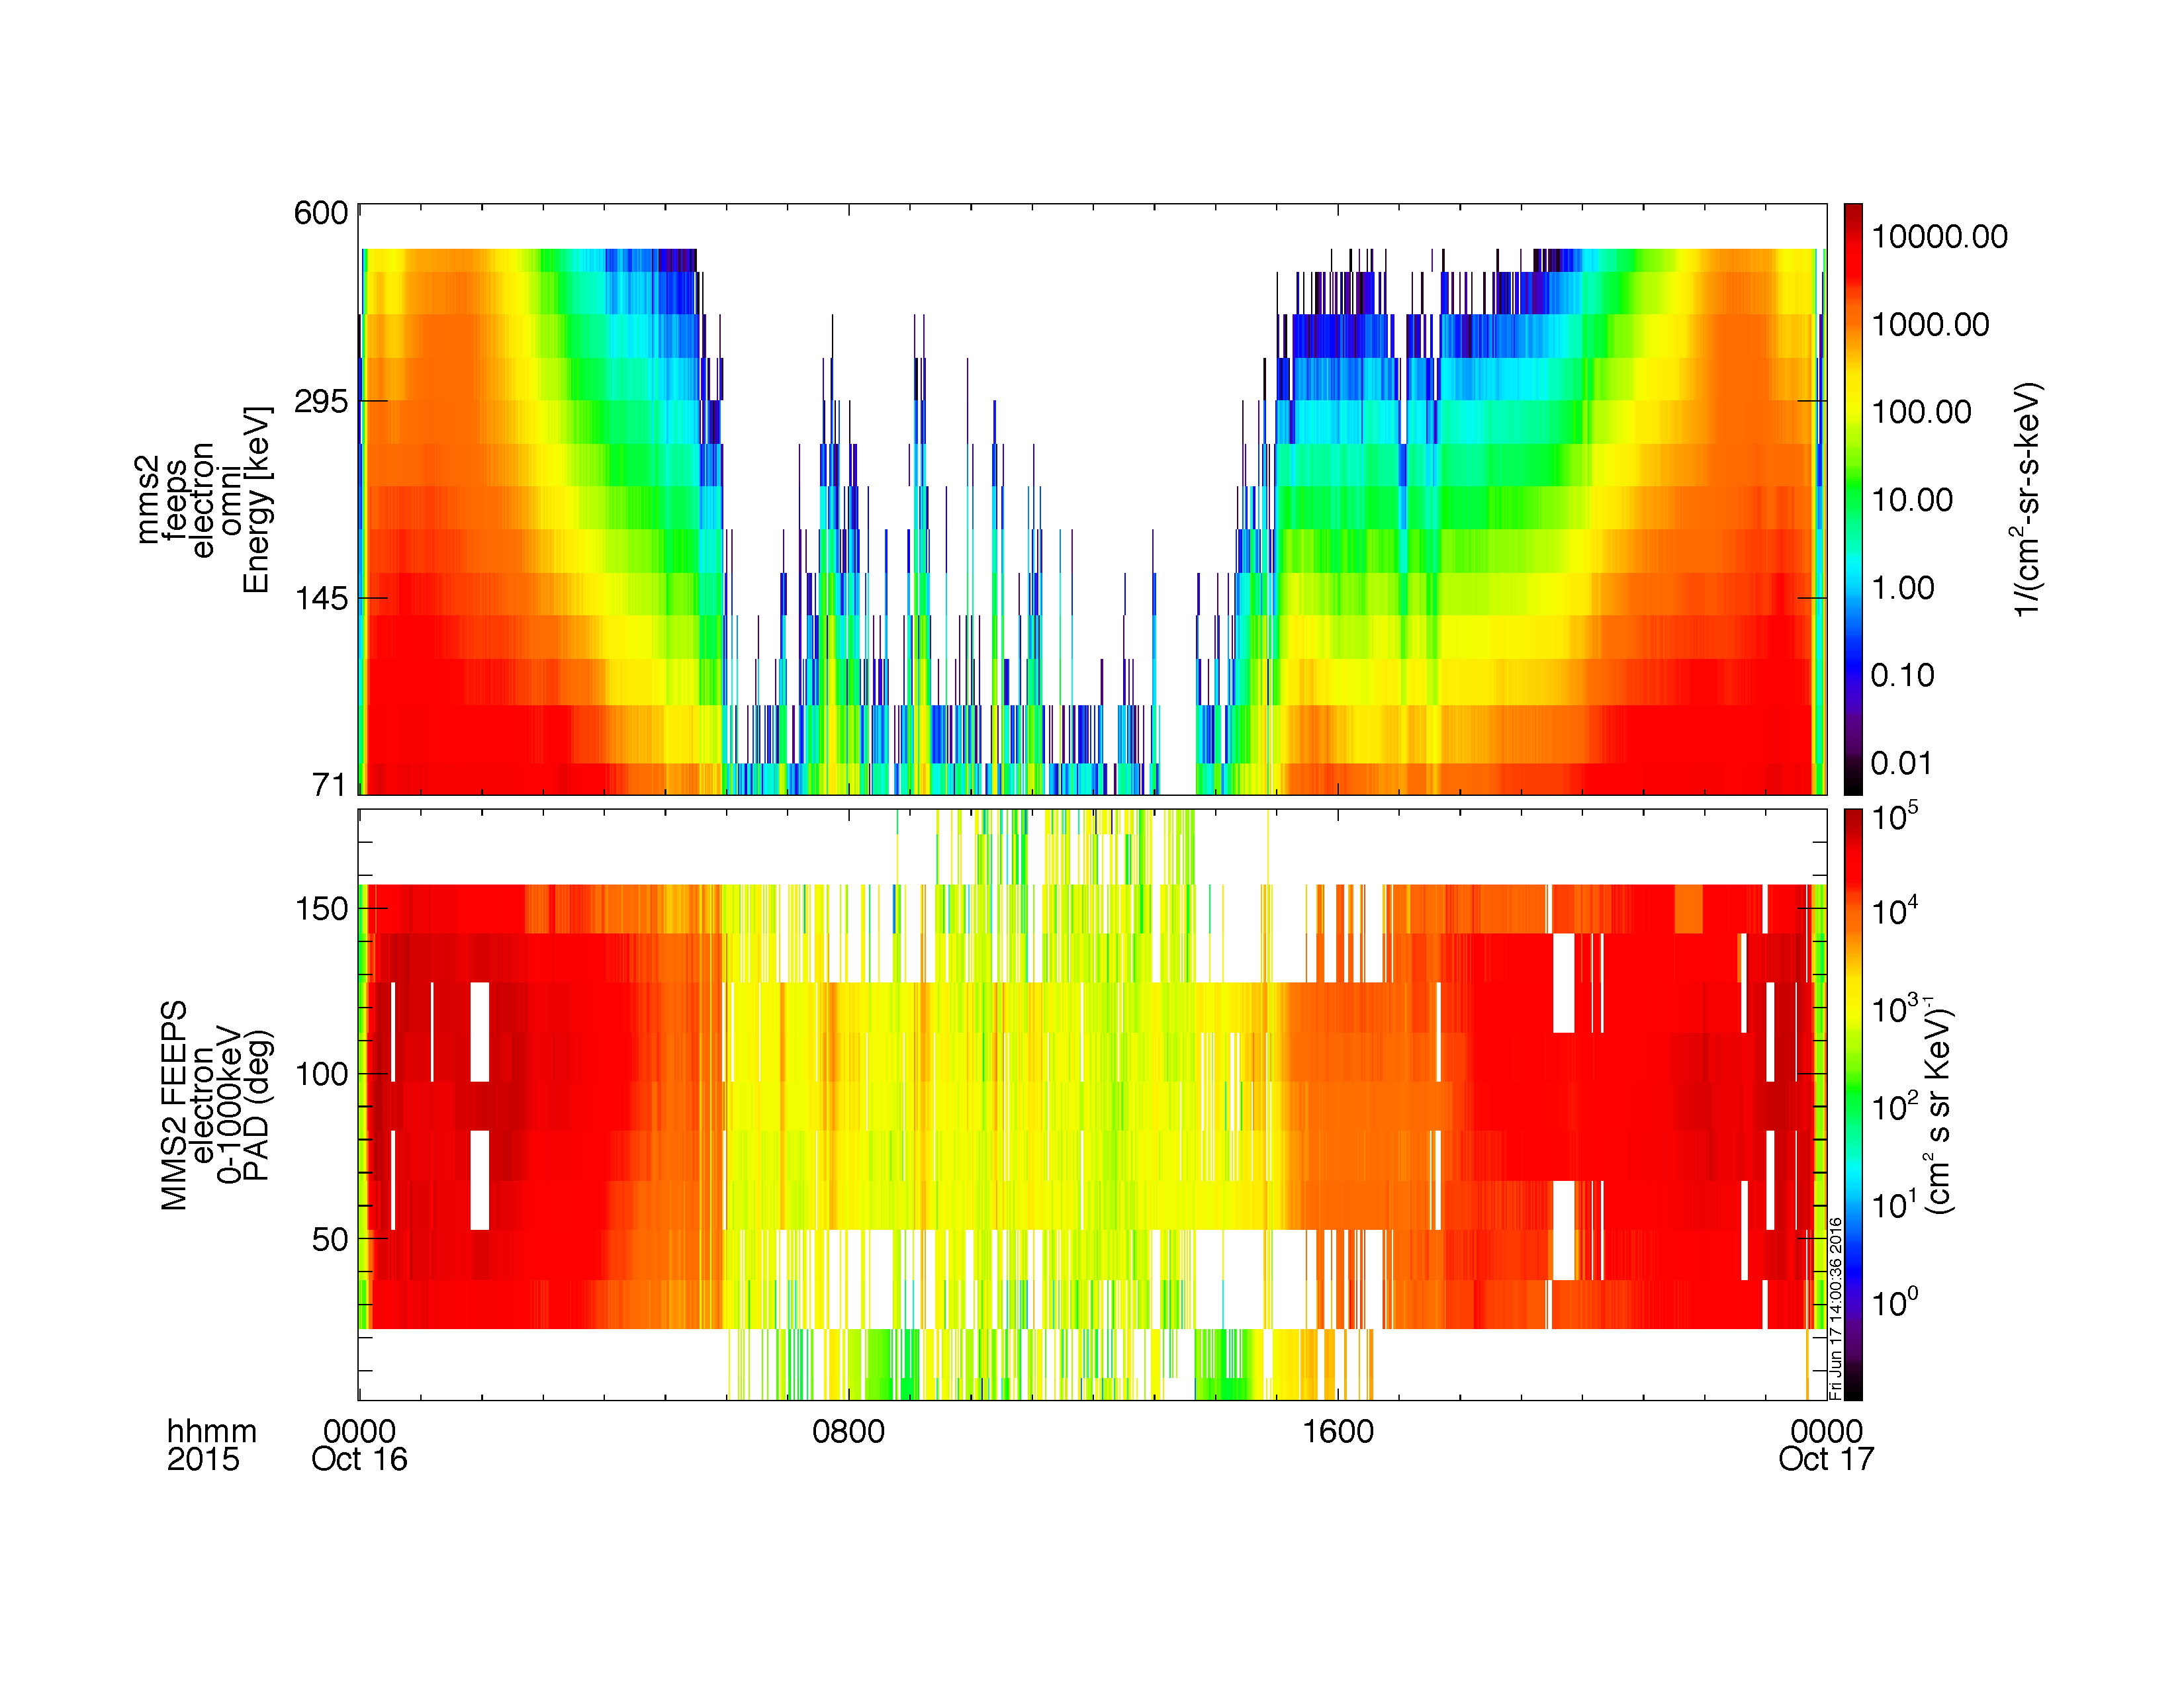
Loading and Plotting Data
EPD FEEPS
What's New / Plug-in Status
Getting Started
Loading and Plotting Data
Analysis Tools
Getting Help

Slide 34
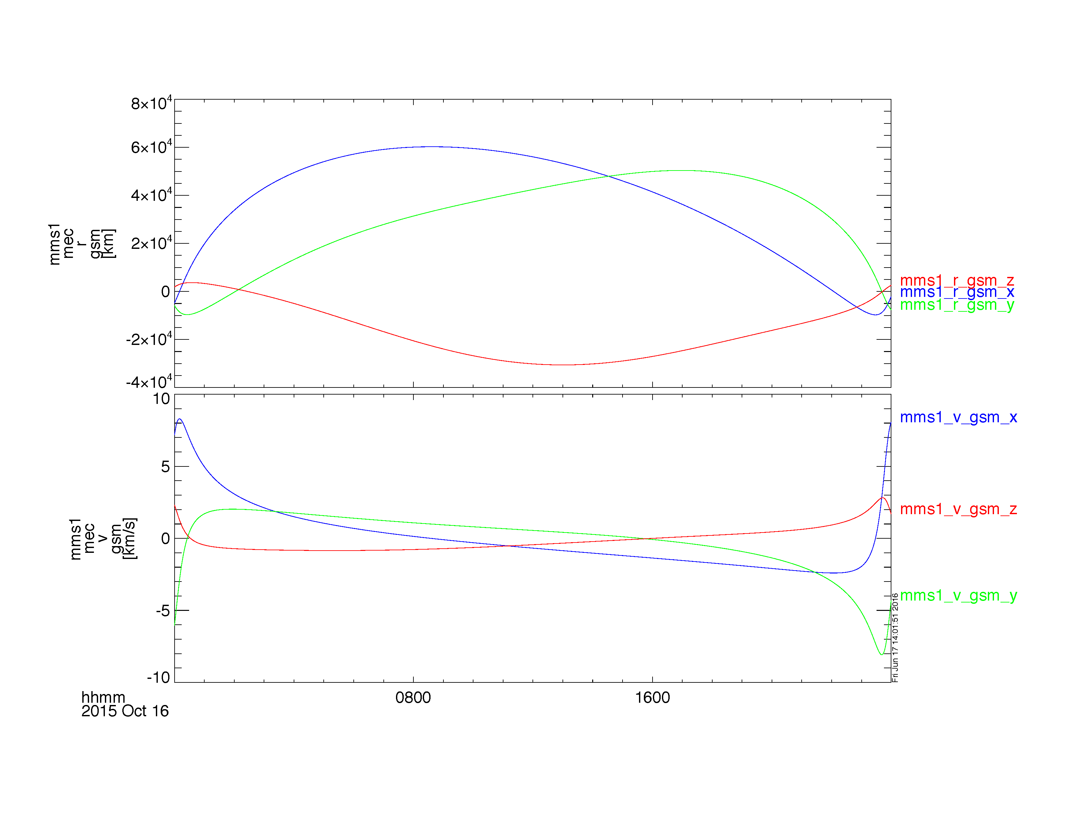
Loading and Plotting Data
MEC
What's New / Plug-in Status
Getting Started
Loading and Plotting Data
Analysis Tools
Getting Help
; load the ephemeris and coordinates data for October 16, 2015
mms_load_mec, probe=1, trange=['2015-10-16', '2015-10-17']
; plot the spacecraft position and velocity in GSM coordinates
tplot, ['mms1_mec_r_gsm', 'mms1_mec_v_gsm']

Slide 35
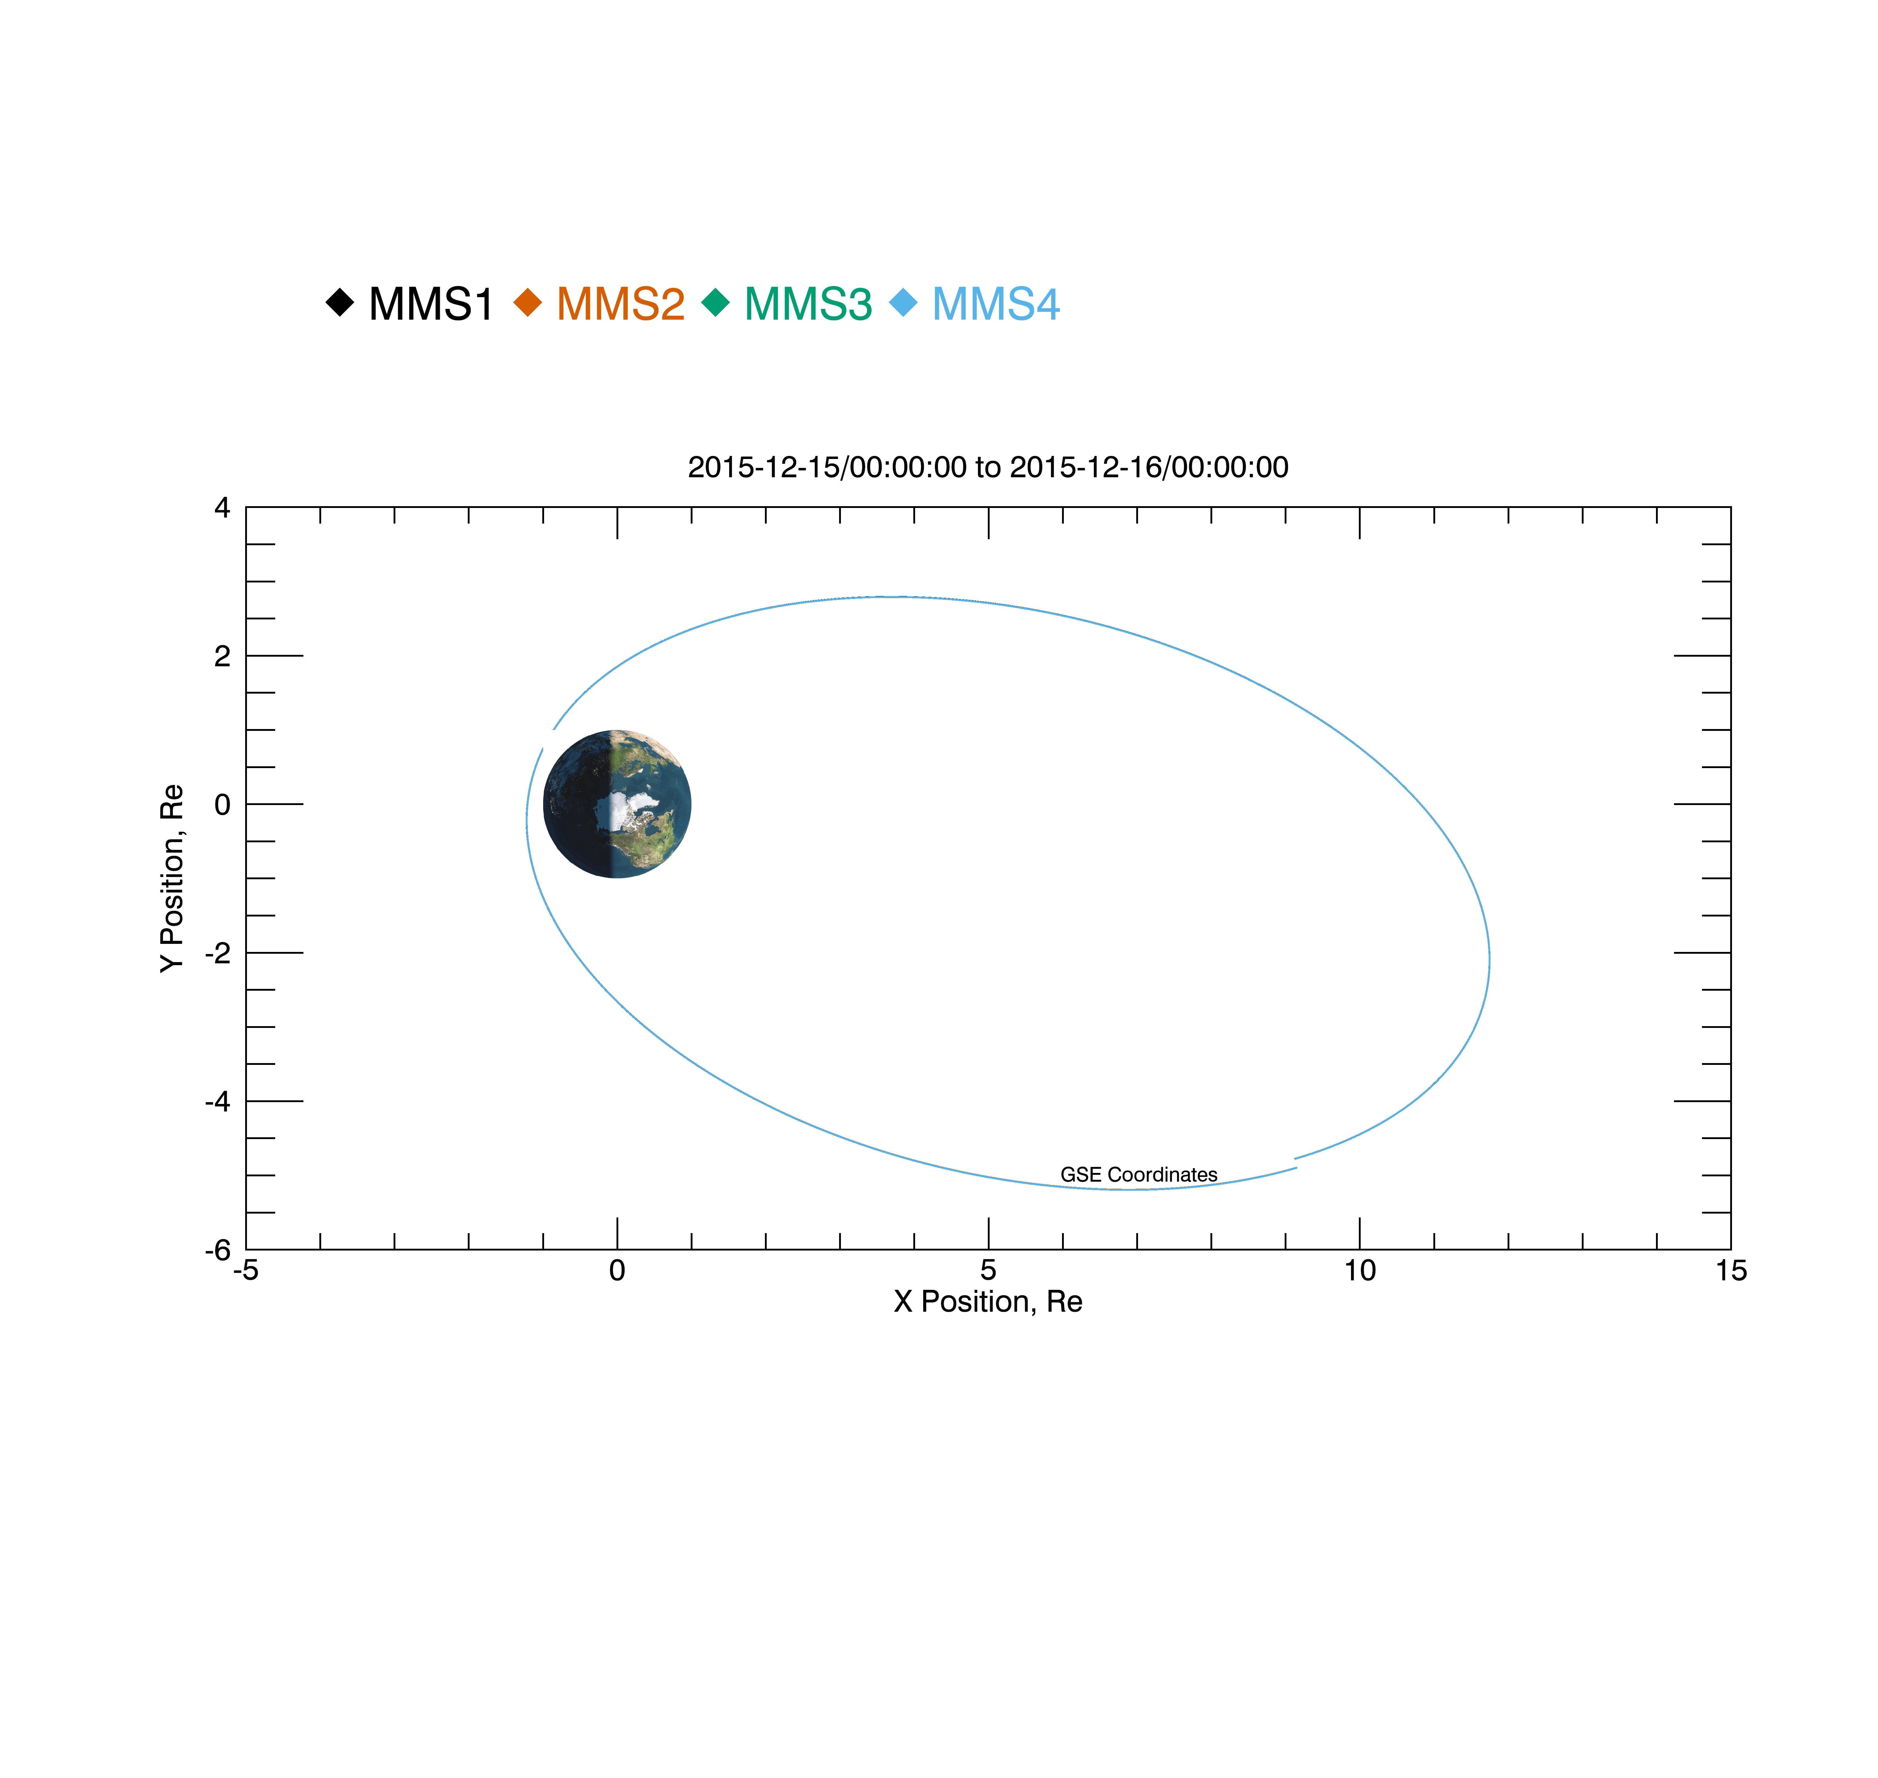
Loading and Plotting Data
Orbits
What's New / Plug-in Status
Getting Started
Loading and Plotting Data
Analysis Tools
Getting Help
; create a plot of the spacecraft orbits for December 15, 2015
mms_orbit_plot, probe=[1, 2, 3, 4], trange=['2015-12-15', '2015-12-16']

Slide 36
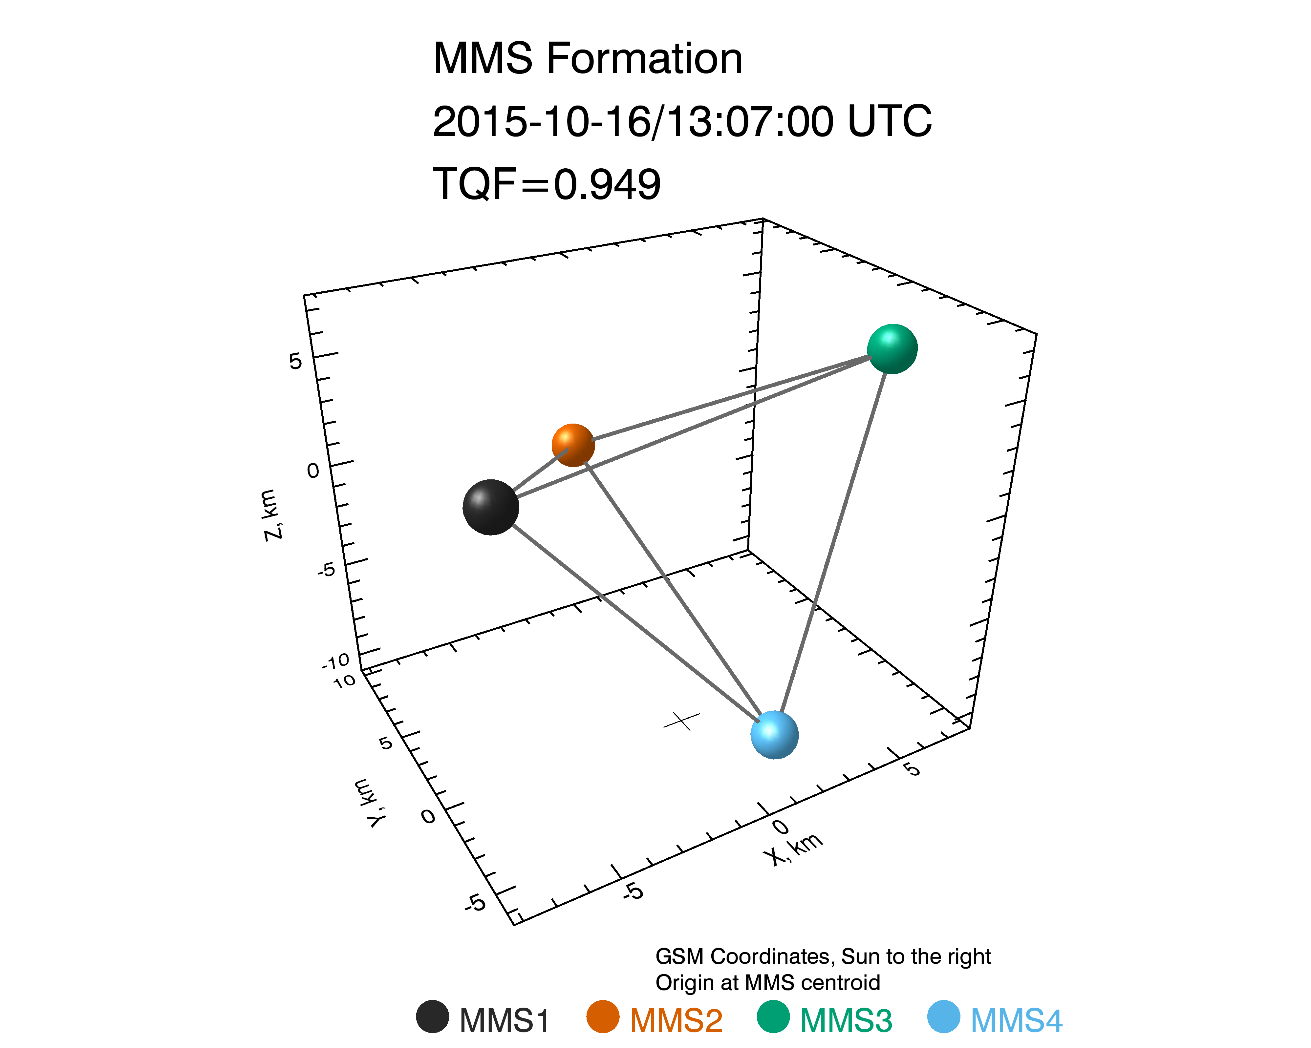
Loading and Plotting Data
Tetrahedron Formation
What's New / Plug-in Status
Getting Started
Loading and Plotting Data
Analysis Tools
Getting Help
; create the formation plot in GSM coordinates, including the tetrahedron quality factor
mms_mec_formation_plot, '2015-10-16/13:07', coord='gsm', /quality_factor

Slide 37
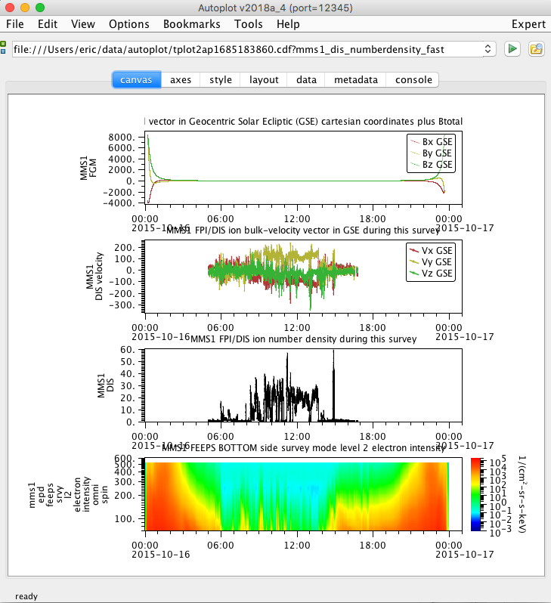
Loading and Plotting Data
Send data to Autoplot
What's New / Plug-in Status
Getting Started
Loading and Plotting Data
Analysis Tools
Getting Help
mms_load_fgm, trange=['2015-10-16', '2015-10-17'], probe=1
mms_load_feeps, trange=['2015-10-16', '2015-10-17'], probe=1
mms_load_fpi, trange=['2015-10-16', '2015-10-17'], datatype='dis-moms', probe=1
tplot2ap, ['mms1_fgm_b_gse_srvy_l2_bvec', 'mms1_dis_bulkv_gse_fast', 'mms1_dis_numberdensity_fast', 'mms1_epd_feeps_srvy_l2_electron_intensity_omni_spin']

Slide 38
Analysis Tools
What's New / Plug-in Status
Getting Started
Loading and Plotting Data
Analysis Tools
Getting Help
Coordinate Transformations
Minimum Variance Analysis
Curlometer Technique
Dynamic Power Spectra
Spectra from Particle Distributions
2D Particle Slices
Flipbook-style figures/movies with 2D Particle Slices
Visualizing the Distributions in 3D
EIS angle-angle Plots
FPI angle-angle Plots

Slide 39
Analysis Tools
Coordinate Transformations
What's New / Plug-in Status
Getting Started
Loading and Plotting Data
Analysis Tools
Getting Help
; load the quaternions from the MEC file
mms_load_mec, probe=3, trange=['2015-10-16/08:00', '2015-10-16/16:00'], /time_clip
; we're going to transform some FGM data
mms_load_fgm, probe=3, trange=['2015-10-16/08:00', '2015-10-16/16:00'], /time_clip
; Cotrans the FGM data from GSM to SM coordinates
mms_qcotrans, 'mms3_fgm_b_gsm_srvy_l2_bvec', 'mms3_fgm_b_sm_srvy_l2_bvec', out_coord='sm'
; plot the data in both GSM and SM coordinates
tplot, ['mms3_fgm_b_gsm_srvy_l2_bvec', 'mms3_fgm_b_sm_srvy_l2_bvec']
; save the plot to a postscript file
tprint, 'mms3_fgm_gsm_sm_coords', /landscape

Slide 40
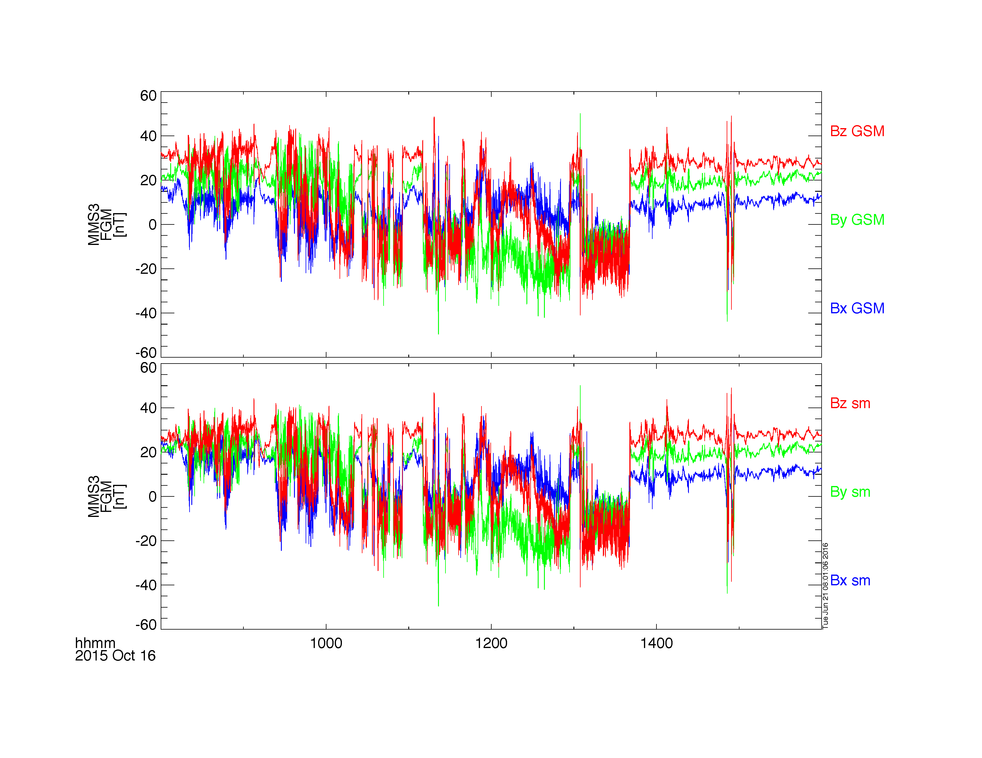
Analysis Tools
Coordinate Transformations
What's New / Plug-in Status
Getting Started
Loading and Plotting Data
Analysis Tools
Getting Help

Slide 41
Analysis Tools
Minimum Variance Analysis
What's New / Plug-in Status
Getting Started
Loading and Plotting Data
Analysis Tools
Getting Help
; load some FGM data
mms_load_fgm, probe=1, trange=['2015-10-16/08:00', '2015-10-16/16:00'], /time_clip
; create the minimum variance transformation matrix
minvar_matrix_make, 'mms1_fgm_b_gse_srvy_l2_bvec', newname='mva_matrix', $
tstart='2015-10-16/13:00', tstop='2015-10-16/13:10'
; rotate the B-field
tvector_rotate, 'mva_matrix', 'mms1_fgm_b_gse_srvy_l2_bvec', newname='mms1_fgm_b_gse_srvy_l2_bvec_mva'
; plot the vector in MVA coordinates
tplot, 'mms1_fgm_b_gse_srvy_l2_bvec_mva'
; save the plot to a postscript file
tprint, 'mms1_fgm_b_gse_srvy_l2_bvec_mva', /landscape

Slide 42
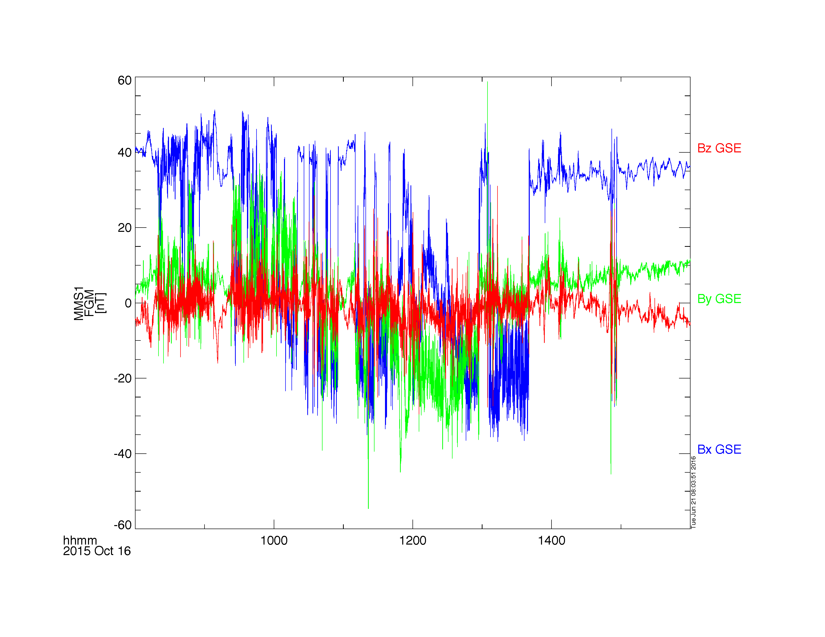
Analysis Tools
Minimum Variance Analysis
What's New / Plug-in Status
Getting Started
Loading and Plotting Data
Analysis Tools
Getting Help

Slide 43
Analysis Tools
Curlometer Technique
What's New / Plug-in Status
Getting Started
Loading and Plotting Data
Analysis Tools
Getting Help
trange = ['2015-10-30/05:15:45', '2015-10-30/05:15:48']
mms_load_fgm, trange=trange, /get_fgm_ephemeris, probes=[1, 2, 3, 4], data_rate='brst'
fields = 'mms'+['1', '2', '3', '4']+'_fgm_b_gse_brst_l2'
positions = 'mms'+['1', '2', '3', '4']+'_fgm_r_gse_brst_l2'
; method #1: mms_curl
mms_curl, trange=trange, fields=fields, positions=positions, suffix='_mms_curl'
tplot, ['divB','curlB','jtotal','jperp','jpar','baryb']+'_mms_curl'

Slide 44
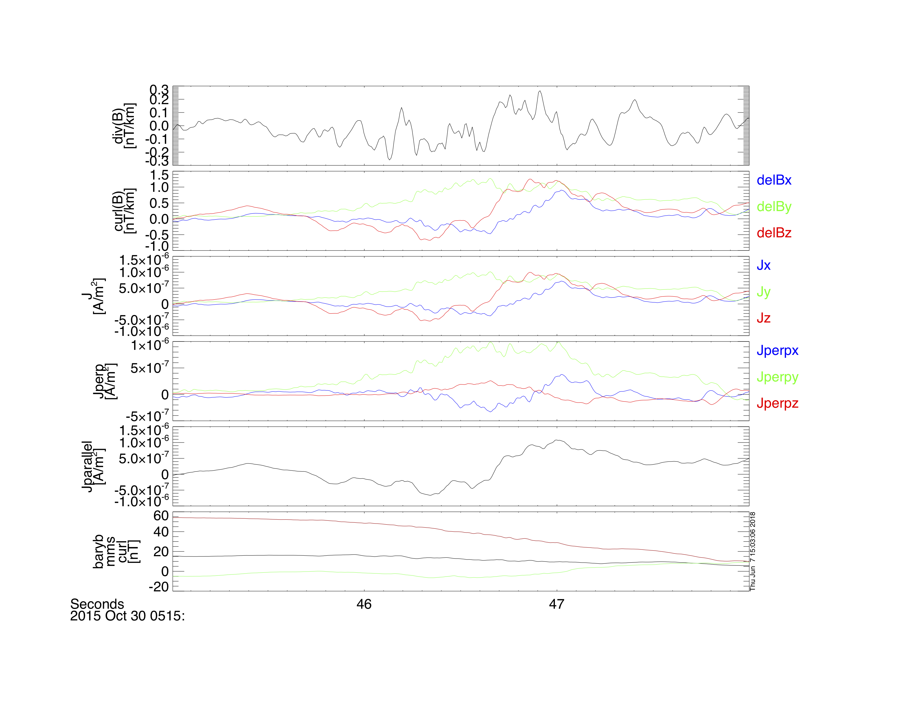
Analysis Tools
Curlometer Technique
What's New / Plug-in Status
Getting Started
Loading and Plotting Data
Analysis Tools
Getting Help

Slide 45
Analysis Tools
Dynamic Power Spectra
What's New / Plug-in Status
Getting Started
Loading and Plotting Data
Analysis Tools
Getting Help
; load some SCM data
mms_load_scm, probe=1, trange=['2015-10-16/00:00', '2015-10-16/04:00']
; calculate the dynamic power spectra
tdpwrspc, 'mms1_scm_acb_gse_scsrvy_srvy_l2', nboxpoints=512,nshiftpoints=512,bin=1
; plot the dynamic power spectra
tplot, ['mms1_scm_acb_gse_scsrvy_srvy_l2_x_dpwrspc', $
'mms1_scm_acb_gse_scsrvy_srvy_l2_y_dpwrspc', $
'mms1_scm_acb_gse_scsrvy_srvy_l2_z_dpwrspc']
; save the plot to a postscript file
tprint, 'mms1_scm_acb_gse_scsrvy_l2_dpwrspc', /landscape

Slide 46
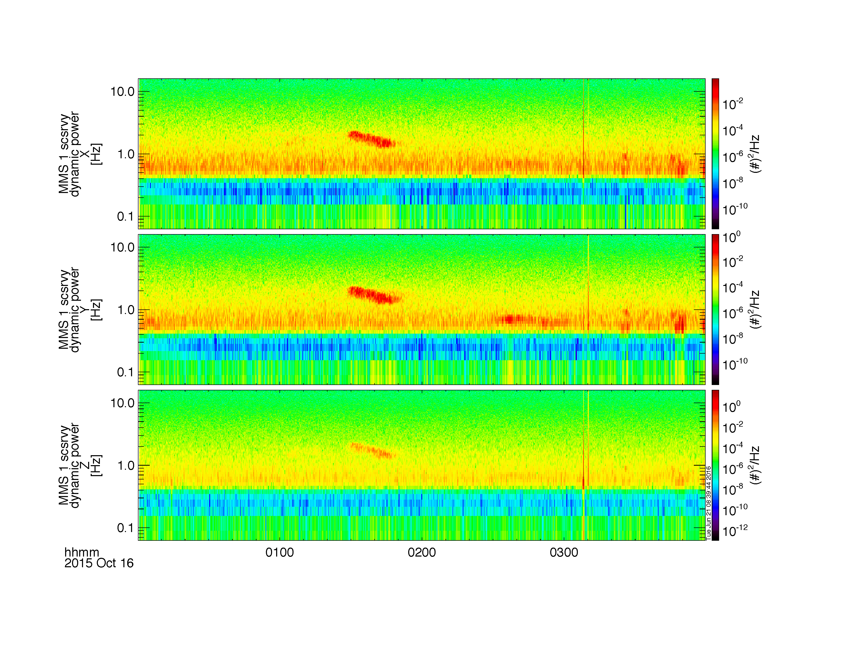
Analysis Tools
Dynamic Power Spectra
What's New / Plug-in Status
Getting Started
Loading and Plotting Data
Analysis Tools
Getting Help

Slide 47
Analysis Tools
Spectra from FPI Distributions
What's New / Plug-in Status
Getting Started
Loading and Plotting Data
Analysis Tools
Getting Help
mms_part_getspec, probe=1, species='e', trange=['2015-10-16/04:00', '2015-10-16/06:00'], output='energy'
; plot the spectra
tplot, 'mms1_des_dist_fast_energy'
; save the plot to a postscript file
tprint, 'mms1_des_dist_fast_energy', /landscape

Slide 48
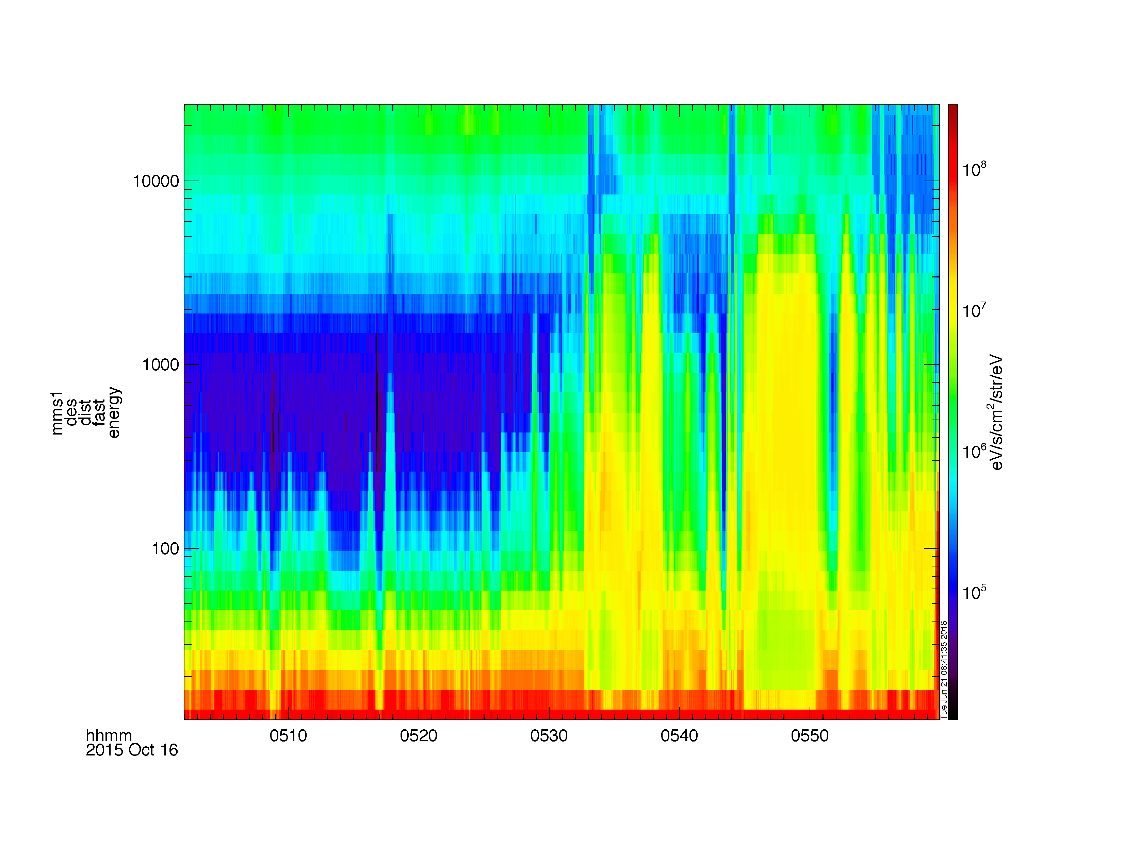
Analysis Tools
Spectra from FPI Distributions
What's New / Plug-in Status
Getting Started
Loading and Plotting Data
Analysis Tools
Getting Help

Slide 49
Analysis Tools
Spectra from HPCA Distributions
What's New / Plug-in Status
Getting Started
Loading and Plotting Data
Analysis Tools
Getting Help
mms_part_getspec, instrument='hpca', probe=2, species='hplus', trange=['2015-10-16/04:00', '2015-10-16/06:00'], output='energy'
tplot, 'mms2_hpca_hplus_phase_space_density_energy'
; save the plot to a postscript file
tprint, 'mms2_hpca_hplus_phase_space_density_energy', /landscape

Slide 50
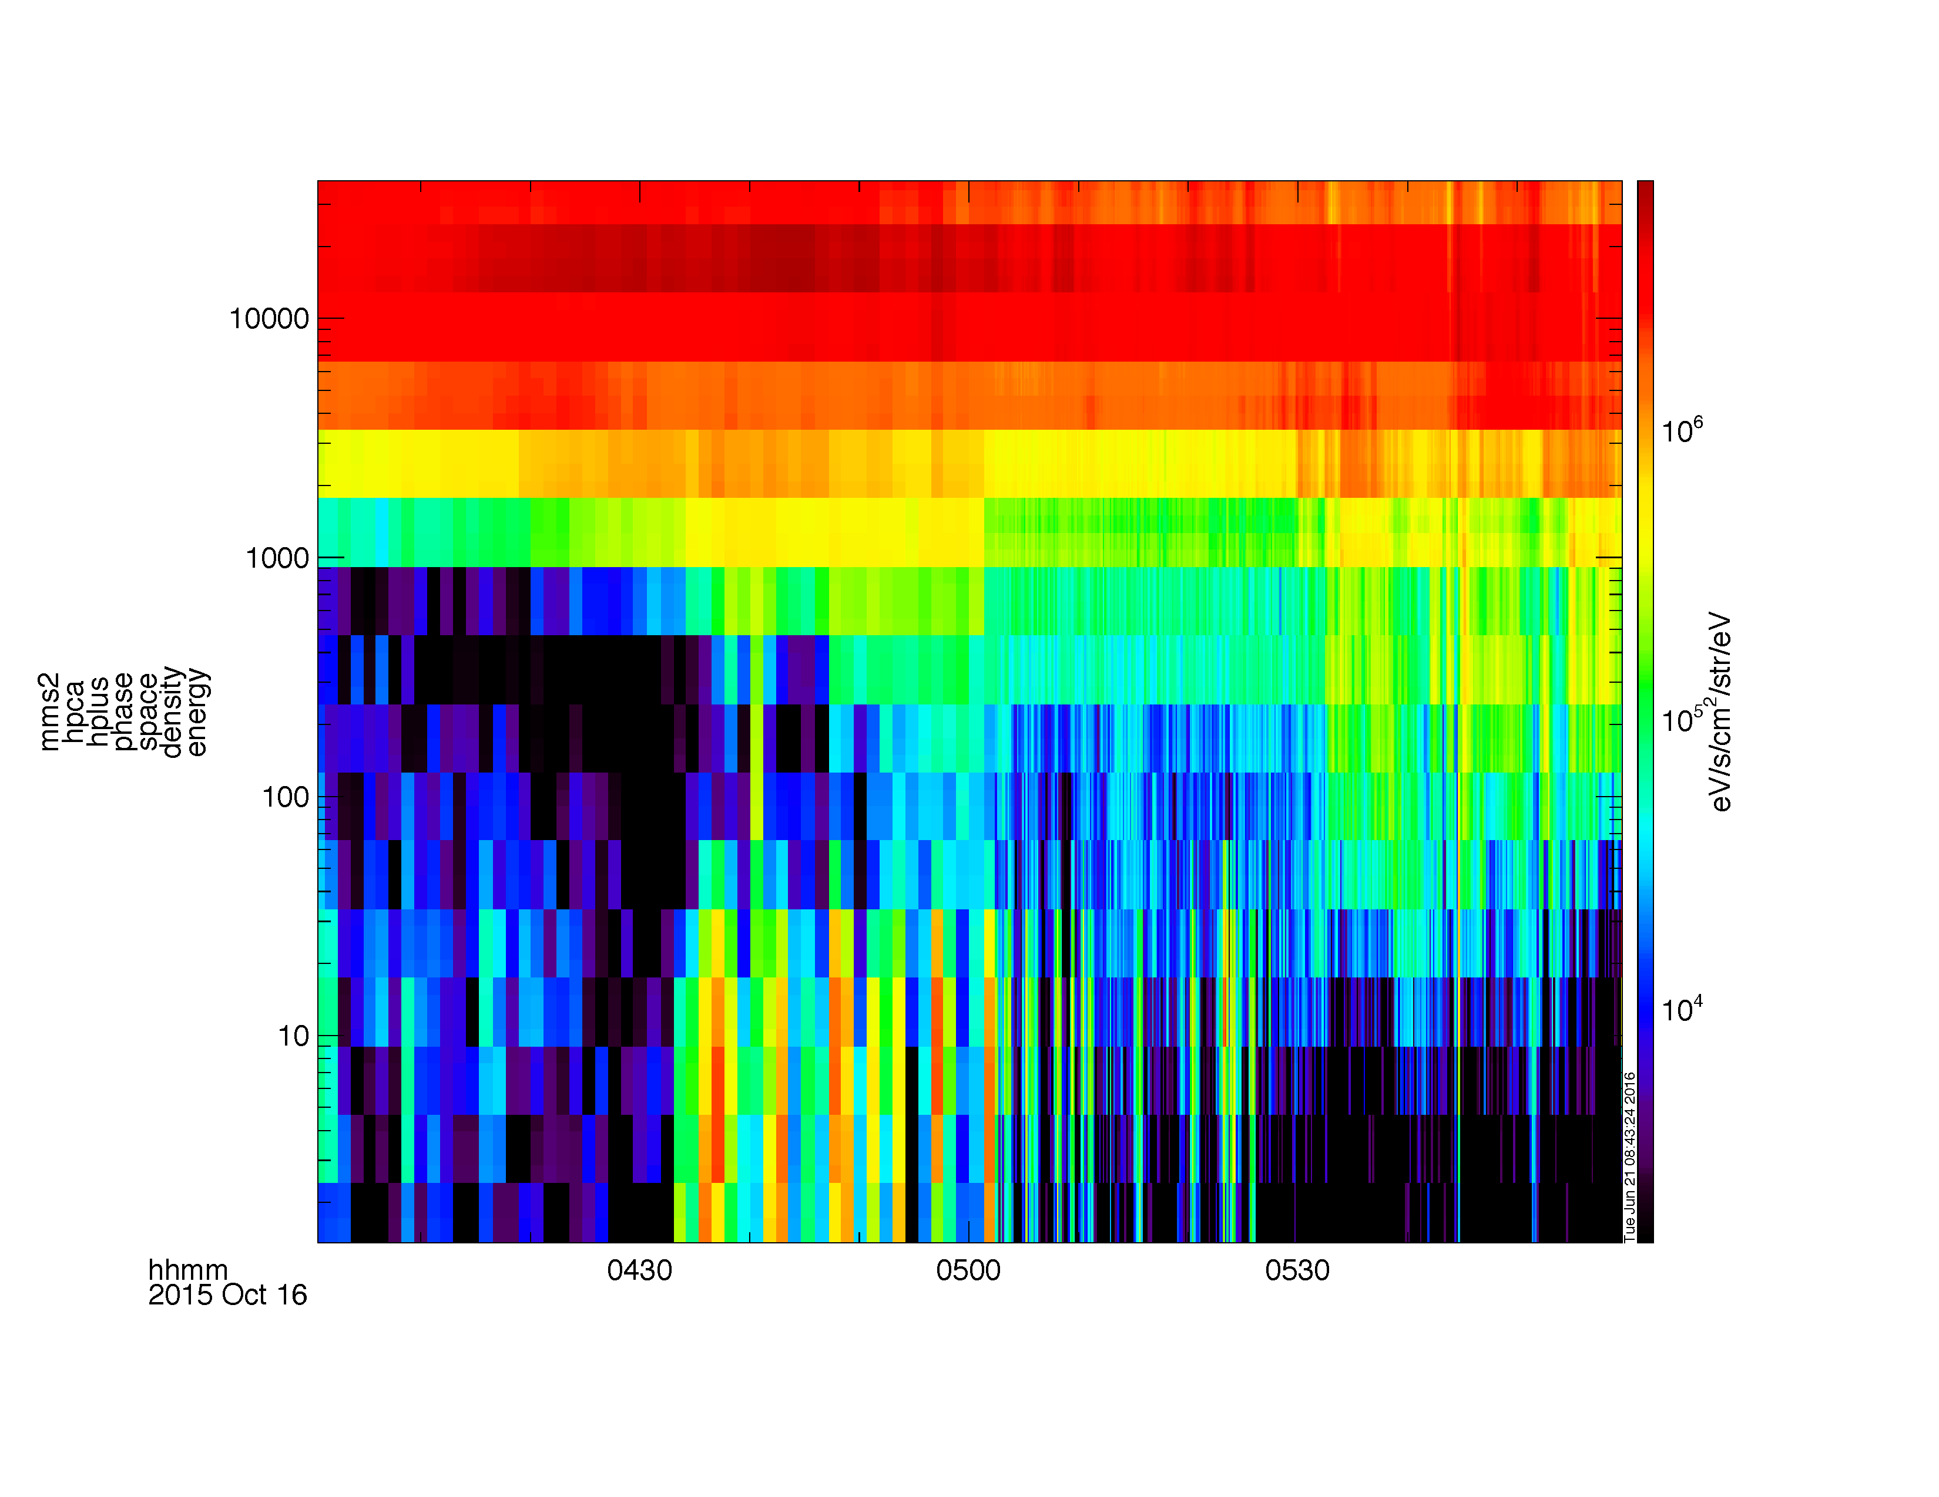
Analysis Tools
Spectra from HPCA Distributions
What's New / Plug-in Status
Getting Started
Loading and Plotting Data
Analysis Tools
Getting Help

Slide 51
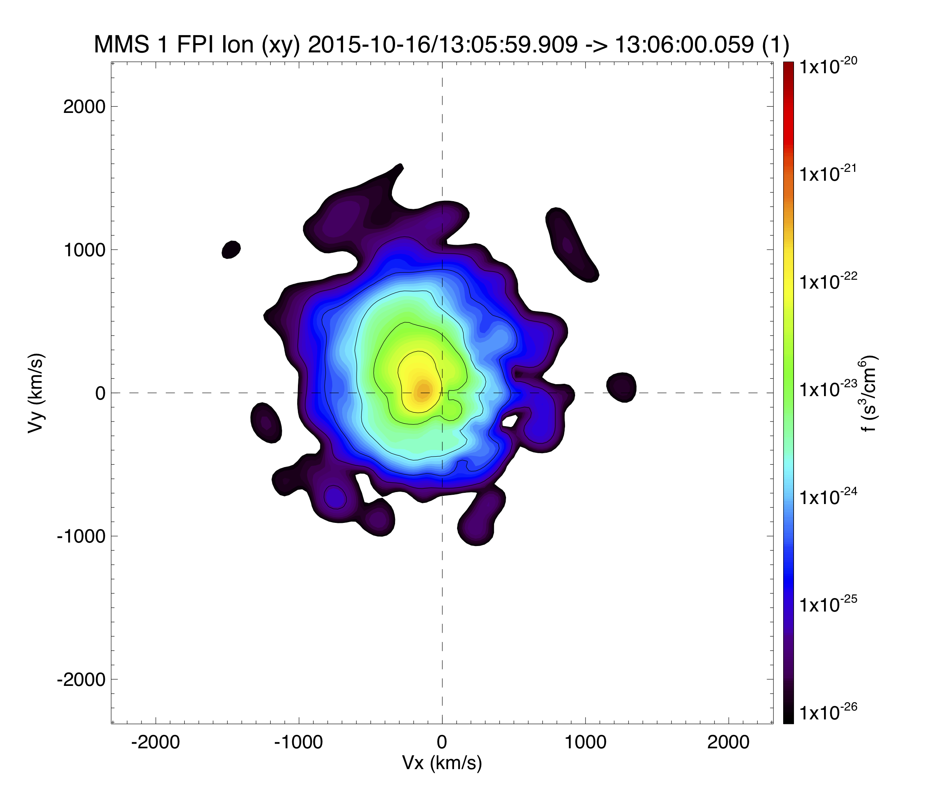
Analysis Tools
2D Particle Slices
What's New / Plug-in Status
Getting Started
Loading and Plotting Data
Analysis Tools
Getting Help
mms_part_slice2d, data_rate='brst', species='i', probe=1, time='2015-10-16/13:06', export='2dslice', /eps

Slide 52
Analysis Tools
mms_flipbookify
What's New / Plug-in Status
Getting Started
Loading and Plotting Data
Analysis Tools
Getting Help
trange=['2015-10-16/13:06:00', '2015-10-16/13:06:30']
probe=1
data_rate = 'brst'
species = 'i'
mms_load_fgm, trange=trange, probe=probe, /time_clip
mms_load_fpi, trange=trange, probe=probe, datatype='d'+species+'s-moms', /time_clip, data_rate=data_rate
; be sure to make the window large enough in the x-direction for the slices
window, xsize=1000, ysize=650
; store the temperature in the same panel
store_data, 'temp', data='mms1_d'+species+'s_temppara_brst mms1_d'+species+'s_tempperp_brst'
tplot, ['mms1_fgm_b_gse_srvy_l2_bvec', 'mms1_d'+species+'s_heatq_dbcs_brst', 'temp', 'mms1_d'+species+'s_bulkv_gse_brst', $
'mms1_d'+species+'s_numberdensity_brst', 'mms1_d'+species+'s_energyspectr_omni_brst']
mms_flipbookify, time_step=10, probe=1, species=species

Slide 53
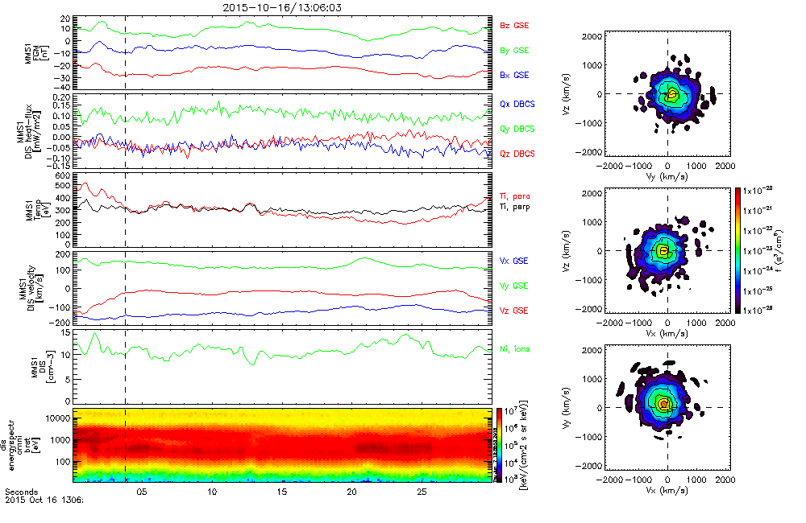
Analysis Tools
mms_flipbookify
What's New / Plug-in Status
Getting Started
Loading and Plotting Data
Analysis Tools
Getting Help

Slide 54
Analysis Tools
Visualizing the Distributions in 3D
What's New / Plug-in Status
Getting Started
Loading and Plotting Data
Analysis Tools
Getting Help
trange = ['2015-10-20/05:56:30', '2015-10-20/05:56:34']
;get +- 60 seconds of support data (FGM and FPI velocity)
support_trange= time_double(trange) + [-60,60]
; load the FPI electron distribution data
mms_load_fpi, probe=1, trange=trange, data_rate='brst', datatype='des-dist'
; load data into standard structures
dist = mms_get_fpi_dist('mms1_des_dist_brst', trange=trange)
; convert structures to isee_3d data model
data = spd_dist_to_hash(dist)
; load B-field (cyan vector) and velocity (yellow vector) support data
mms_load_fgm, probe=1, trange=support_trange
mms_load_fpi, data_rate='brst', datatype='des-moms', probe=1, trange=support_trange
; combine separate velocity components into a vector
join_vec, 'mms1_des_bulk' + ['x','y','z'] +'_dbcs_brst', 'mms1_des_bulk'
; Once GUI is open select PSD from Units menu
isee_3d, data=data, trange=trange, bfield= 'mms1_fgm_b_gse_srvy_l2_bvec', velocity='mms1_des_bulk'

Slide 55
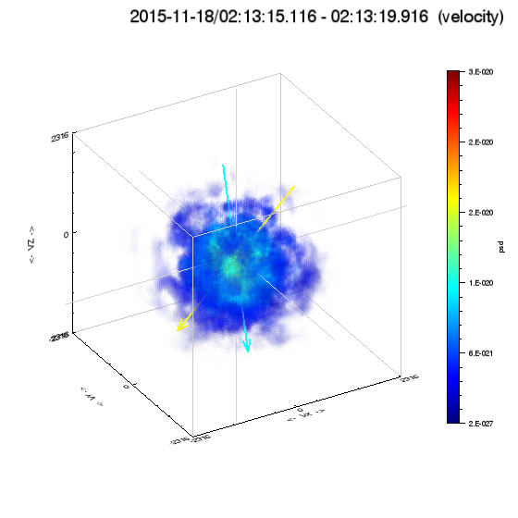
Analysis Tools
Visualizing the Distributions in 3D
What's New / Plug-in Status
Getting Started
Loading and Plotting Data
Analysis Tools
Getting Help

Slide 56
Analysis Tools
EIS angle-angle plots
What's New / Plug-in Status
Getting Started
Loading and Plotting Data
Analysis Tools
Getting Help
; to plot the angle-angle plots for EIS, use the following tool
; developed by Ian Cohen and Joe Westlake at JHU/APL
eis_ang_ang, probe='1', trange=['2015-12-15/13:00', '2015-12-15/13:10'], energy_chan=[1, 2, 3, 4]

Slide 57
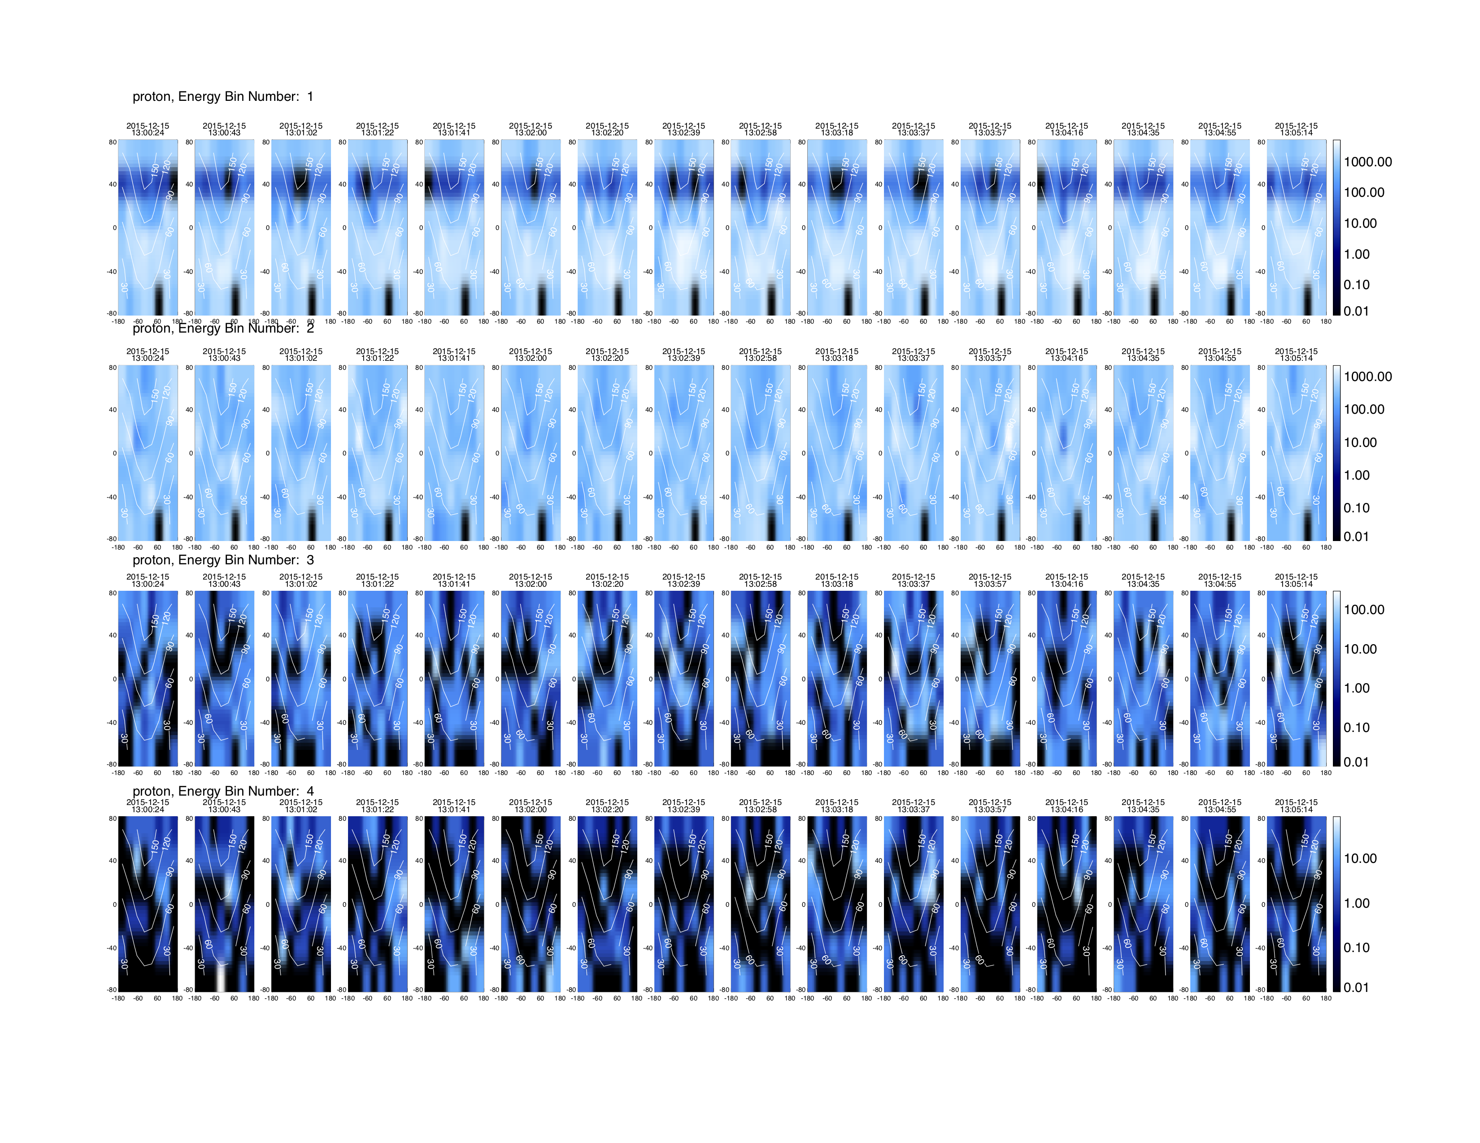
Analysis Tools
EIS angle-angle plots
What's New / Plug-in Status
Getting Started
Loading and Plotting Data
Analysis Tools
Getting Help

Slide 58
Analysis Tools
FPI angle-angle plots
What's New / Plug-in Status
Getting Started
Loading and Plotting Data
Analysis Tools
Getting Help
; to plot the angle-angle plots for FPI, use the following tool
mms_fpi_ang_ang, '2015-10-16/13:06:59.985', /postscript, species='i', data_rate='brst'

Slide 59
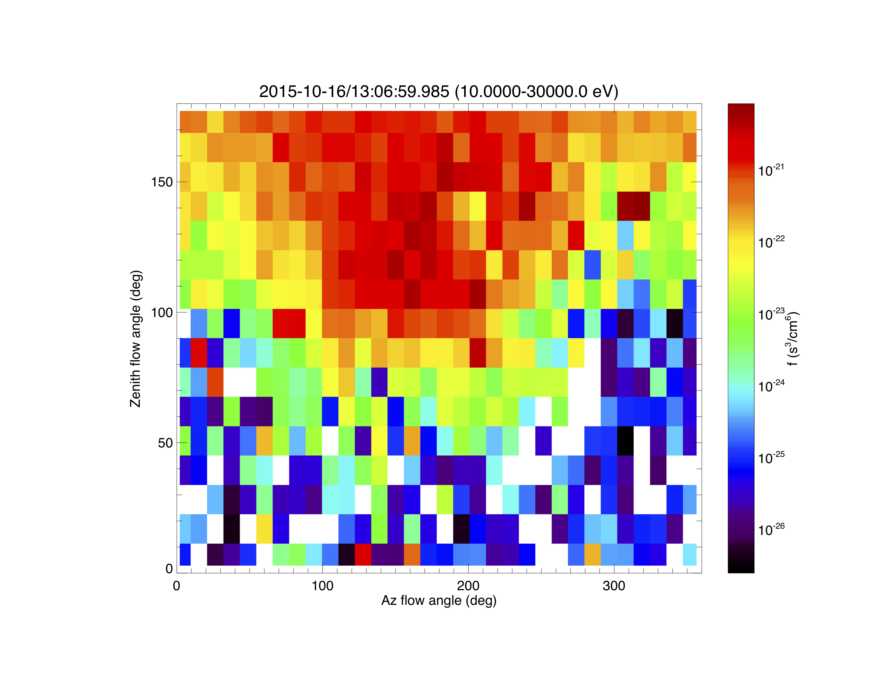
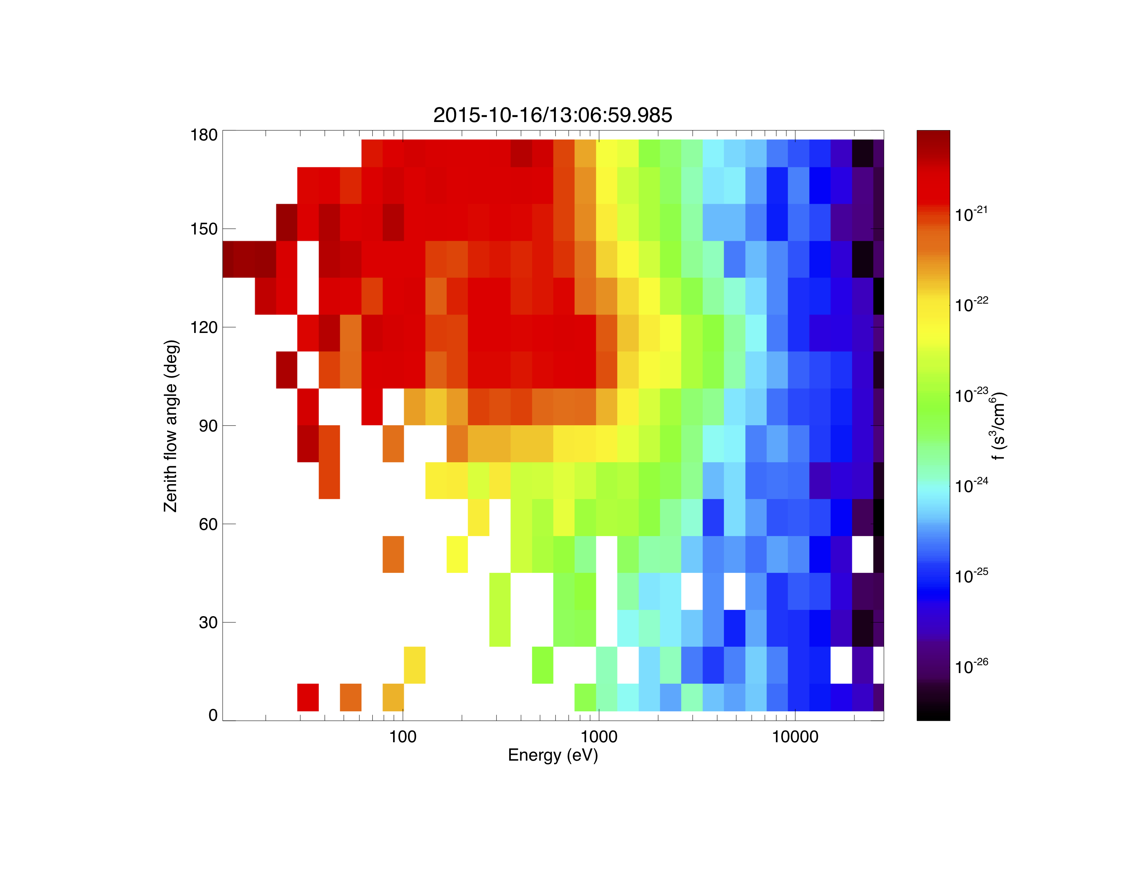
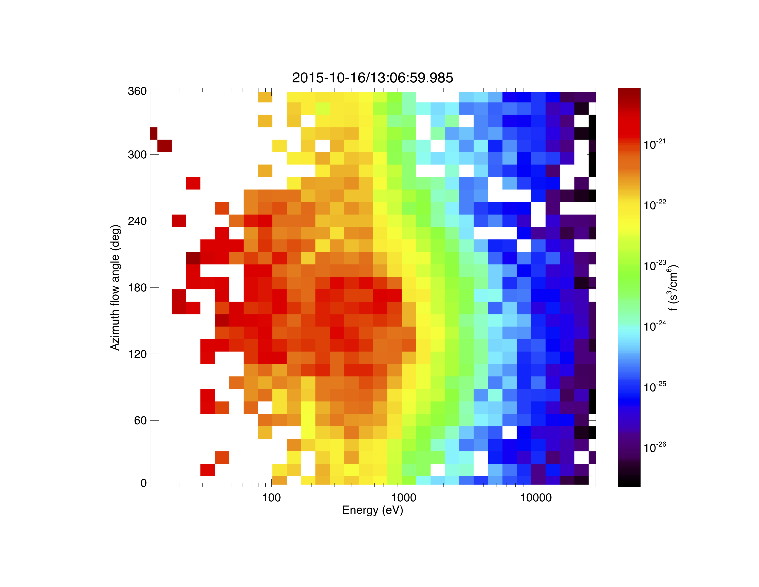
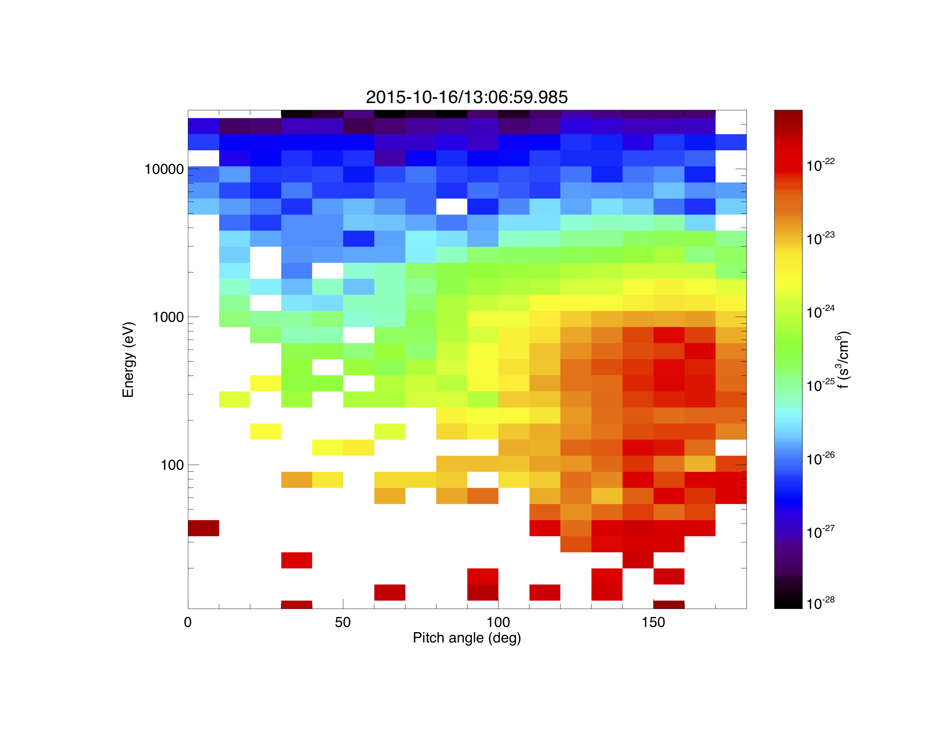
Analysis Tools
FPI angle-angle plots
What's New / Plug-in Status
Getting Started
Loading and Plotting Data
Analysis Tools
Getting Help

Slide 60
Examples
Where to find more examples?
What's New / Plug-in Status
Getting Started
Loading and Plotting Data
Analysis Tools
Getting Help
/projects/mms/examples/basic/
Basic examples for each load routine; this is a good place for new users to start
/projects/mms/examples/advanced/
Examples showing more advanced functionality of the plugin
/projects/mms/examples/quicklook/
Scripts that create the QL plots at the SDC; note: these require MMS team member access to the SDC to run
/projects/mms/examples/webinars/
Scripts created to showcase plug-in functionality during webinars

Slide 61
Getting Help
What's New / Plug-in Status
Getting Started
Loading and Plotting Data
Analysis Tools
Getting Help
SPEDAS Forum
SPEDAS Wiki
Ask Eric
https://groups.google.com/forum/#!forum/spedas
http://spedas.org/wiki/
egrimes@igpp.ucla.edu

Slide 62
Getting Help
Download
What's New / Plug-in Status
Getting Started
Loading and Plotting Data
Analysis Tools
Getting Help
Download this presentation:
http://spedas.org/mms/mms_bergen_2018.pdf

Slide 63
SPEDAS
Other Useful Crib Sheets
What's New / Plug-in Status
Getting Started
Loading and Plotting Data
Analysis Tools
Getting Help
general/examples/crib_tplot.pro
general/examples/crib_tplot_annotation.pro
general/examples/crib_tplot_layout.pro
general/examples/crib_tplot_range.pro
general/examples/crib_tplot_ticks.pro
general/examples/crib_dproc.pro

