Slide 1
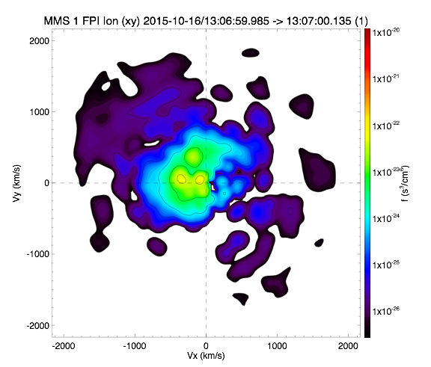
Using MMS Data with SPEDAS

Slide 2
Overview
Getting Started
Loading and Plotting Data
Analysis Tools
Examples
Getting Help

Slide 3
Getting Started
Requirements
Getting Started
Loading and Plotting Data
Analysis Tools
Examples
Getting Help
Windows, Linux, OS X, or Solaris
IDL 8.4+
IDL CDF Library 3.6.3+

Slide 4
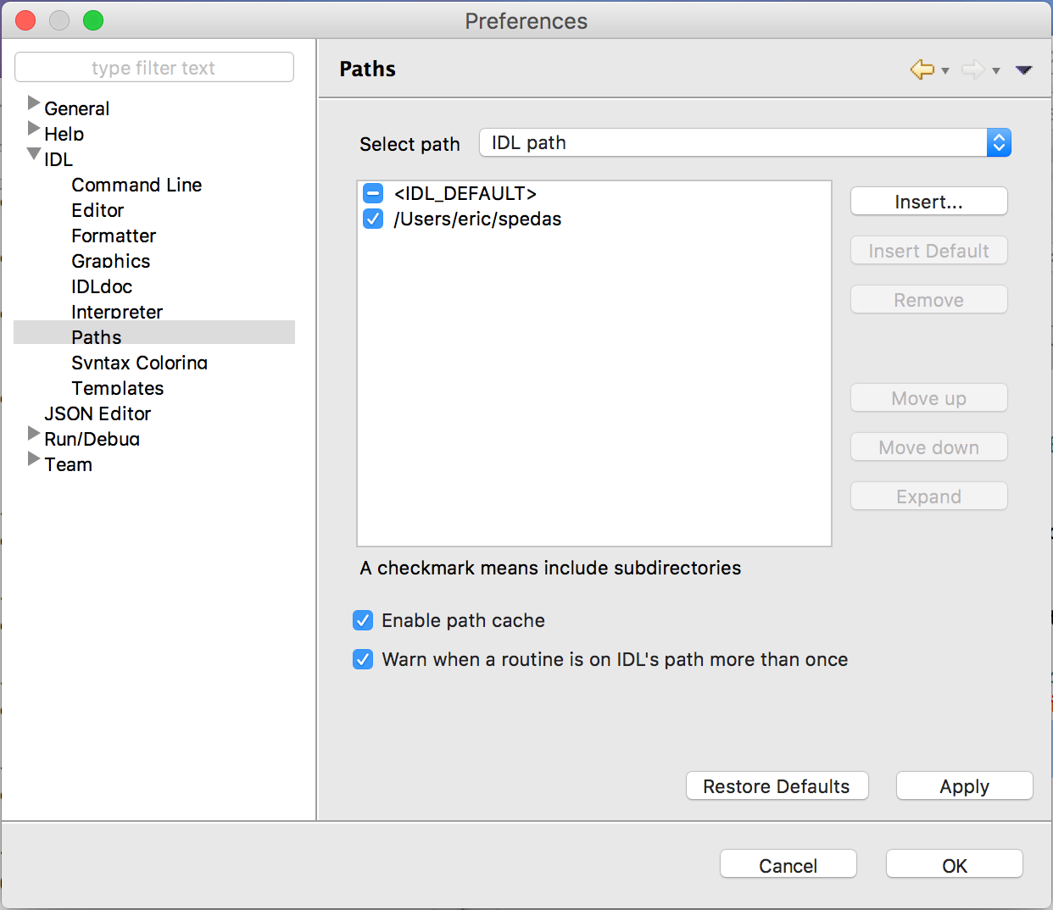
Getting Started
Installing SPEDAS
Getting Started
Loading and Plotting Data
Analysis Tools
Examples
Getting Help
http://spedas.org/wiki/index.php?title=Downloads_and_Installation

Slide 5
Getting Started
Organization
Getting Started
Loading and Plotting Data
Analysis Tools
Examples
Getting Help
spedas_gui: Components of the SPEDAS Graphical User Interface (GUI)
external: Code developed externally, but distributed with SPEDAS (CDAWeb, Geopack, etc.)
projects: Mission specific code
general: General science analysis tools

Slide 6
Getting Started
MMS Load Routines
Getting Started
Loading and Plotting Data
Analysis Tools
Examples
Getting Help
mms_load_fgm | Fluxgate Magnetometer
mms_load_scm | Search-coil Magnetometer
mms_load_mec | Ephemeris and Coordinates
mms_load_fpi | Fast Plasma Investigation
mms_load_hpca | Hot Plasma Composition Analyzer
mms_load_eis | Energetic Ion Spectrometer
mms_load_feeps | Fly’s Eye Energetic Particle Sensor
mms_load_edp | Electric-field Double Probe
mms_load_edi | Electron Drift Instrument
mms_load_dsp | Digital Signal Processor
mms_load_aspoc | Active Spacecraft Potential Control
mms_load_tetrahedron_qf | Tetrahedron Quality Factor
mms_load_brst_segments | Find burst intervals
mms_load_fast_segments | Find fast intervals
See folder: /projects/mms/

Slide 7
Getting Started
Standard Keywords
Getting Started
Loading and Plotting Data
Analysis Tools
Examples
Getting Help
trange
probes
level
data_rate
datatype
trange=['2015-10-16', '2015-10-17']
probes=[1, 2, 3, 4]
level='l2'
data_rate='srvy'
datatype=['des-moms', 'dis-moms']

Slide 8
Getting Started
Standard Keywords
Getting Started
Loading and Plotting Data
Analysis Tools
Examples
Getting Help
suffix
time_clip
no_update
spdf
tplotnames
suffix='_burst_mode'
/time_clip
/no_update
/spdf
tplotnames=tvarnames

Slide 9
Getting Started
Standard Keywords
Getting Started
Loading and Plotting Data
Analysis Tools
Examples
Getting Help
local_data_dir
cdf_filenames
cdf_version
min_version
latest_version
local_data_dir='/Users/eric/mydata/'
cdf_filenames=data_file_list
cdf_version='3.0.0'
min_version='3.0.0'
/latest_version

Slide 10
Getting Started
Standard Keywords
Getting Started
Loading and Plotting Data
Analysis Tools
Examples
Getting Help
major_version
versions
available
/major_version
versions=version_list
/available

Slide 11
Getting Started
Standard Keywords
Getting Started
Loading and Plotting Data
Analysis Tools
Examples
Getting Help
For a complete list of keywords and their descriptions, see the header for the load routine you’re interested in, e.g.,
; PROCEDURE:
; mms_load_fpi
;
; PURPOSE:
; Load data from the Fast Plasma Investigation (FPI) onboard MMS
;
; KEYWORDS:
; trange: time range of interest [starttime, endtime] with the format
; ['YYYY-MM-DD','YYYY-MM-DD'] or to specify more or less than a day
; ['YYYY-MM-DD/hh:mm:ss','YYYY-MM-DD/hh:mm:ss']
; probes: list of probes, valid values for MMS probes are ['1','2','3','4'].
; If no probe is specified the default is probe '3'
; level: indicates level of data processing. FPI levels currently include 'l2',
; 'l1b', 'sitl', 'ql'.
; datatype: valid datatypes are:
; Quicklook: ['des', 'dis']
; SITL: '' (none; loads both electron and ion data from single CDF)
; L1b/L2: ['des-dist', 'dis-dist', 'dis-moms', 'des-moms']
; data_rate: instrument data rates for MMS FPI include 'fast', 'brst'.
; local_data_dir: local directory to store the CDF files; should be set if
; you're on *nix or OSX, the default currently assumes Windows (c:\data\mms\)
; source: specifies a different system variable. By default the MMS mission system
; variable is !mms
; get_support_data: load support data (defined by support_data attribute in the CDF)
; tplotnames: returns a list of the names of the tplot variables loaded by the load routine
; no_color_setup: don't setup graphics configuration; use this keyword when you're
; using this load routine from a terminal without an X server running
; time_clip: clip the data to the requested time range; note that if you do not use
; this keyword you may load a longer time range than requested

Slide 12
Getting Started
SDC Data Availability
Getting Started
Loading and Plotting Data
Analysis Tools
Examples
Getting Help
Browse the status of the data:
https://lasp.colorado.edu/mms/sdc/public/about/processing/
Browse the data files:
https://lasp.colorado.edu/mms/sdc/public/data/
Search for data files:
https://lasp.colorado.edu/mms/sdc/public/search/
Browse the quicklook plots at the SDC:
https://lasp.colorado.edu/mms/sdc/public/quicklook/

Slide 13
Getting Started
Simple Example
Getting Started
Loading and Plotting Data
Analysis Tools
Examples
Getting Help
; load the MMS1 FGM data for October 16, 2015
mms_load_fgm, probe=1, data_rate='srvy', trange=['2015-10-16', '2015-10-17']
; list the tplot variables loaded
tplot_names
; get the data out of a tplot variable
get_data, 'mms1_fgm_b_gsm_srvy_l2_bvec', data=bgsm_vec, dlimits=bgsm_metadata
; get basic info on the IDL vars that hold the B-field data
help, bgsm_vec ; structure, x: times, y: data (x, y, z)
help, bgsm_metadata ; plotting and file metadata
; store the data into a different tplot variable
store_data, 'new_var_with_b_gsm', data=bgsm_vec, dlimits=bgsm_metadata
; plot the newly created variable
tplot, 'new_var_with_b_gsm'

Slide 14
FGM Example
; load 10 minutes of burst-mode FGM data for probe 1 on October 16, 2015
mms_load_fgm, probe=1, data_rate='brst', trange=['2015-10-16/13:00', '2015-10-16/13:10'], /time_clip, versions=version_numbers
; remove gaps
tdegap, ['mms1_fgm_b_gsm_brst_l2_bvec', 'mms1_fgm_b_gsm_brst_l2_btot'], /overwrite
; plot the vector and magnitude
tplot, ['mms1_fgm_b_gsm_brst_l2_bvec', 'mms1_fgm_b_gsm_brst_l2_btot']
; save the plot to a postscript file
tprint, 'mms1_fgm_b_gsm_brst_l2', /landscape
https://lasp.colorado.edu/mms/sdc/public/datasets/fields/

Slide 15
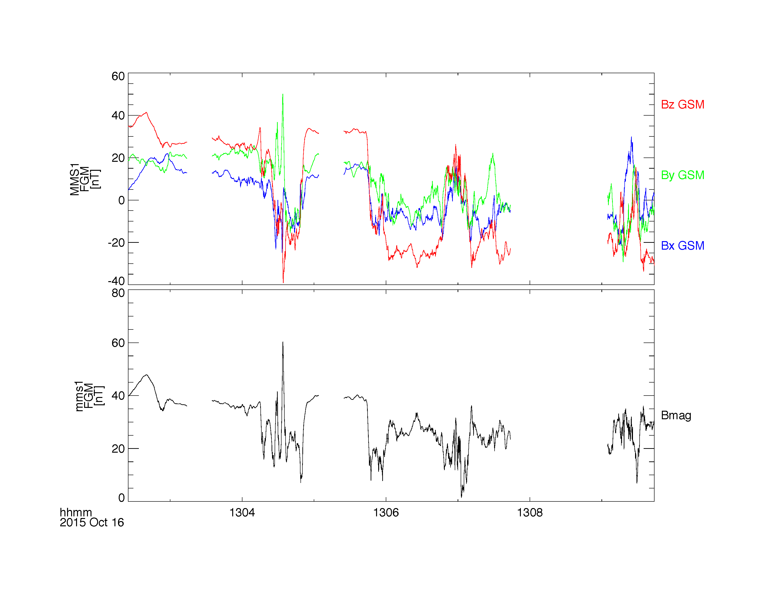
Loading and Plotting Data
FGM
Getting Started
Loading and Plotting Data
Analysis Tools
Examples
Getting Help

Slide 16
Loading and Plotting Data
FGM
Getting Started
Loading and Plotting Data
Analysis Tools
Examples
Getting Help
; add burst segments bar to the top of the figure
mms_load_brst_segments, trange=['2015-10-16/13:00', '2015-10-16/13:10']
tplot, 'mms_bss_burst', /add
; save the plot as a postscript file
tprint, 'mms1_fgm_b_gsm_brst_l2_with_burstbar', /landscape

Slide 17
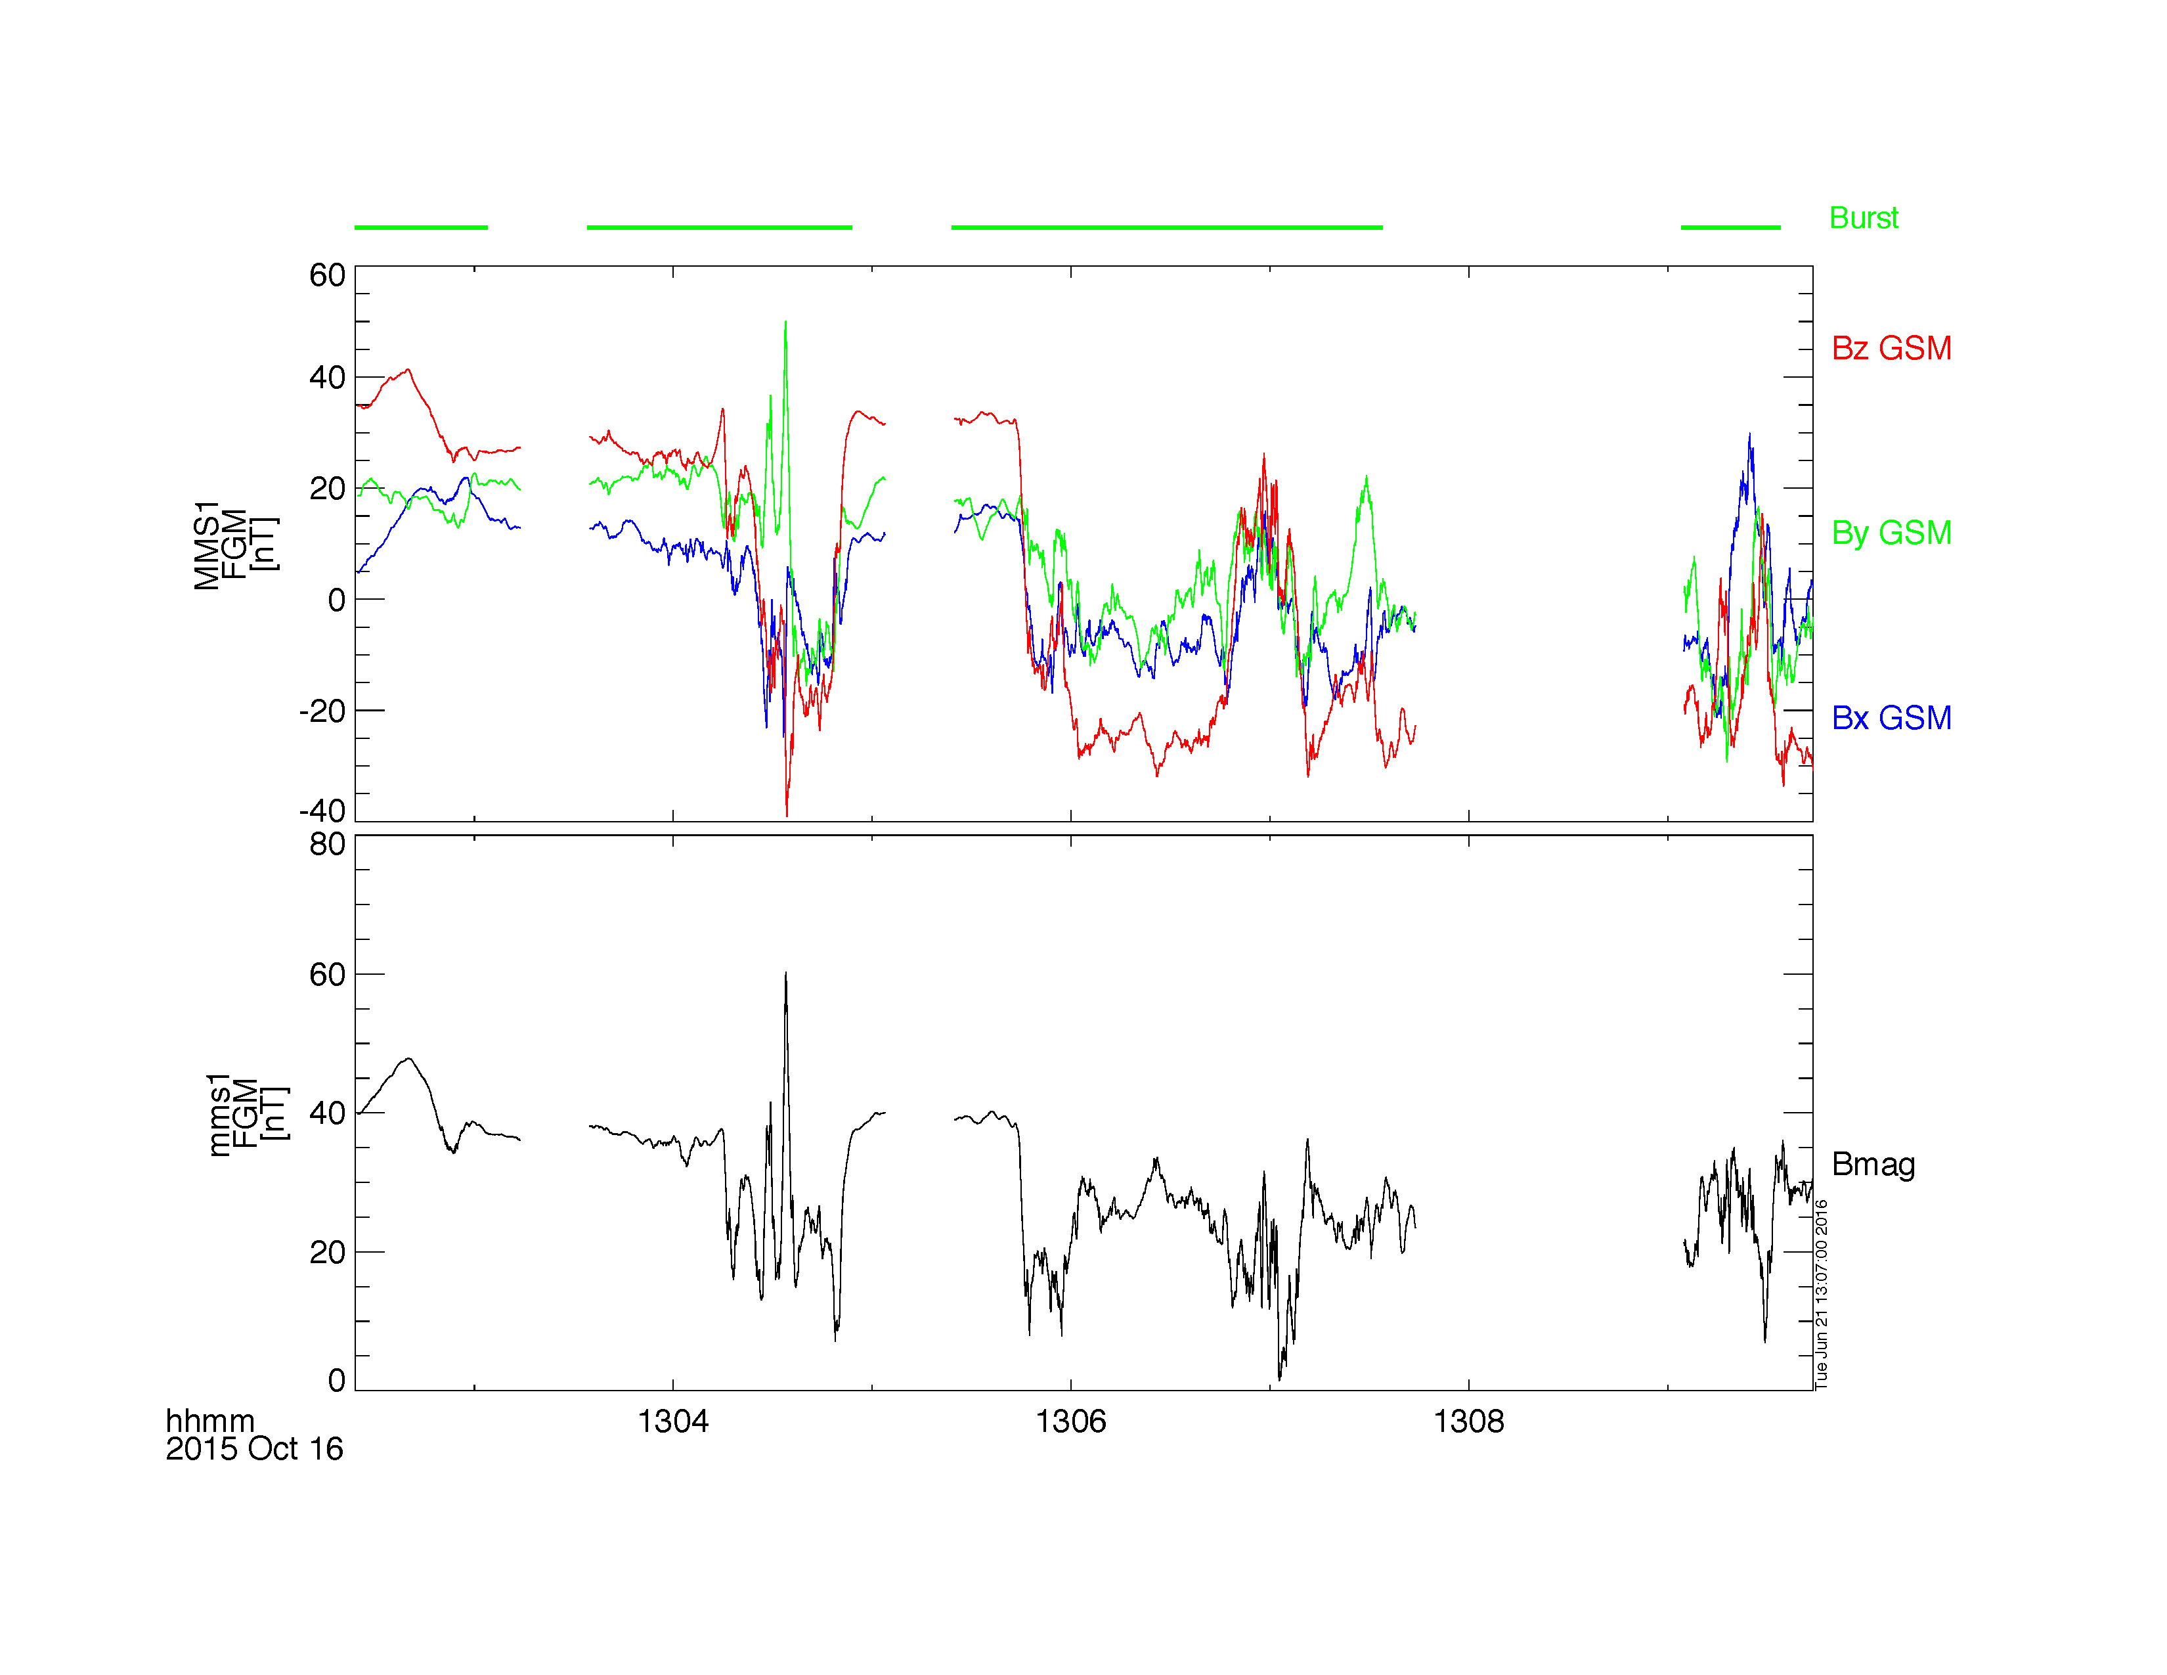
Loading and Plotting Data
FGM
Getting Started
Loading and Plotting Data
Analysis Tools
Examples
Getting Help

Slide 18
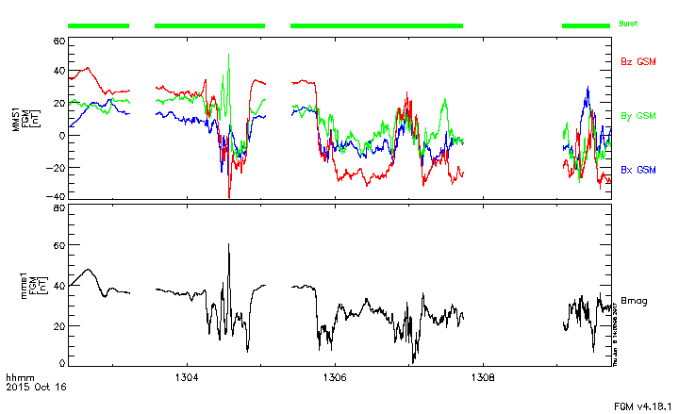
Loading and Plotting Data
FGM
Getting Started
Loading and Plotting Data
Analysis Tools
Examples
Getting Help
; add CDF version #s to the bottom right of the figure
mms_load_fgm, probe=1, data_rate='brst', versions=version_numbers
mms_add_cdf_versions, 'fgm', version_numbers, /right

Slide 19
Loading and Plotting Data
SCM
Getting Started
Loading and Plotting Data
Analysis Tools
Examples
Getting Help
; load 10 minutes of burst-mode SCM data for probe 2 on October 16, 2015
mms_load_scm, probe='2', data_rate='brst', trange=['2015-10-16/13:00', '2015-10-16/13:10'], /time_clip
; plot the data
tplot, 'mms2_scm_acb_gse_scb_brst_l2'
; zoom into a few seconds after 13:07
tlimit, ['2015-10-16/13:07:00', '2015-10-16/13:07:02']
; save the plot to a postscript file
tprint, 'mms2_scm_acb_gse_scb_brst_l2', /landscape
https://lasp.colorado.edu/mms/sdc/public/datasets/fields/

Slide 20
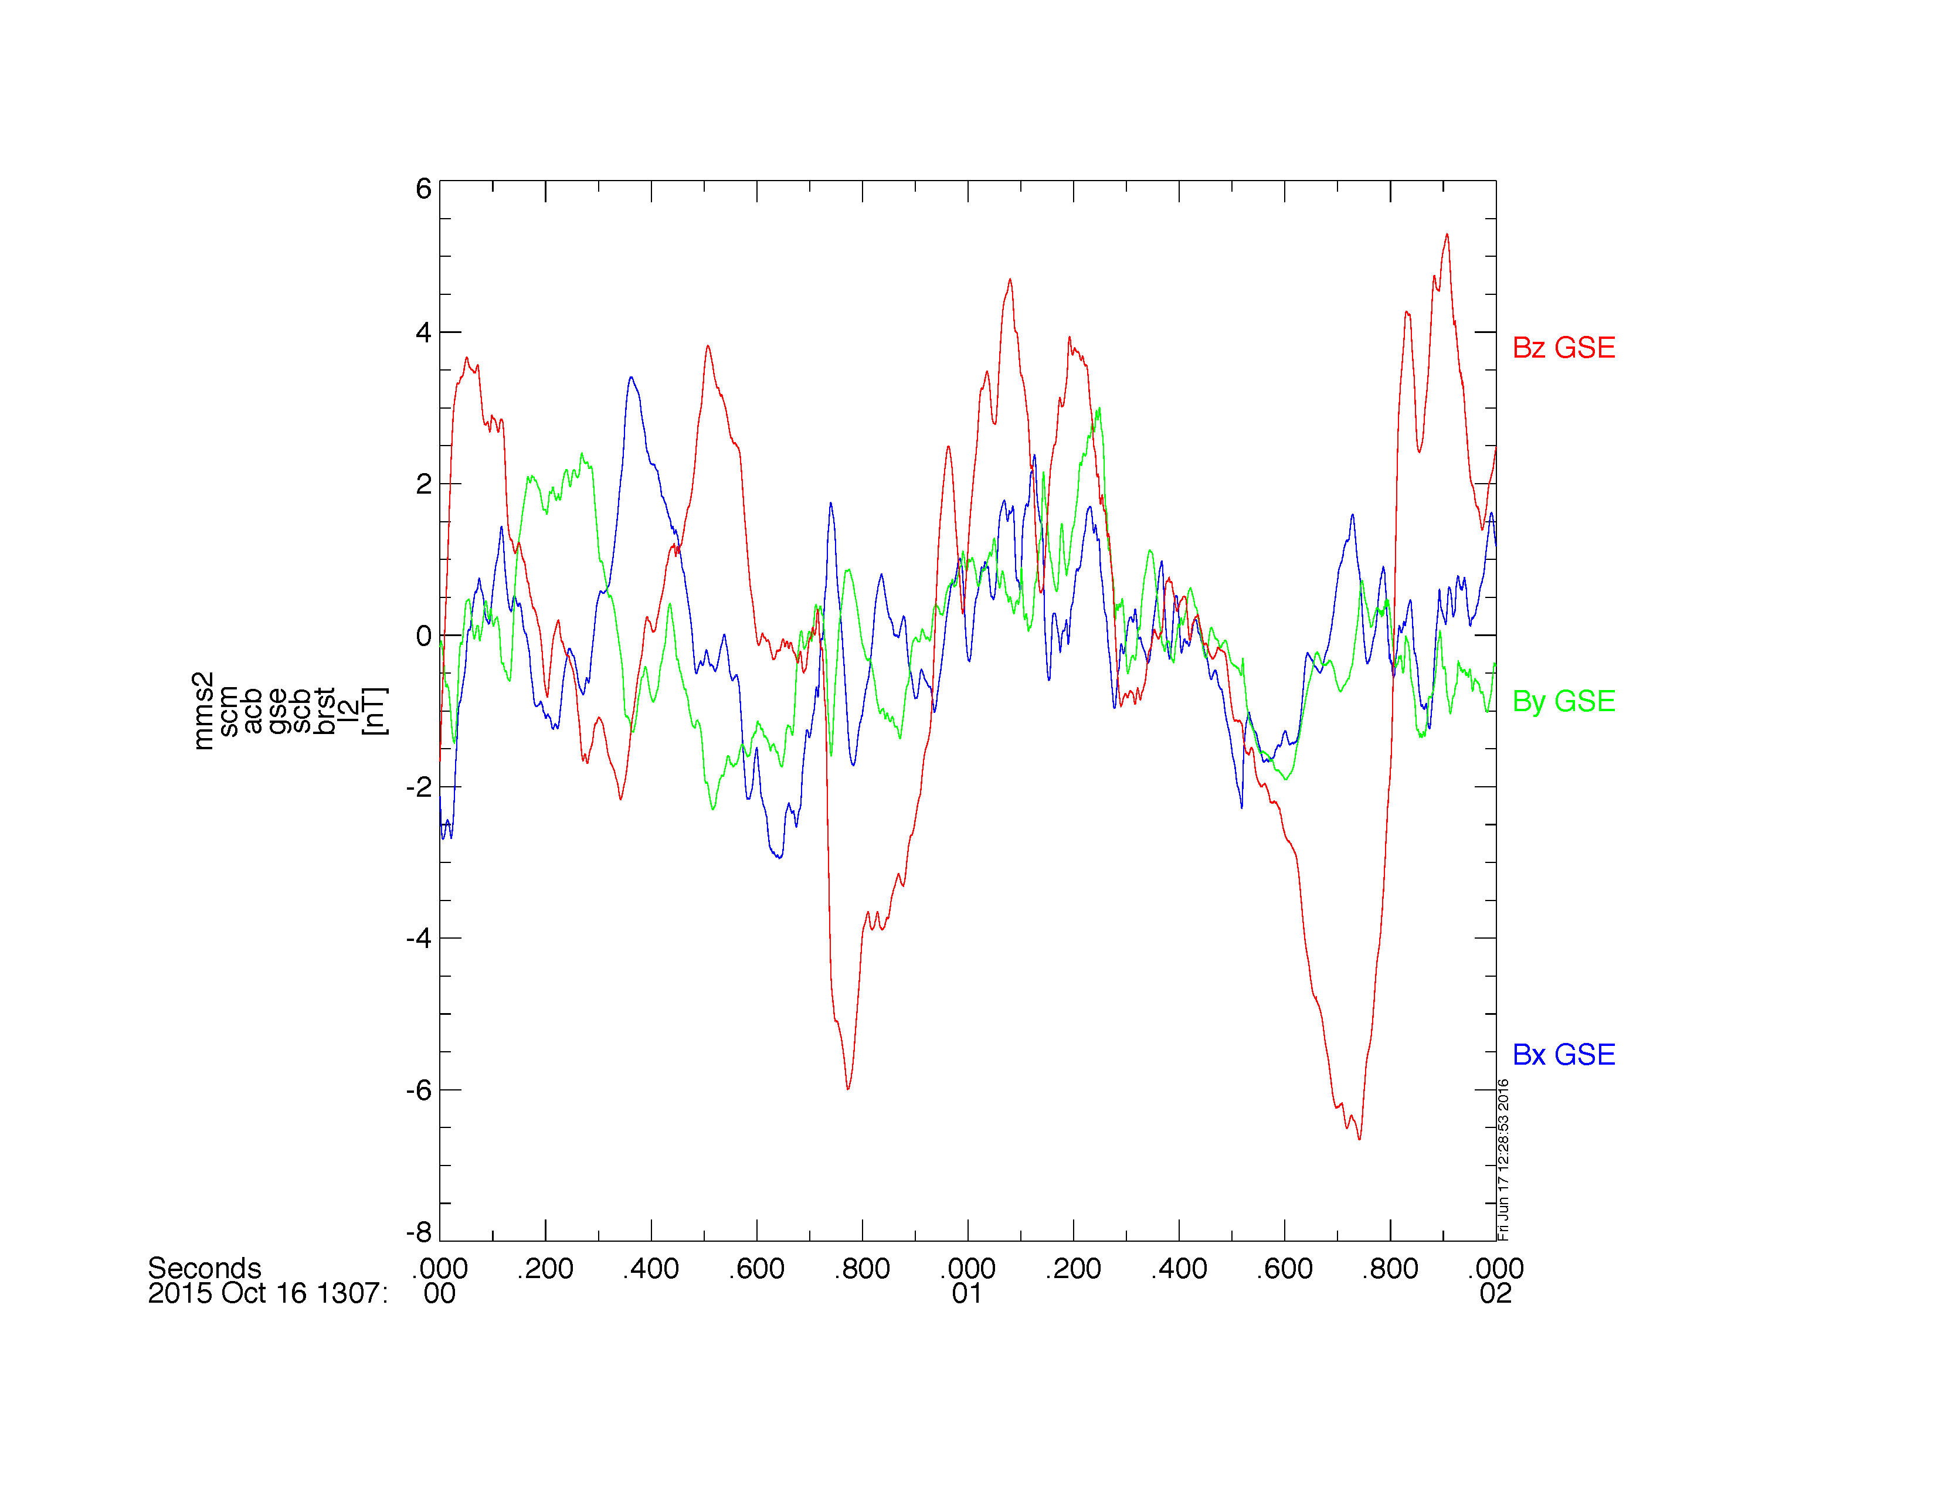
Loading and Plotting Data
SCM
Getting Started
Loading and Plotting Data
Analysis Tools
Examples
Getting Help

Slide 21
Loading and Plotting Data
EDP
Getting Started
Loading and Plotting Data
Analysis Tools
Examples
Getting Help
mms_load_edp, probe=1, level='l2', datatype='dce', trange=['2015-10-16', '2015-10-17'], /latest_version
; plot the E-field data
tplot, 'mms1_edp_dce_gse_fast_l2'
; save the plot to a postscript file
tprint, 'mms1_edp_dce_gse_fast_l2', /landscape
https://lasp.colorado.edu/mms/sdc/public/datasets/fields/

Slide 22
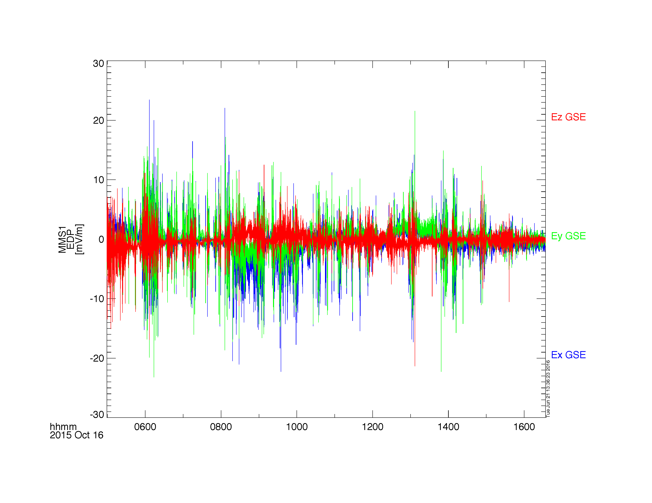
Loading and Plotting Data
EDP
Getting Started
Loading and Plotting Data
Analysis Tools
Examples
Getting Help

Slide 23
Loading and Plotting Data
FPI
Getting Started
Loading and Plotting Data
Analysis Tools
Examples
Getting Help
; load the FPI electron moments data for October 16, 2015
mms_load_fpi, probe=3, data_rate='fast', trange=['2015-10-16', '2015-10-17'], datatype='des-moms'
; plot the omni-directional electron energy spectra and pitch angle distribution
tplot, ['mms3_des_energyspectr_omni_fast', 'mms3_des_pitchangdist_avg']
; save the plot to a postscript file
tprint, 'mms3_des_spec_and_pad', /landscape
https://lasp.colorado.edu/mms/sdc/public/datasets/fpi/

Slide 24
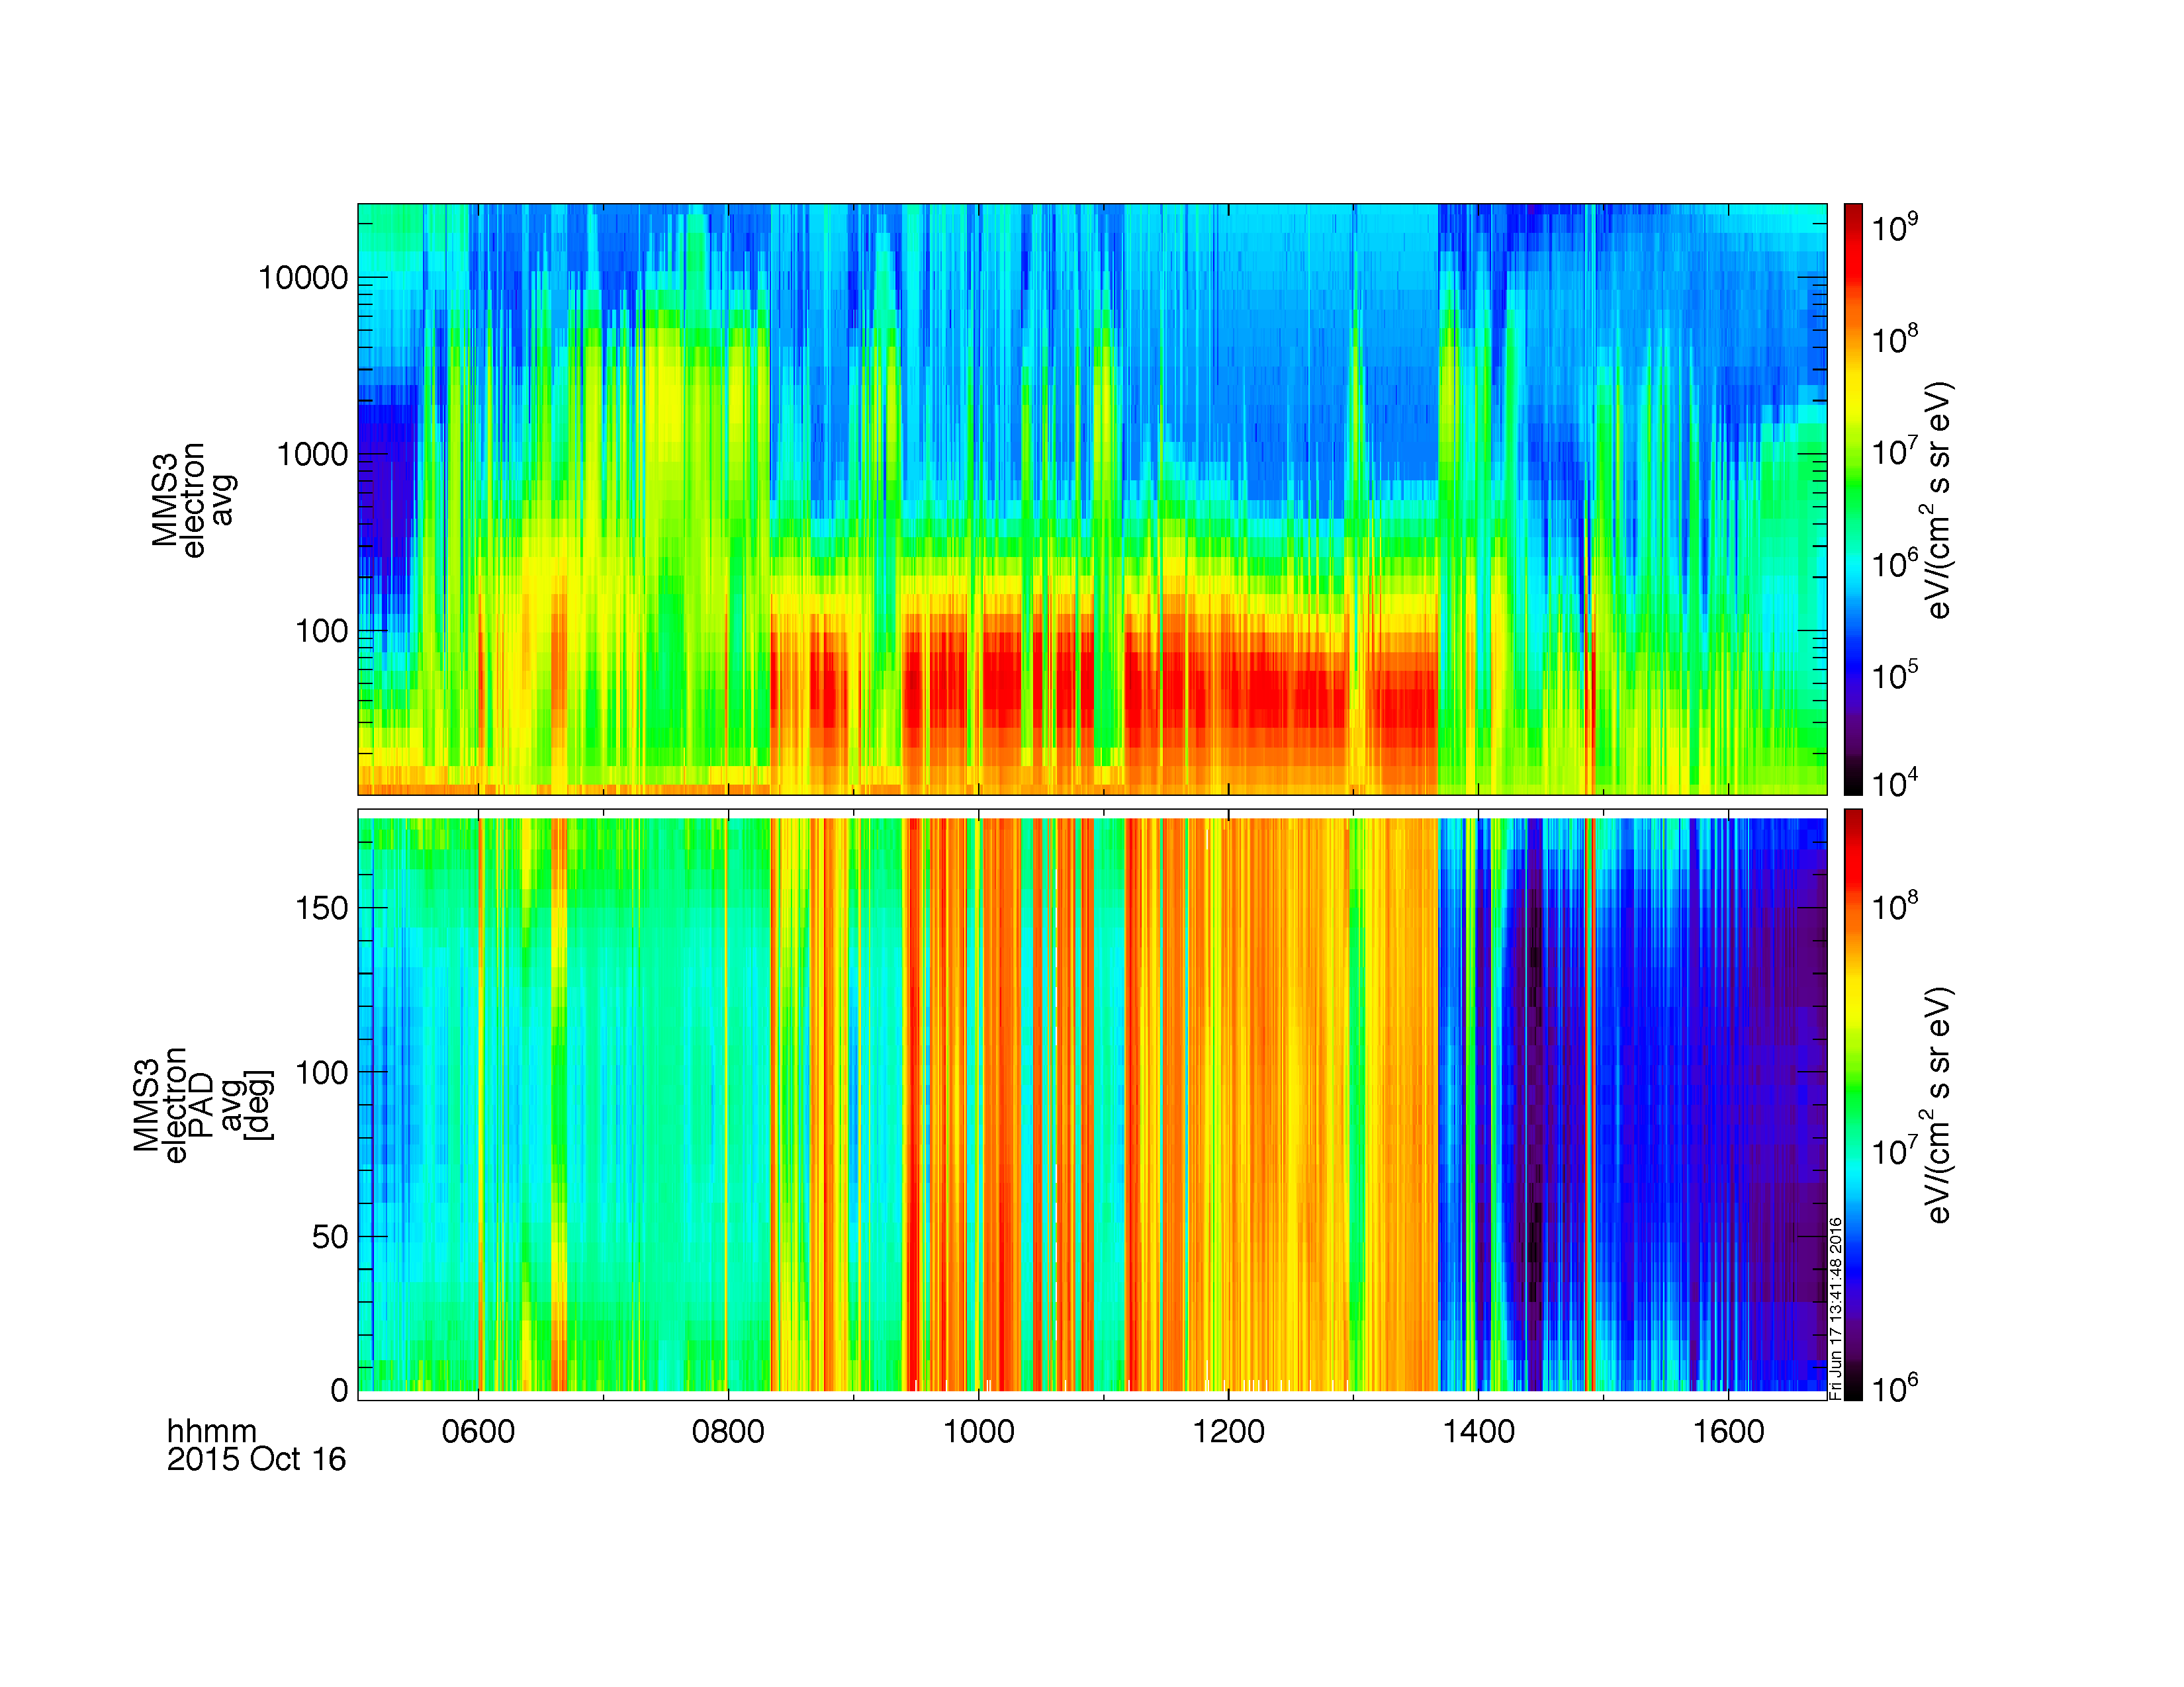
Loading and Plotting Data
FPI
Getting Started
Loading and Plotting Data
Analysis Tools
Examples
Getting Help

Slide 25
Loading and Plotting Data
FPI
Getting Started
Loading and Plotting Data
Analysis Tools
Examples
Getting Help
; we can also plot the FPI density, bulk velocity
; plot the electron density and flow velocity
tplot, ['mms3_des_bulkv_dbcs_fast', 'mms3_des_numberdensity_fast']
; save the plot to a postscript file
tprint, 'mms3_des_vel_density', /landscape
https://lasp.colorado.edu/mms/sdc/public/datasets/fpi/

Slide 26
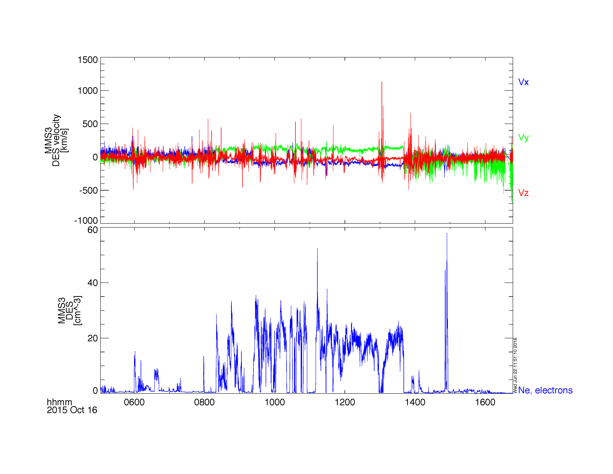
Loading and Plotting Data
FPI
Getting Started
Loading and Plotting Data
Analysis Tools
Examples
Getting Help

Slide 27
Loading and Plotting Data
HPCA
Getting Started
Loading and Plotting Data
Analysis Tools
Examples
Getting Help
; load the HPCA moments data for October 16, 2015
mms_load_hpca, probe=4, data_rate='srvy', trange=['2015-10-16', '2015-10-17'], datatype='moments'
; plot the H+ density, temperature and bulk velocity
tplot, ['mms4_hpca_hplus_number_density', 'mms4_hpca_hplus_scalar_temperature', 'mms4_hpca_hplus_ion_bulk_velocity']
; save the plot to a postscript file
tprint, 'mms4_hpca_hplus_moments', /landscape
https://lasp.colorado.edu/mms/sdc/public/datasets/hpca/

Slide 28
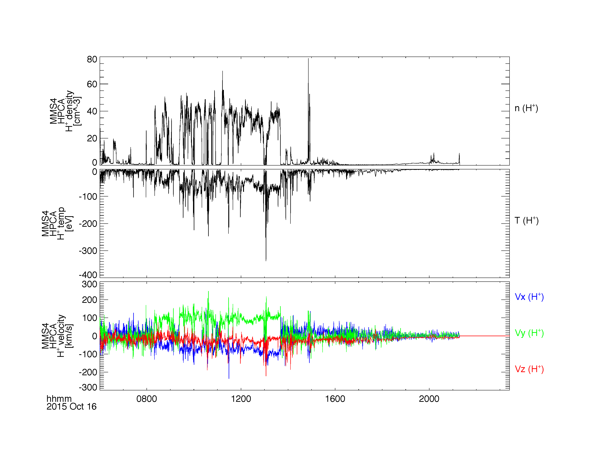
Loading and Plotting Data
HPCA
Getting Started
Loading and Plotting Data
Analysis Tools
Examples
Getting Help

Slide 29
Loading and Plotting Data
HPCA
Getting Started
Loading and Plotting Data
Analysis Tools
Examples
Getting Help
; load the HPCA ion data for October 16, 2015
mms_load_hpca, probe=4, data_rate='srvy', trange=['2015-10-16', '2015-10-17'], datatype='ion'
; calculate the omni-directional flux by averaging over the anodes for the full field of view
mms_hpca_calc_anodes, fov=[0, 360]
; plot the H+ and O+ spectra
tplot, ['mms4_hpca_hplus_flux_elev_0-360', $
'mms4_hpca_oplus_flux_elev_0-360']
; save the plot to a postscript file
tprint, 'mms4_hpca_hplus_flux_fullFoV', /landscape
https://lasp.colorado.edu/mms/sdc/public/datasets/hpca/

Slide 30
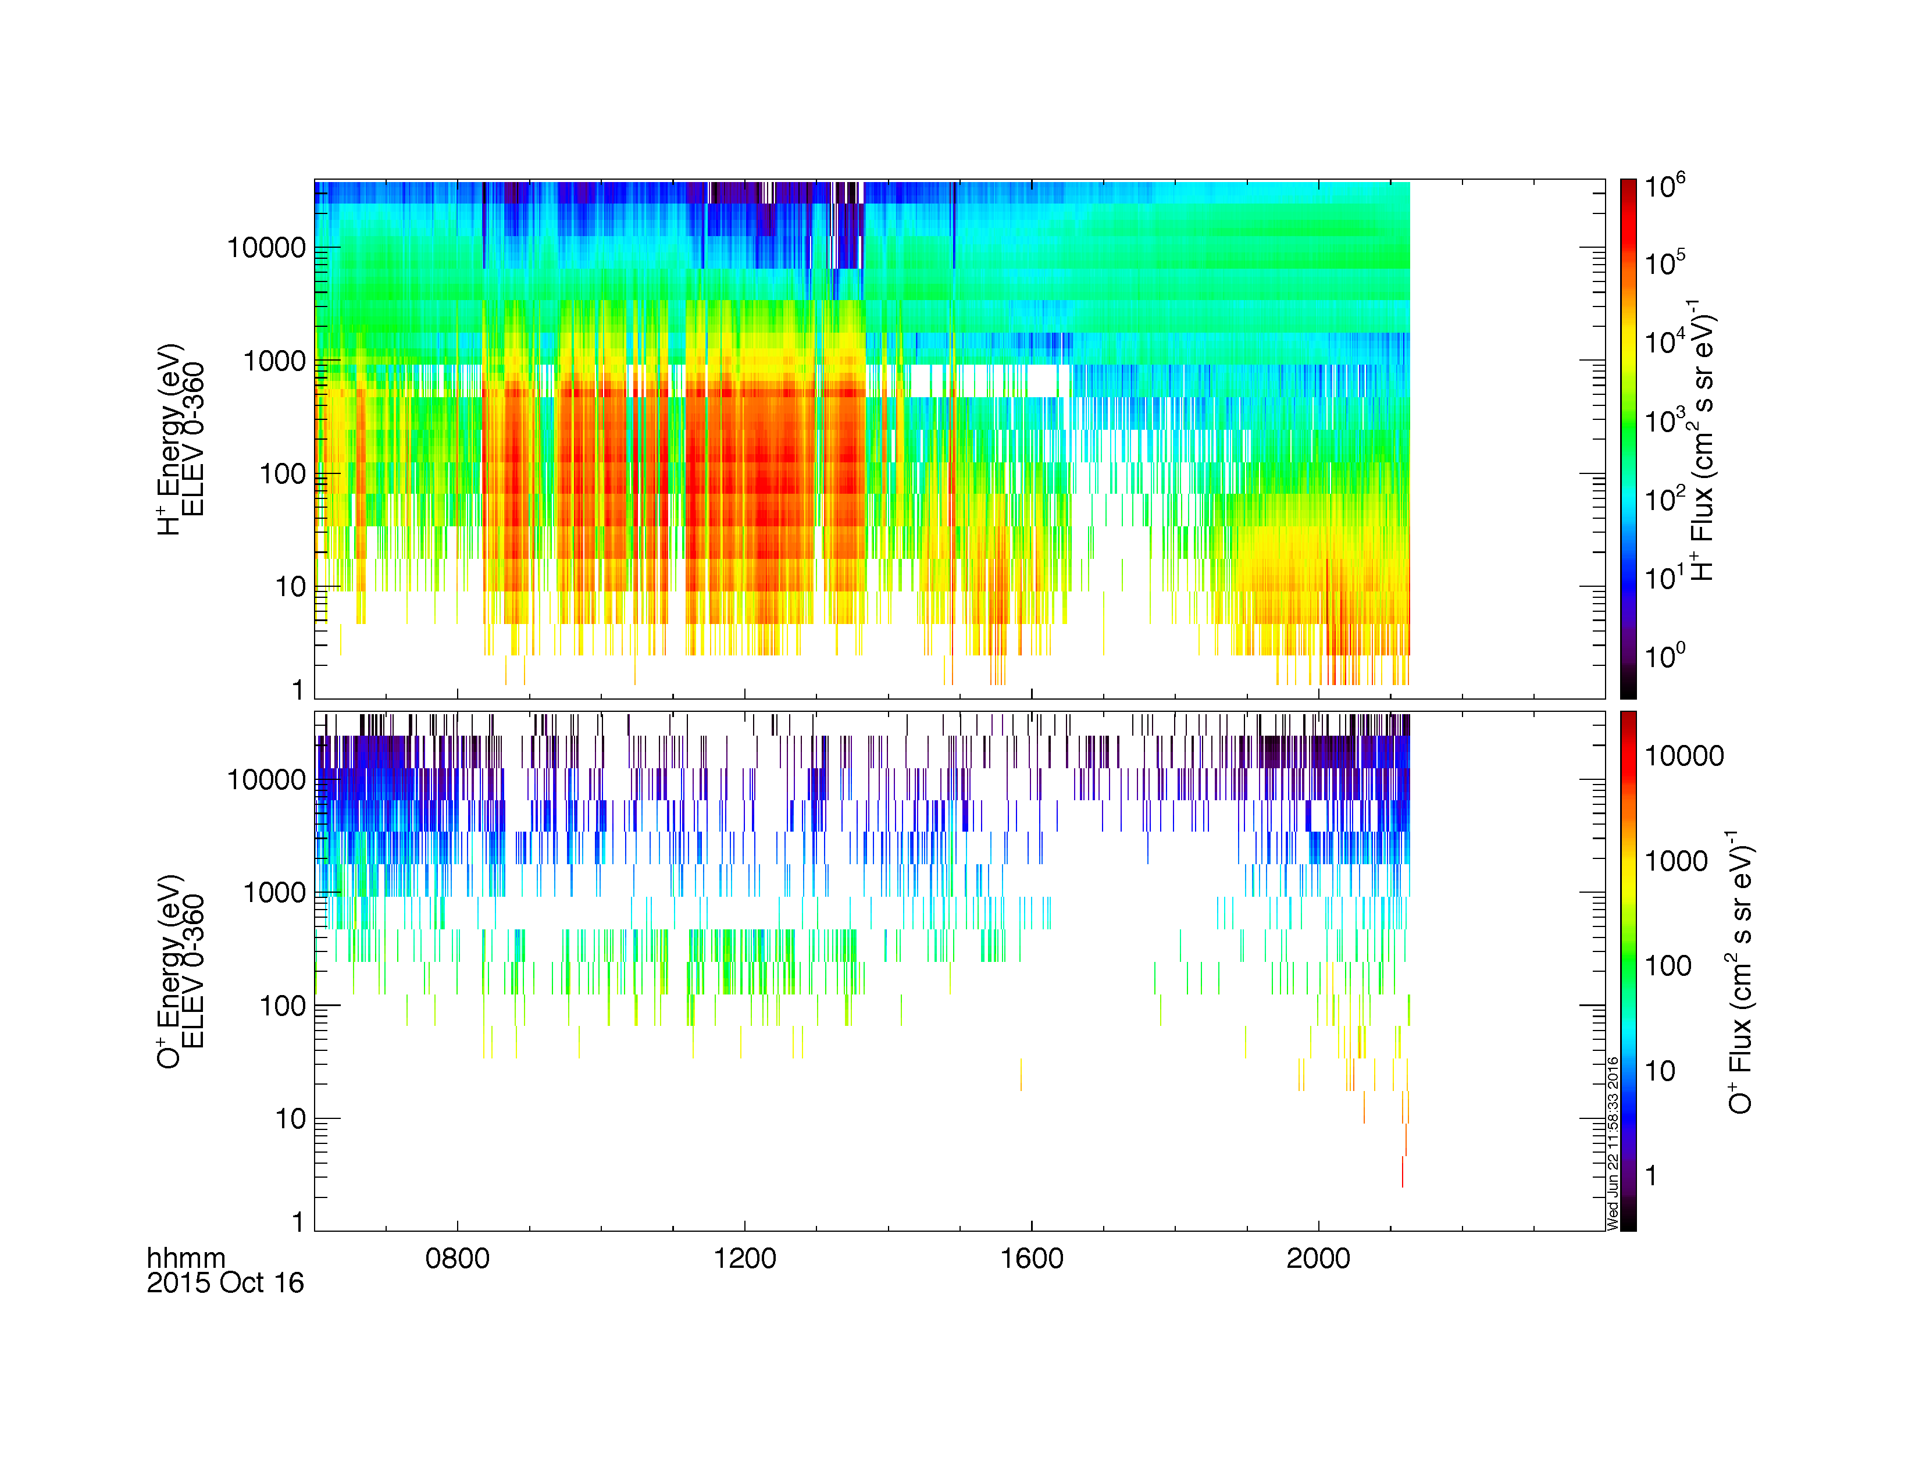
Loading and Plotting Data
HPCA
Getting Started
Loading and Plotting Data
Analysis Tools
Examples
Getting Help

Slide 31
Loading and Plotting Data
EPD EIS
Getting Started
Loading and Plotting Data
Analysis Tools
Examples
Getting Help
; load the EIS energy x time of flight (ExTOF) ion data for MMS1
mms_load_eis, probe=1, data_rate='srvy', datatype='extof', trange=['2015-10-16', '2015-10-17']
; calculate the EIS pitch angle distribution
mms_eis_pad, probe=1, data_rate='srvy', datatype='extof'
; plot the spin-averaged energy spectra and pitch angle distribution
tplot, ['mms1_epd_eis_extof_proton_flux_omni_spin', 'mms1_epd_eis_extof_0-1000keV_proton_flux_omni_pad_spin']
; save the plot to a postscript file
tprint, 'mms1_epd_eis_extof_protons', /landscape
https://lasp.colorado.edu/mms/sdc/public/datasets/epd/

Slide 32
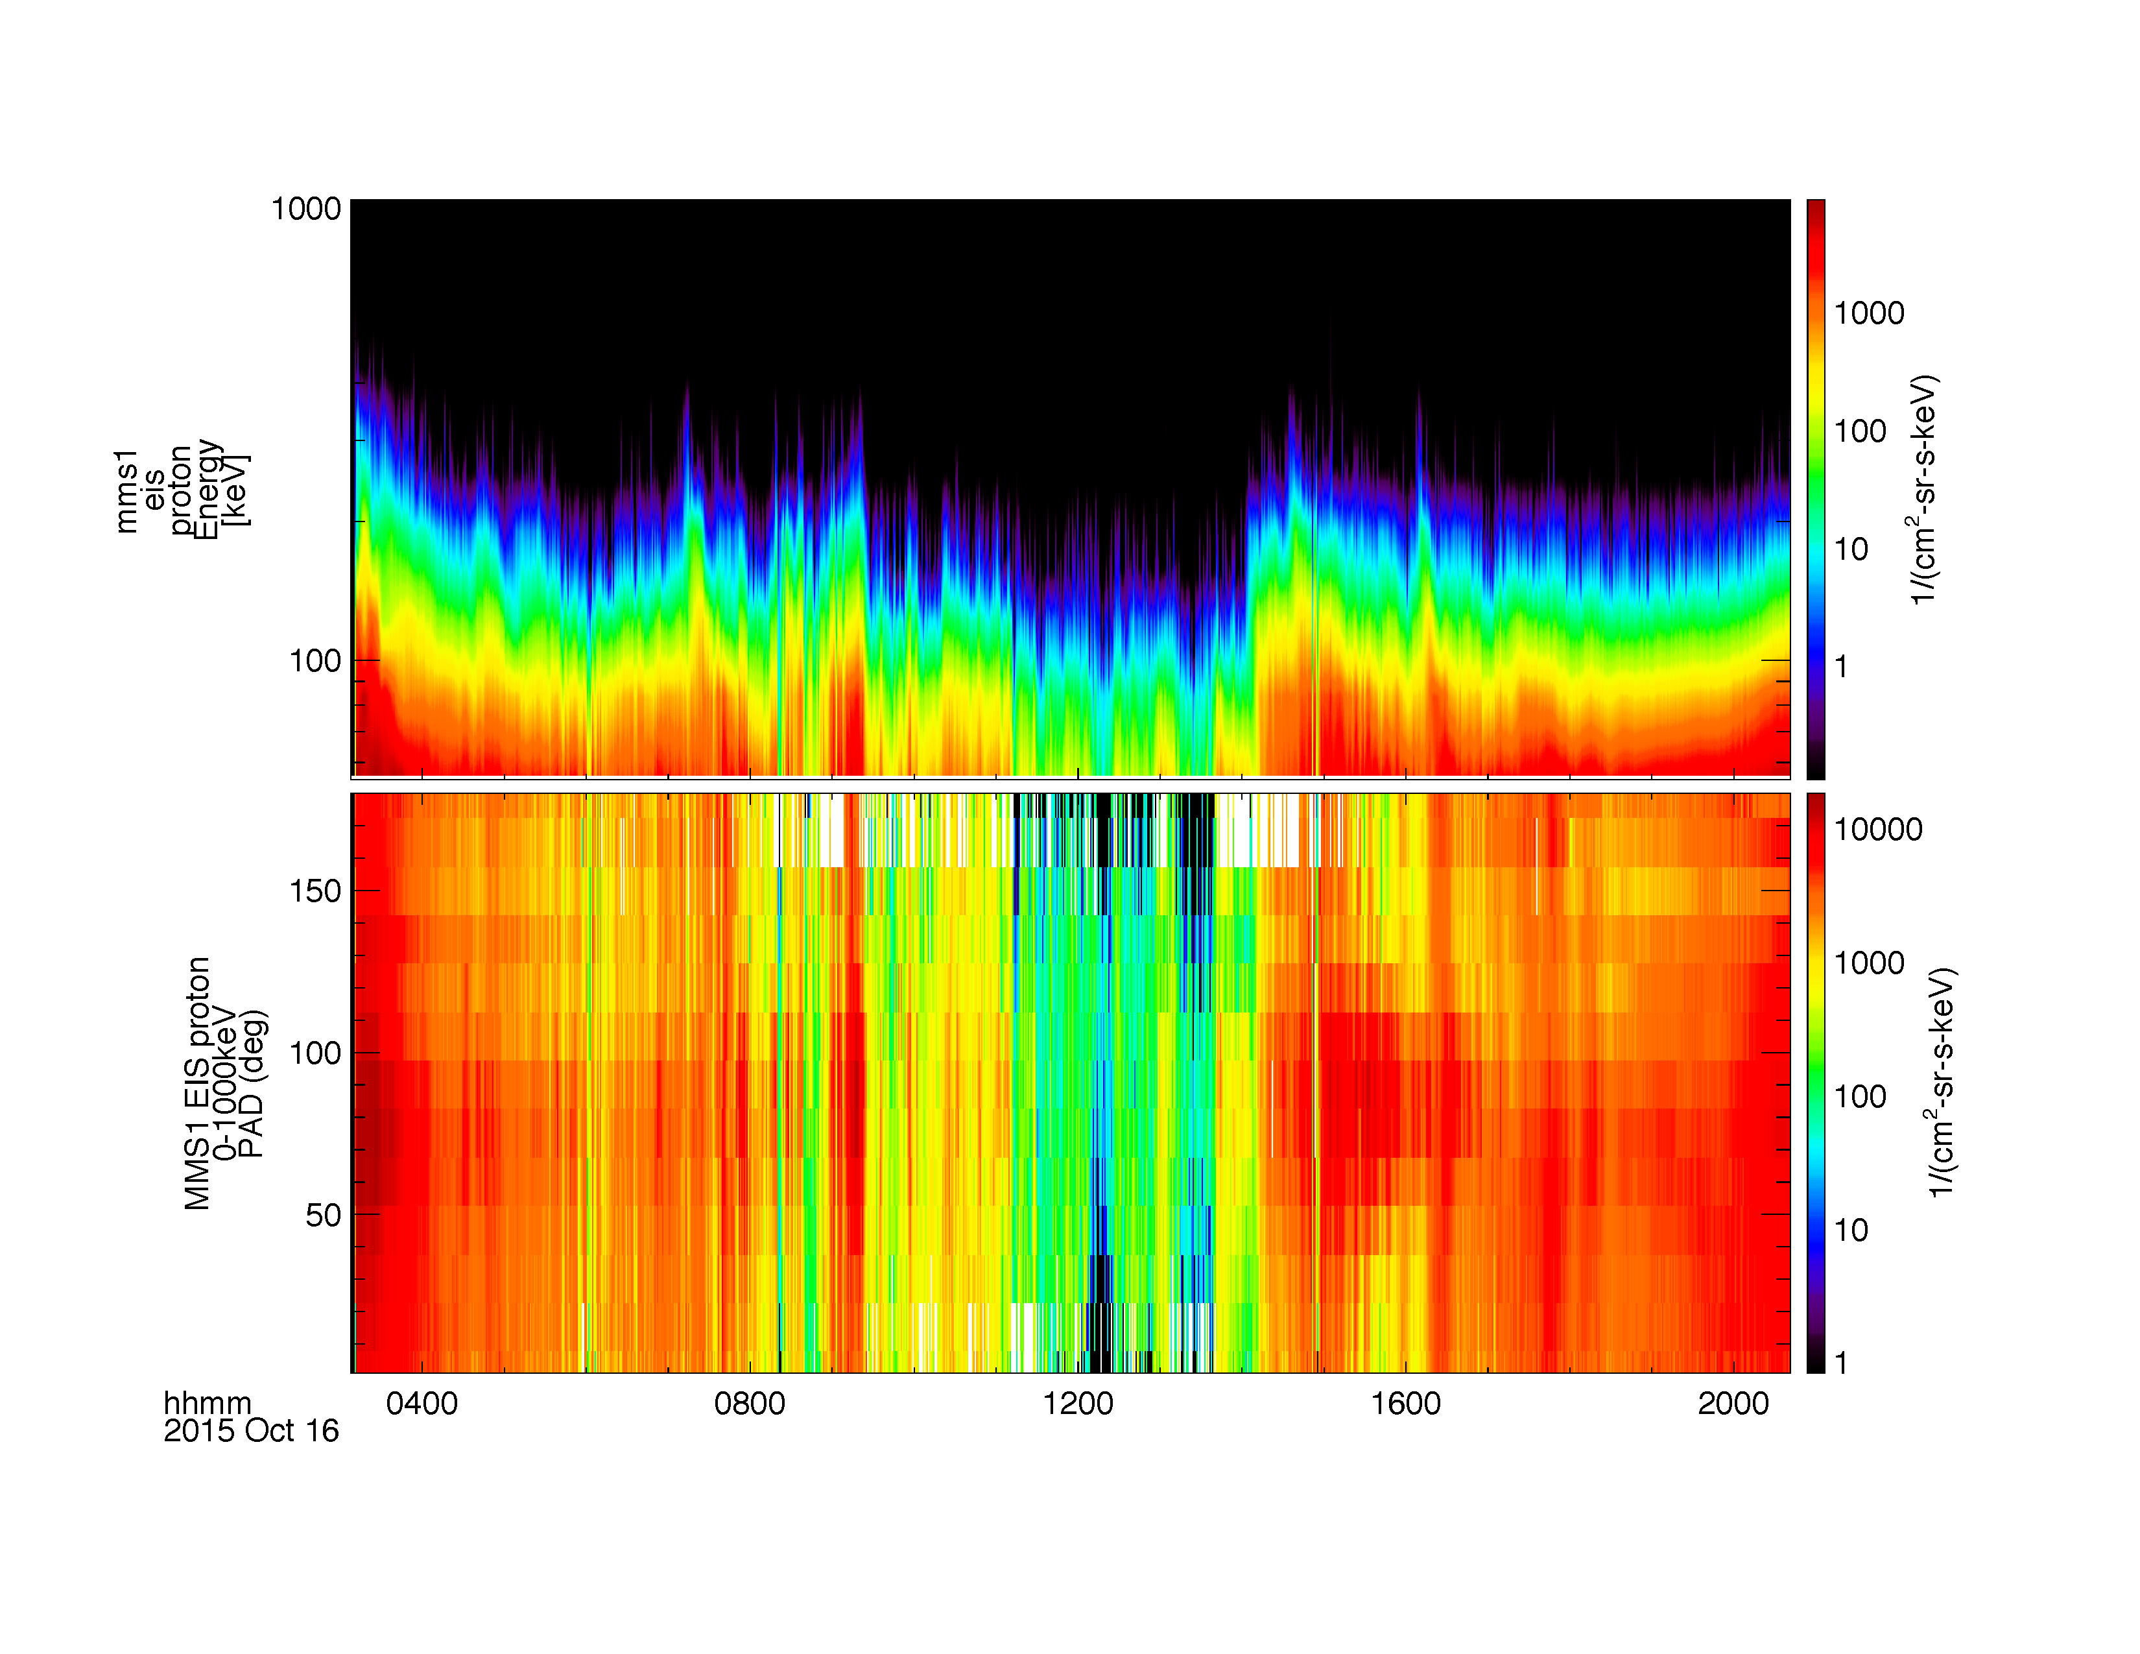
Loading and Plotting Data
EPD EIS
Getting Started
Loading and Plotting Data
Analysis Tools
Examples
Getting Help

Slide 33
Loading and Plotting Data
EPD FEEPS
Getting Started
Loading and Plotting Data
Analysis Tools
Examples
Getting Help
; load the FEEPS electron data for MMS2
mms_load_feeps, probe=2, data_rate='srvy', datatype='electron', trange=['2015-10-16', '2015-10-17']
; calculate the FEEPS pitch angle distribution
mms_feeps_pad, probe=2, data_rate='srvy', datatype='electron'
; plot the spin averaged electron spectra and pitch angle distribution
tplot, ['mms2_epd_feeps_srvy_l2_electron_intensity_omni_spin', 'mms2_epd_feeps_srvy_l2_electron_intensity_70-1000keV_pad_spin']
; save the plot to a postscript file
tprint, 'mms2_epd_feeps_electrons', /landscape
https://lasp.colorado.edu/mms/sdc/public/datasets/epd/

Slide 34
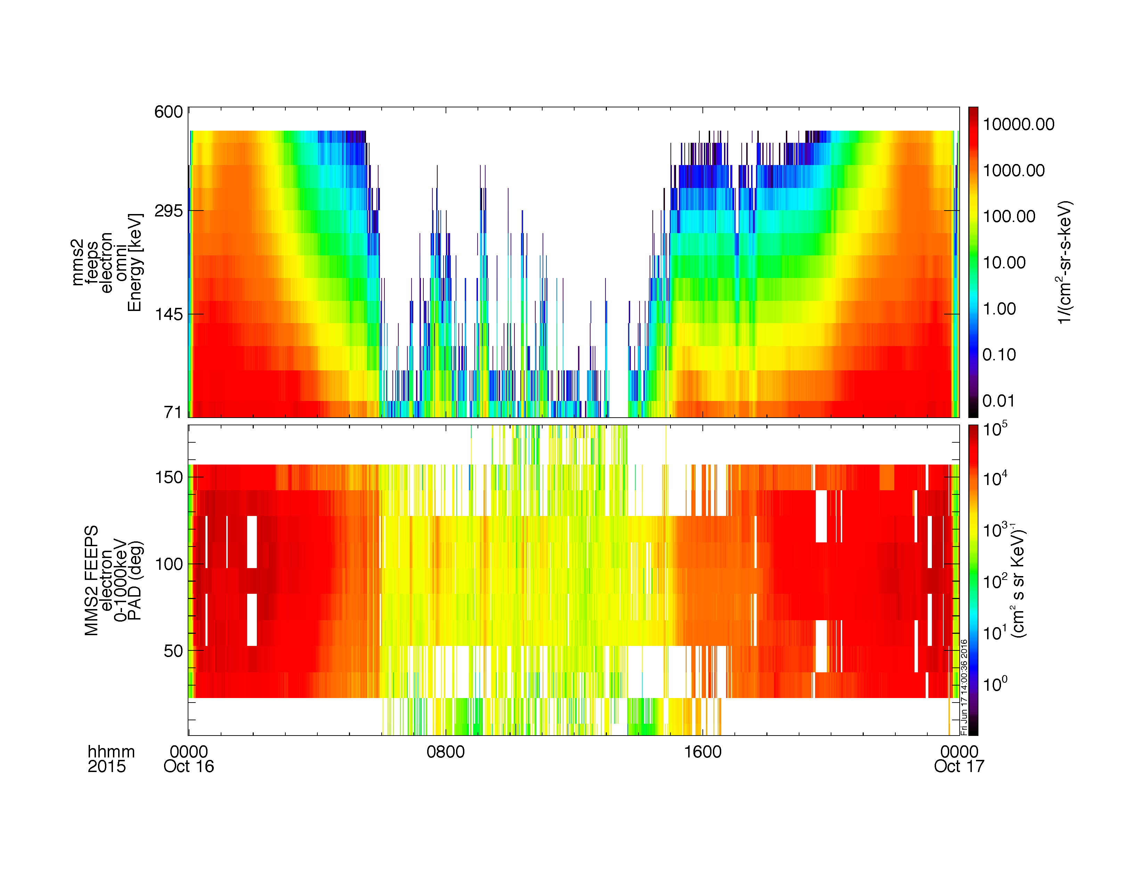
Loading and Plotting Data
EPD FEEPS
Getting Started
Loading and Plotting Data
Analysis Tools
Examples
Getting Help

Slide 35
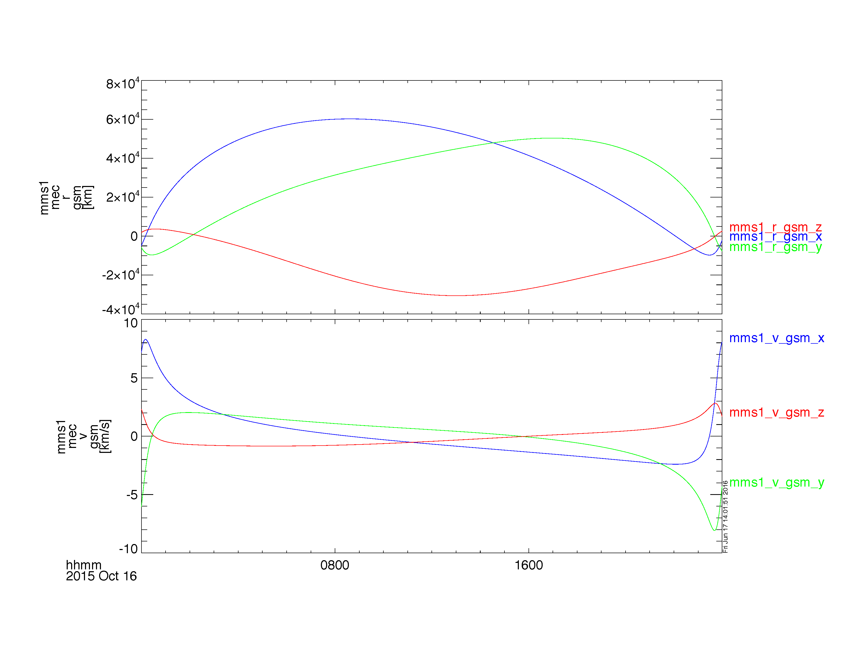
Loading and Plotting Data
MEC
Getting Started
Loading and Plotting Data
Analysis Tools
Examples
Getting Help
; load the ephemeris and coordinates data for October 16, 2015
mms_load_mec, probe=1, trange=['2015-10-16', '2015-10-17']
; plot the spacecraft position and velocity in GSM coordinates
tplot, ['mms1_mec_r_gsm', 'mms1_mec_v_gsm']

Slide 36
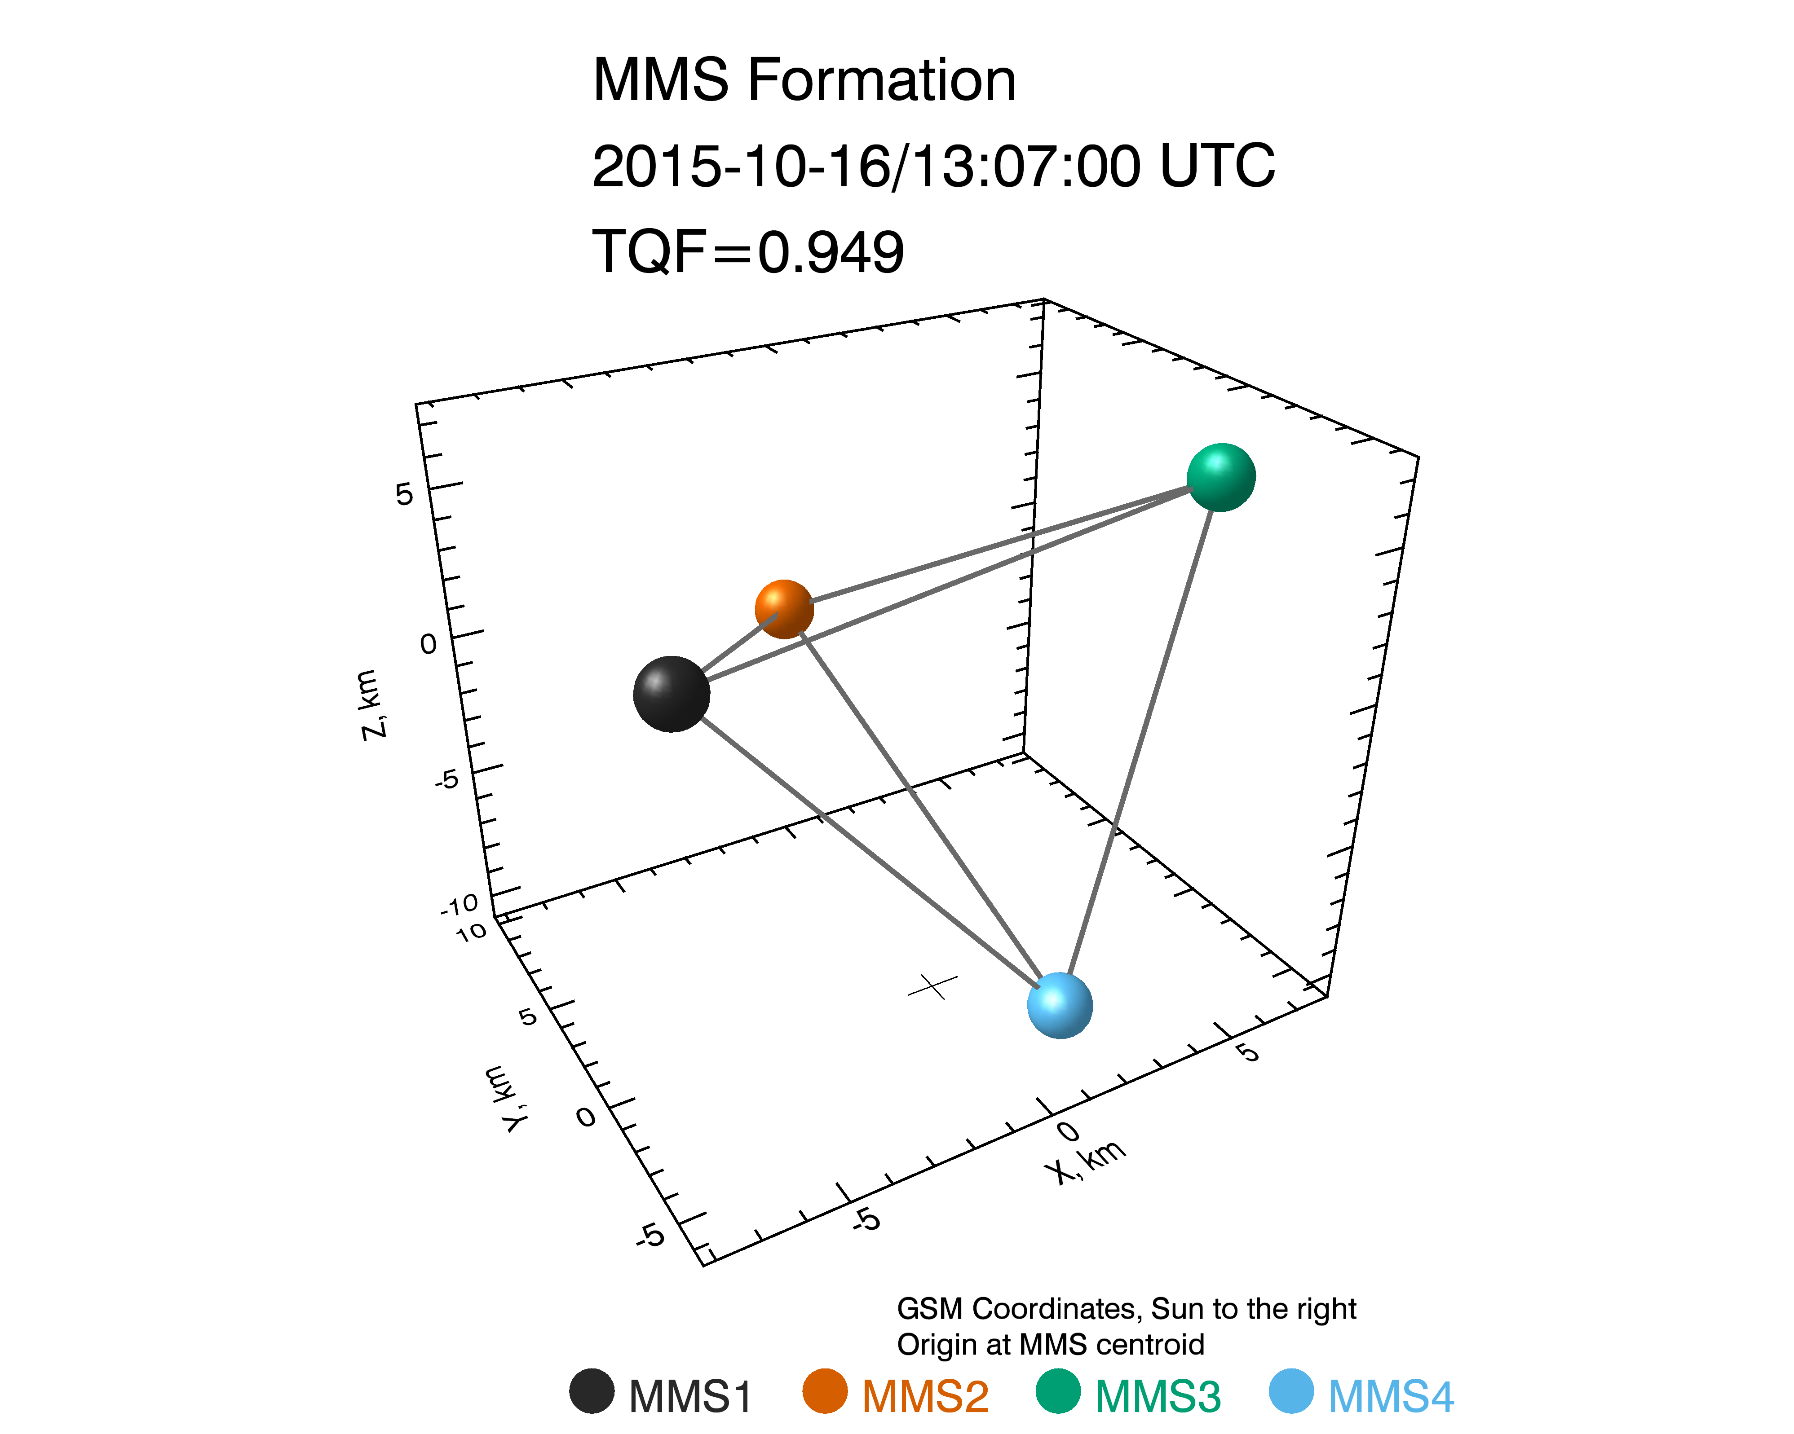
Loading and Plotting Data
Tetrahedron Formation
Getting Started
Loading and Plotting Data
Analysis Tools
Examples
Getting Help
; create the formation plot in GSM coordinates, including the tetrahedron quality factor
mms_mec_formation_plot, '2015-10-16/13:07', coord='gsm', /quality_factor

Slide 37
Analysis Tools
Curlometer Calculations
Coordinate Transformations
Minimum Variance Analysis
Dynamic Power Spectra
Spectra from Particle Distributions
2D Particle Slices
Visualizing the Distributions in 3D

Slide 38
Analysis Tools
Curlometer Calculations
Getting Started
Loading and Plotting Data
Analysis Tools
Examples
Getting Help
trange = ['2015-10-30/05:15:45', '2015-10-30/05:15:48']
mms_load_fgm, trange=trange, /get_fgm_ephemeris, probes=[1, 2, 3, 4], data_rate='brst'
fields = 'mms'+['1', '2', '3', '4']+'_fgm_b_gse_brst_l2'
positions = 'mms'+['1', '2', '3', '4']+'_fgm_r_gse_brst_l2'
mms_curl, trange=trange, fields=fields, positions=positions, suffix='_mms_curl'
tplot, ['divB','curlB','jtotal','jperp','jpar','baryb']+'_mms_curl'

Slide 39
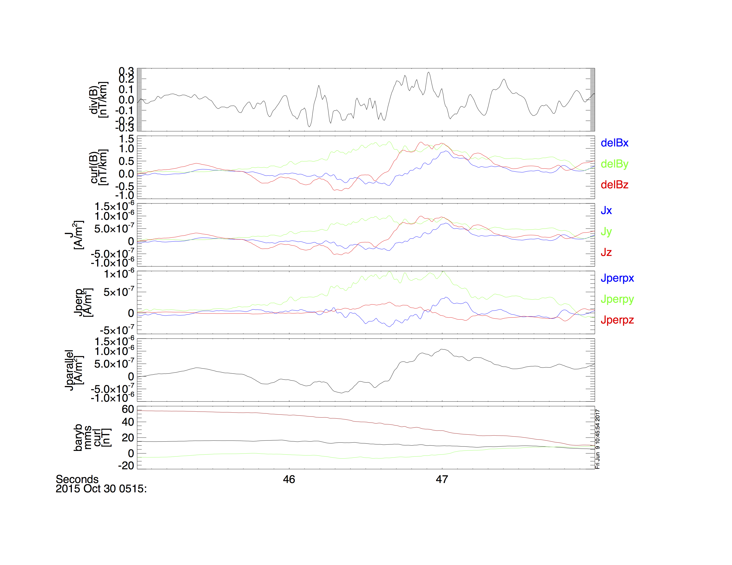
Analysis Tools
Curlometer Calculations
Getting Started
Loading and Plotting Data
Analysis Tools
Examples
Getting Help

Slide 40
Analysis Tools
Coordinate Transformations
Getting Started
Loading and Plotting Data
Analysis Tools
Examples
Getting Help
; load the quaternions from the MEC file
mms_load_mec, probe=3, trange=['2015-10-16/08:00', '2015-10-16/16:00'], /time_clip
; we're going to transform some FGM data
mms_load_fgm, probe=3, trange=['2015-10-16/08:00', '2015-10-16/16:00'], /time_clip
; Cotrans the FGM data from GSM to SM coordinates
mms_qcotrans, 'mms3_fgm_b_gsm_srvy_l2_bvec', 'mms3_fgm_b_sm_srvy_l2_bvec', out_coord='sm'
; plot the data in both GSM and SM coordinates
tplot, ['mms3_fgm_b_gsm_srvy_l2_bvec', 'mms3_fgm_b_sm_srvy_l2_bvec']
; save the plot to a postscript file
tprint, 'mms3_fgm_gsm_sm_coords', /landscape

Slide 41
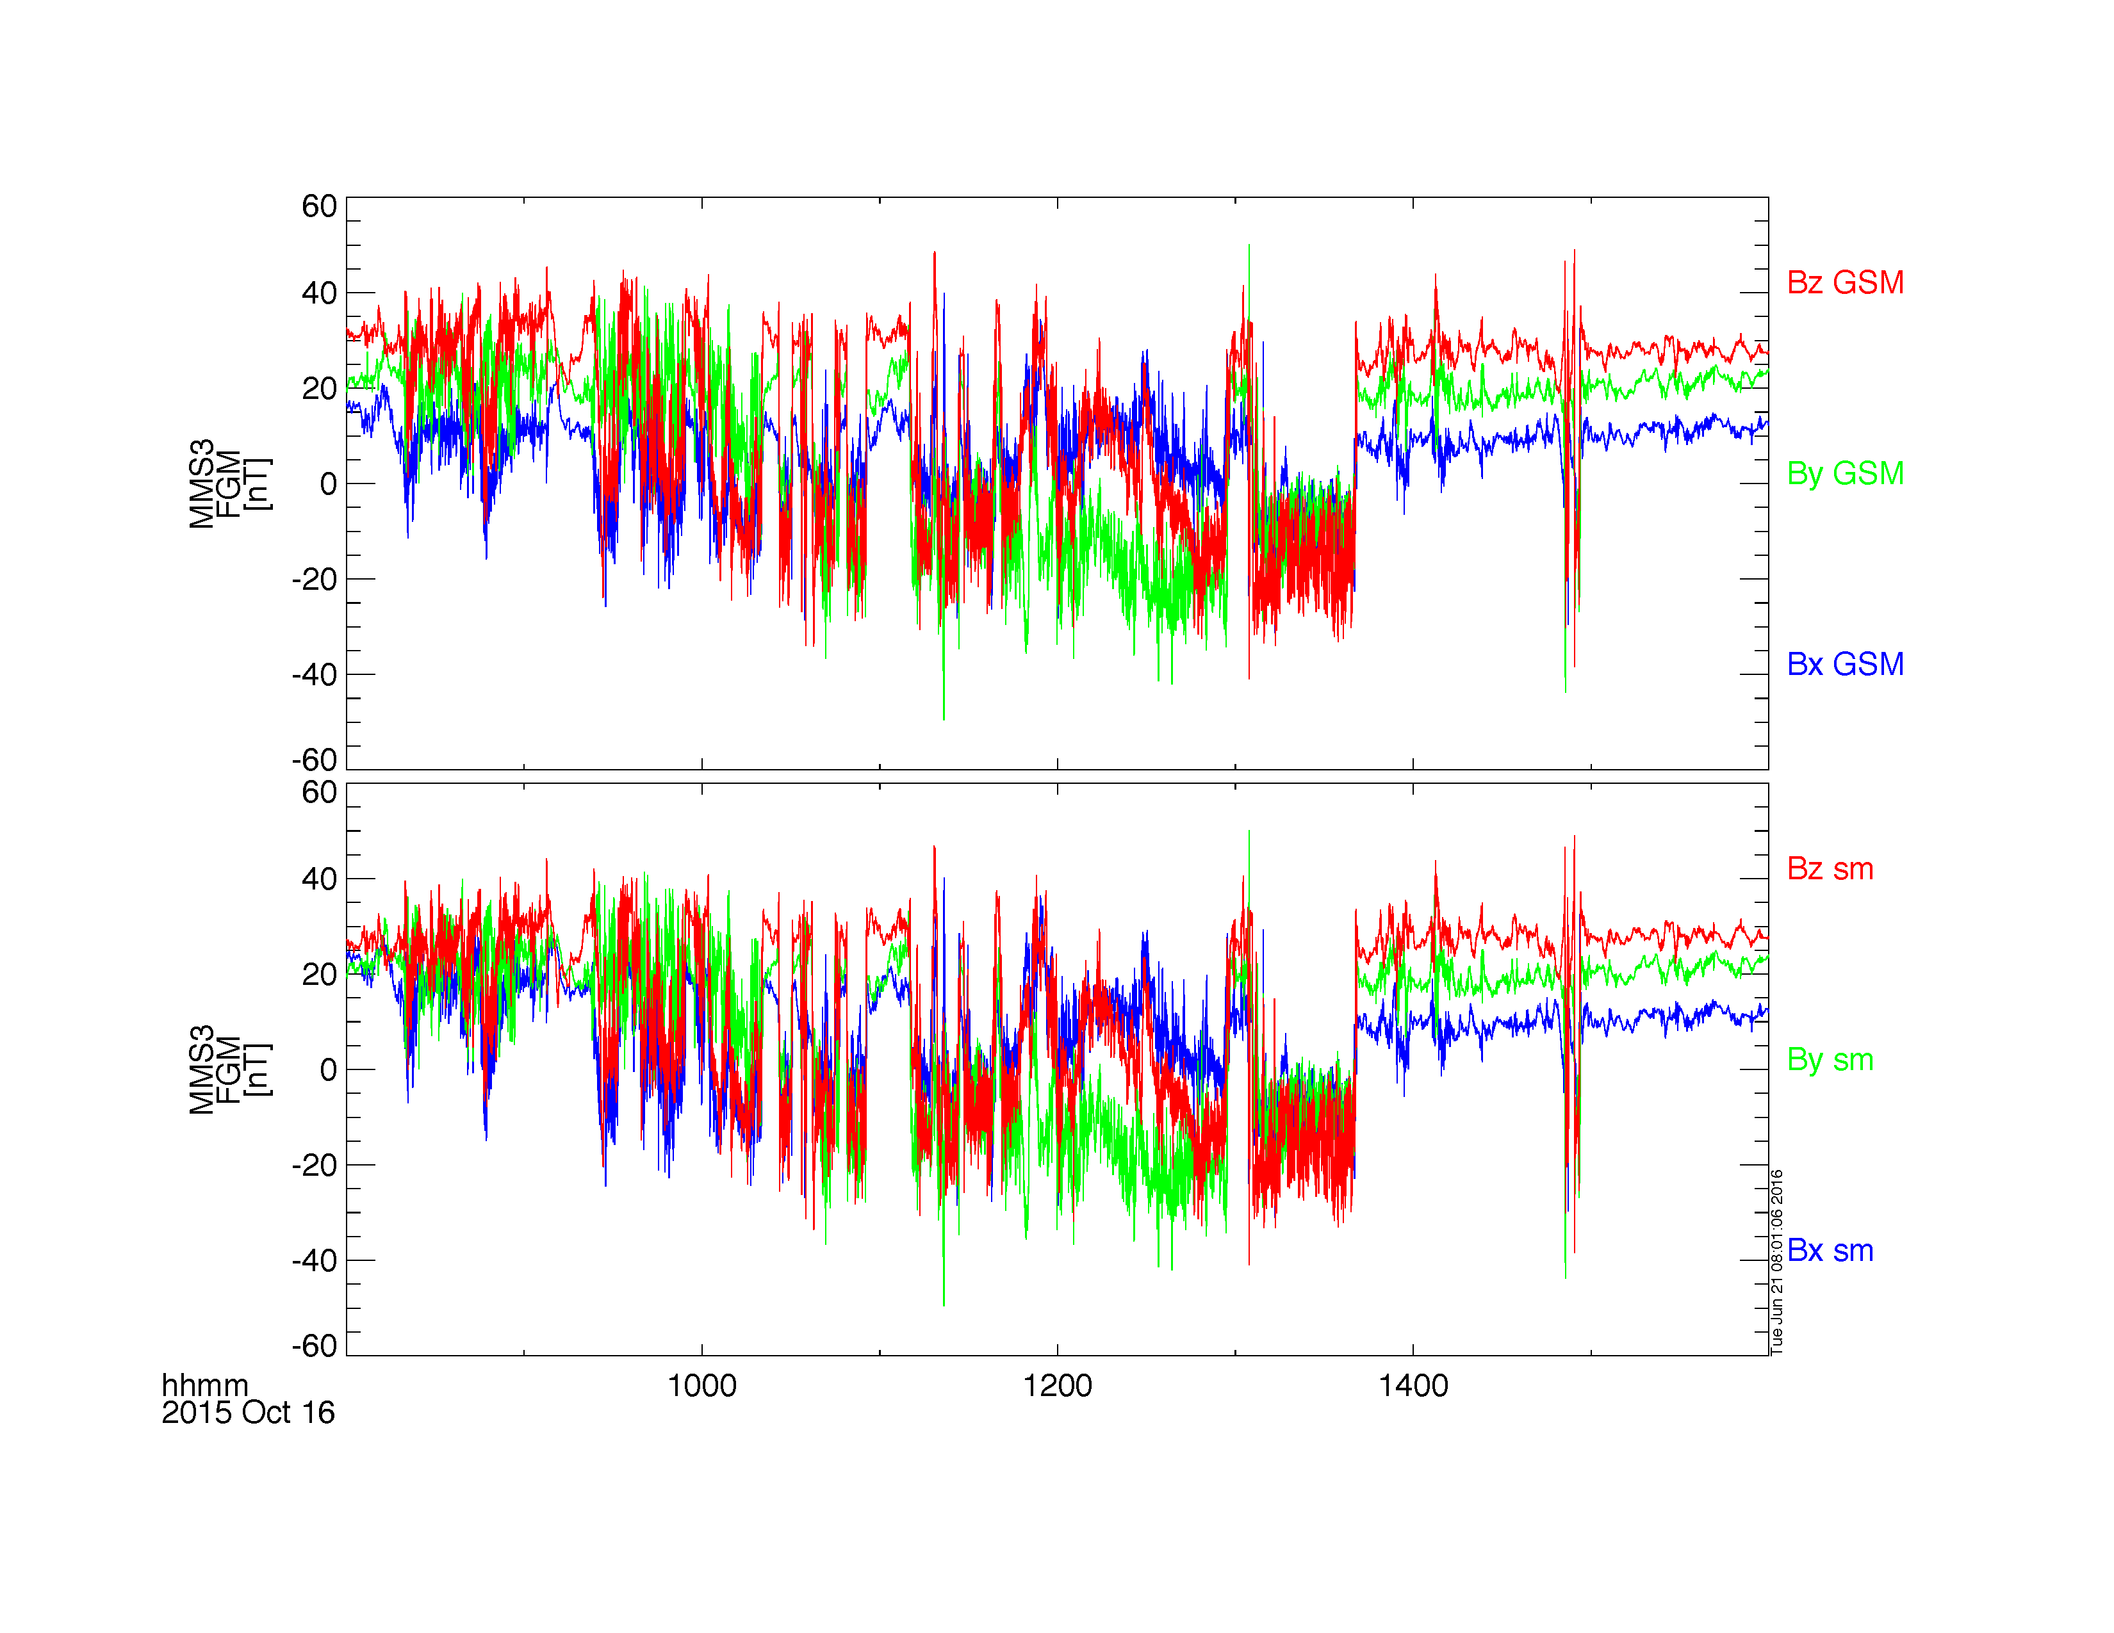
Analysis Tools
Coordinate Transformations
Getting Started
Loading and Plotting Data
Analysis Tools
Examples
Getting Help

Slide 42
Analysis Tools
Minimum Variance Analysis
Getting Started
Loading and Plotting Data
Analysis Tools
Examples
Getting Help
; load some FGM data
mms_load_fgm, probe=1, trange=['2015-10-16/08:00', '2015-10-16/16:00'], /time_clip
; create the minimum variance transformation matrix
minvar_matrix_make, 'mms1_fgm_b_gse_srvy_l2_bvec', newname='mva_matrix', $
tstart='2015-10-16/13:00', tstop='2015-10-16/13:10'
; rotate the B-field
tvector_rotate, 'mva_matrix', 'mms1_fgm_b_gse_srvy_l2_bvec', newname='mms1_fgm_b_gse_srvy_l2_bvec_mva'
; plot the vector in MVA coordinates
tplot, 'mms1_fgm_b_gse_srvy_l2_bvec_mva'
; save the plot to a postscript file
tprint, 'mms1_fgm_b_gse_srvy_l2_bvec_mva', /landscape

Slide 43
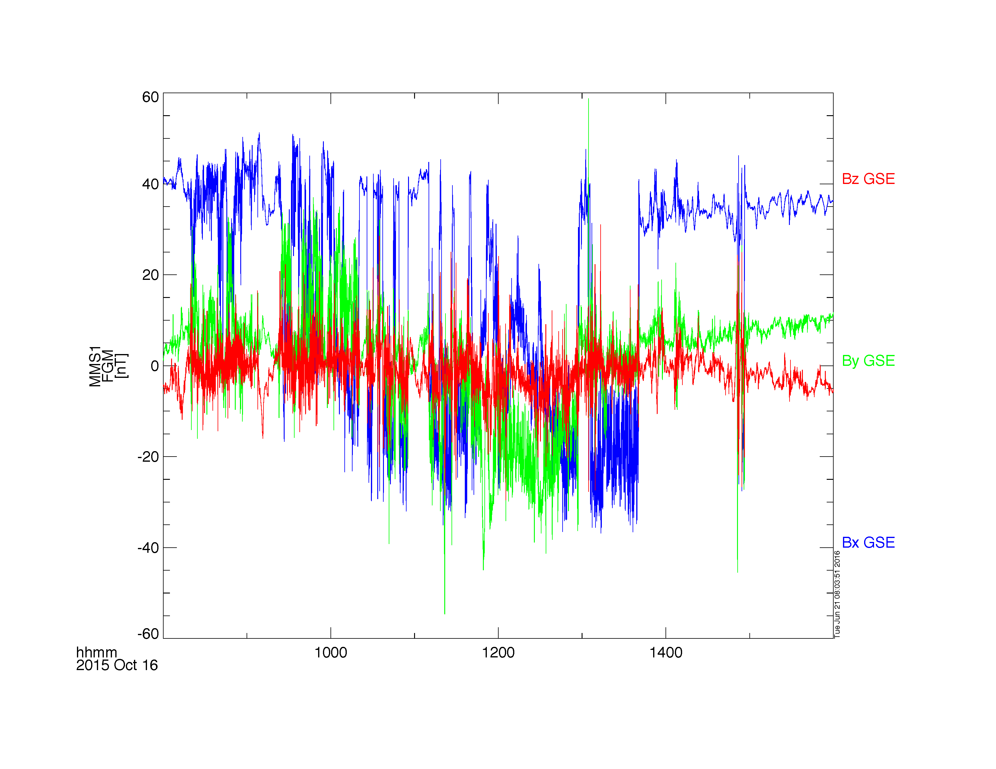
Analysis Tools
Minimum Variance Analysis
Getting Started
Loading and Plotting Data
Analysis Tools
Examples
Getting Help

Slide 44
Analysis Tools
Dynamic Power Spectra
Getting Started
Loading and Plotting Data
Analysis Tools
Examples
Getting Help
; load some SCM data
mms_load_scm, probe=1, trange=['2015-10-16/00:00', '2015-10-16/04:00']
; calculate the dynamic power spectra
tdpwrspc, 'mms1_scm_acb_gse_scsrvy_srvy_l2', nboxpoints=512,nshiftpoints=512,bin=1
; plot the dynamic power spectra
tplot, ['mms1_scm_acb_gse_scsrvy_srvy_l2_x_dpwrspc', $
'mms1_scm_acb_gse_scsrvy_srvy_l2_y_dpwrspc', $
'mms1_scm_acb_gse_scsrvy_srvy_l2_z_dpwrspc']
; save the plot to a postscript file
tprint, 'mms1_scm_acb_gse_scsrvy_l2_dpwrspc', /landscape

Slide 45
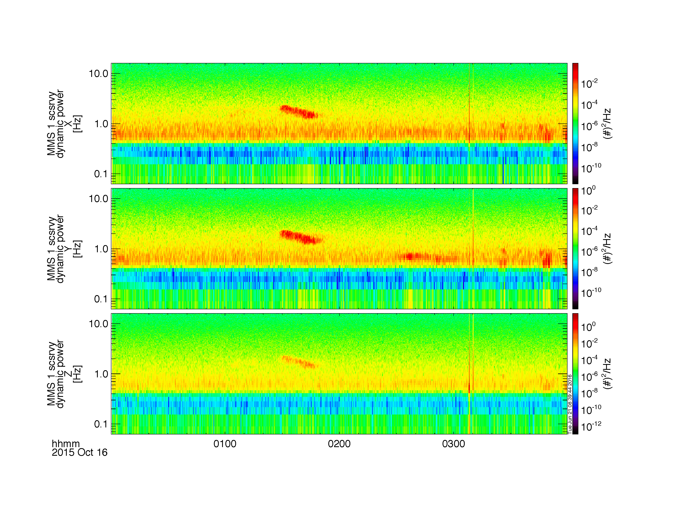
Analysis Tools
Dynamic Power Spectra
Getting Started
Loading and Plotting Data
Analysis Tools
Examples
Getting Help

Slide 46
Analysis Tools
Spectra from FPI Distributions
Getting Started
Loading and Plotting Data
Analysis Tools
Examples
Getting Help
; calculate the electron energy spectra from the FPI distribution functions
mms_part_getspec, instrument='fpi', probe=1, species='e', trange=['2015-10-16/04:00', '2015-10-16/06:00'], outputs=['energy']
; plot the spectra
tplot, 'mms1_des_dist_fast_energy'
; save the plot to a postscript file
tprint, 'mms1_des_dist_fast_energy', /landscape

Slide 47
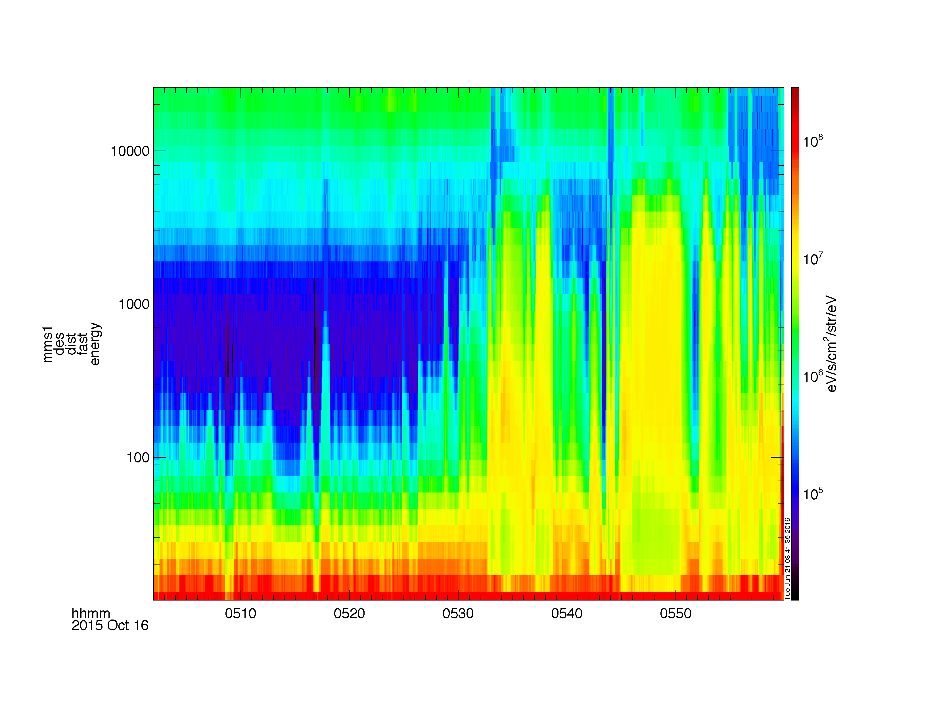
Analysis Tools
Spectra from FPI Distributions
Getting Started
Loading and Plotting Data
Analysis Tools
Examples
Getting Help

Slide 48
Analysis Tools
Spectra from HPCA Distributions
Getting Started
Loading and Plotting Data
Analysis Tools
Examples
Getting Help
; we can do the same thing with the HPCA distribution functions
mms_part_getspec, instrument='hpca', probe=2, species='hplus', trange=['2015-10-16/04:00', '2015-10-16/06:00'], outputs=['energy']
tplot, 'mms2_hpca_hplus_phase_space_density_energy'
; save the plot to a postscript file
tprint, 'mms2_hpca_hplus_phase_space_density_energy', /landscape

Slide 49
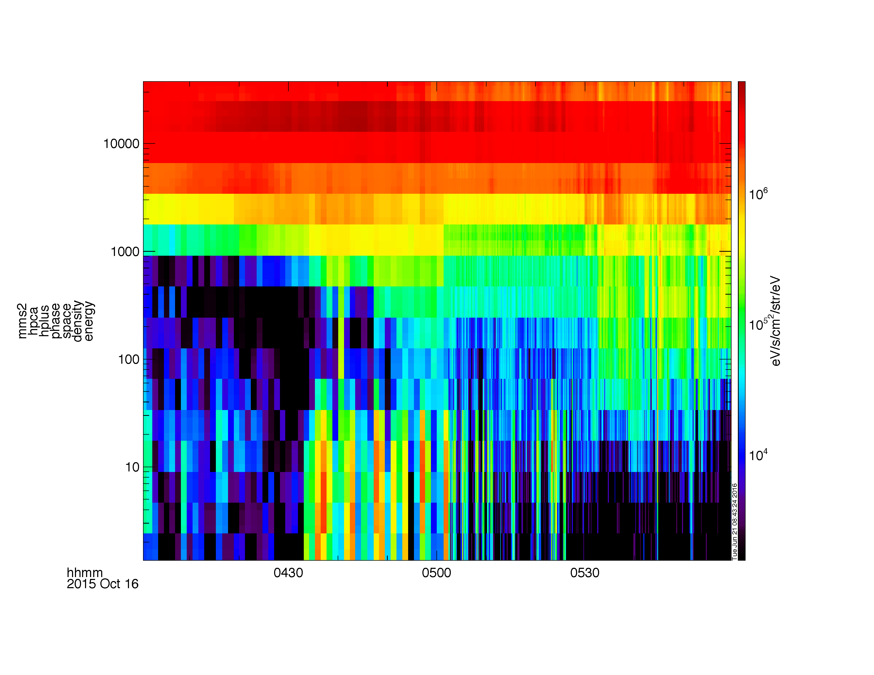
Analysis Tools
Spectra from HPCA Distributions
Getting Started
Loading and Plotting Data
Analysis Tools
Examples
Getting Help

Slide 50
Analysis Tools
2D Particle Slices
Getting Started
Loading and Plotting Data
Analysis Tools
Examples
Getting Help
; load some burst mode FPI data
mms_load_fpi, data_rate='brst', datatype='dis-dist', probe=1, trange=['2015-10-16/13:06', '2015-10-16/13:07']
; reformat data from tplot variable into compatible 3D structures
dist = mms_get_dist('mms1_dis_dist_brst', trange=['2015-10-16/13:06', '2015-10-16/13:07'])
; get the single distribution
slice = spd_slice2d(dist, time='2015-10-16/13:06:00') ;3D interpolation
; plot the slice
spd_slice2d_plot, slice

Slide 51
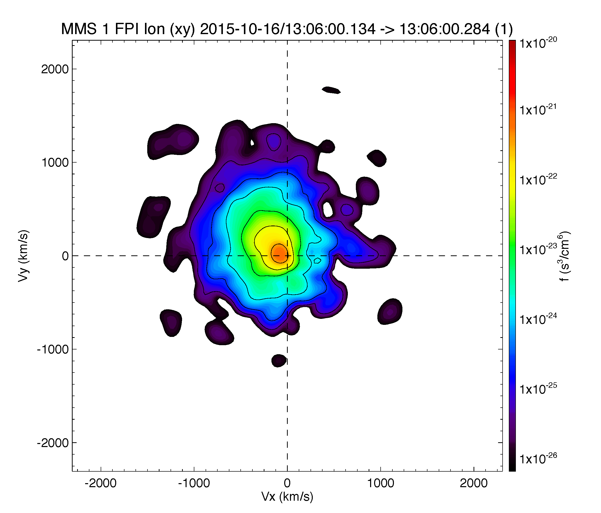
Analysis Tools
2D Particle Slices
Getting Started
Loading and Plotting Data
Analysis Tools
Examples
Getting Help

Slide 52
Analysis Tools
Visualizing the Distributions in 3D
Getting Started
Loading and Plotting Data
Analysis Tools
Examples
Getting Help
trange = ['2015-10-20/05:56:30', '2015-10-20/05:56:34']
;get +- 60 seconds of support data (FGM and FPI velocity)
support_trange= time_double(trange) + [-60,60]
; load the FPI electron distribution data
mms_load_fpi, probe=1, trange=trange, data_rate='brst', datatype='des-dist'
; load data into standard structures
dist = mms_get_fpi_dist('mms1_des_dist_brst', trange=trange)
; convert structures to isee_3d data model
data = spd_dist_to_hash(dist)
; load B-field (cyan vector) and velocity (yellow vector) support data
mms_load_fgm, probe=1, trange=support_trange
mms_load_fpi, data_rate='brst', datatype='des-moms', probe=1, trange=support_trange
; Once GUI is open select PSD from Units menu
isee_3d, data=data, trange=trange, bfield= 'mms1_fgm_b_gse_srvy_l2_bvec', velocity='mms1_des_bulkv_dbcs_brst'

Slide 53
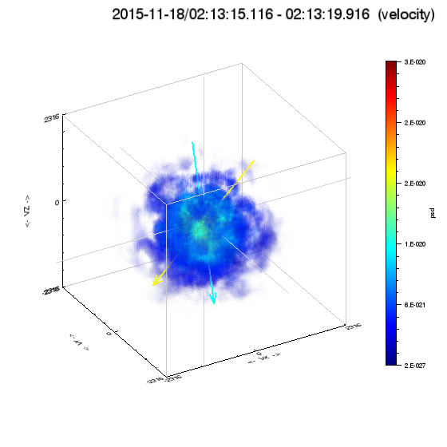
Analysis Tools
Visualizing the Distributions in 3D
Getting Started
Loading and Plotting Data
Analysis Tools
Examples
Getting Help

Slide 54
Examples
Where to find more examples?
Getting Started
Loading and Plotting Data
Analysis Tools
Examples
Getting Help
/projects/mms/examples/basic/
Basic examples for each load routine; this is a good place for new users to start
/projects/mms/examples/advanced/
Examples showing more advanced functionality of the plugin
/projects/mms/examples/quicklook/
Scripts that create the QL plots at the SDC; note: these require MMS team member access to the SDC to run

Slide 55
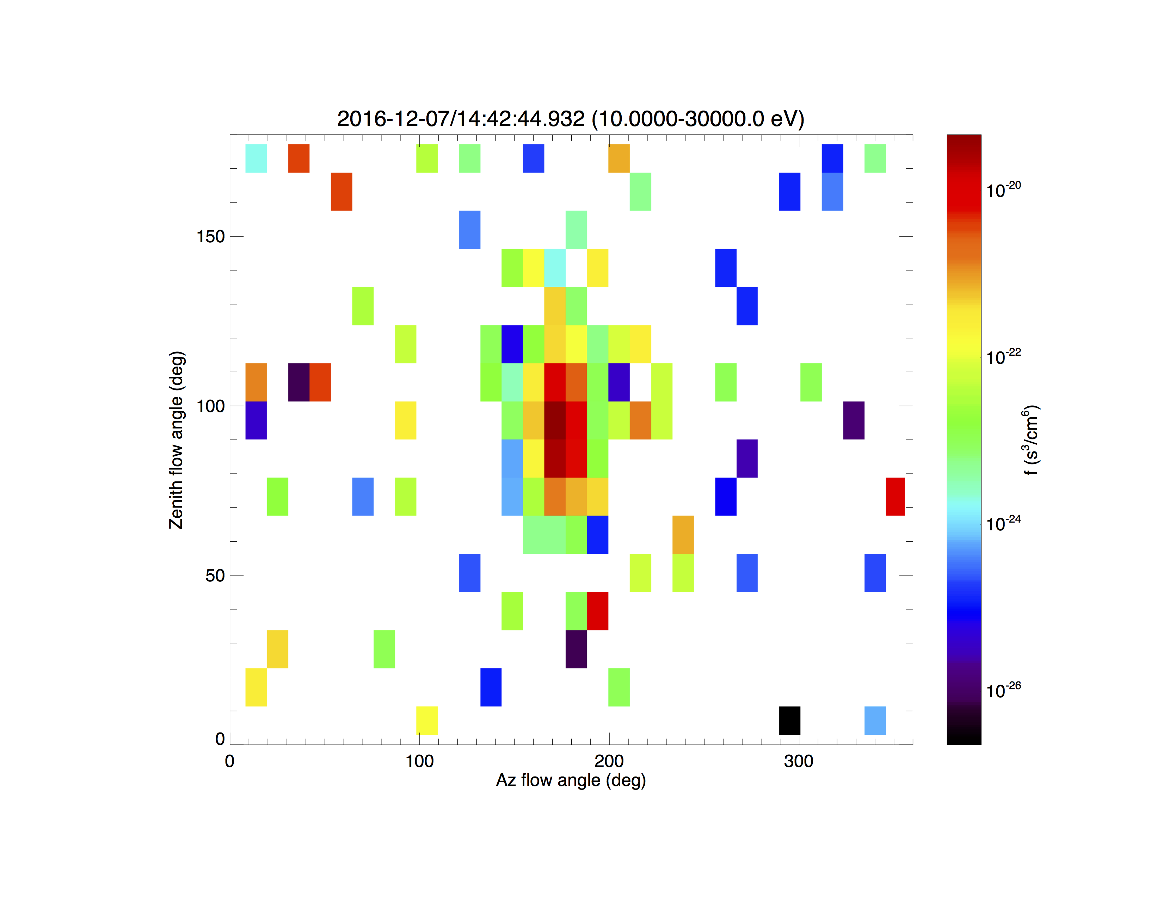
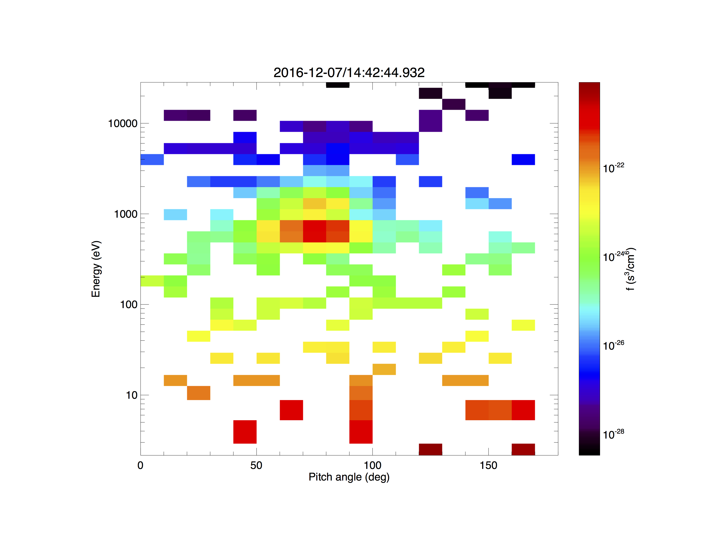
Getting Started
Loading and Plotting Data
Analysis Tools
Examples
Getting Help
MMS FPI angle-angle, PA-energy Plots
/projects/mms/examples/basic/mms_fpi_angle_angle_crib.pro
mms_fpi_ang_ang, '2016-12-07/14:42:45', species='i', data_rate='brst'

Slide 56
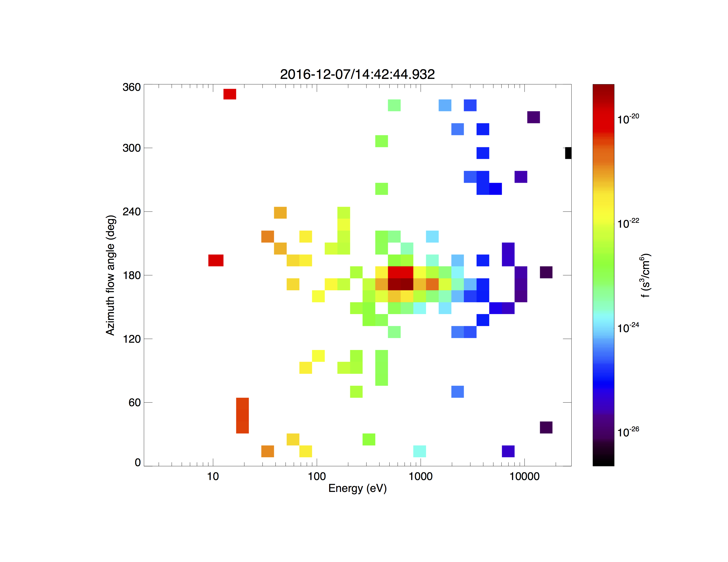
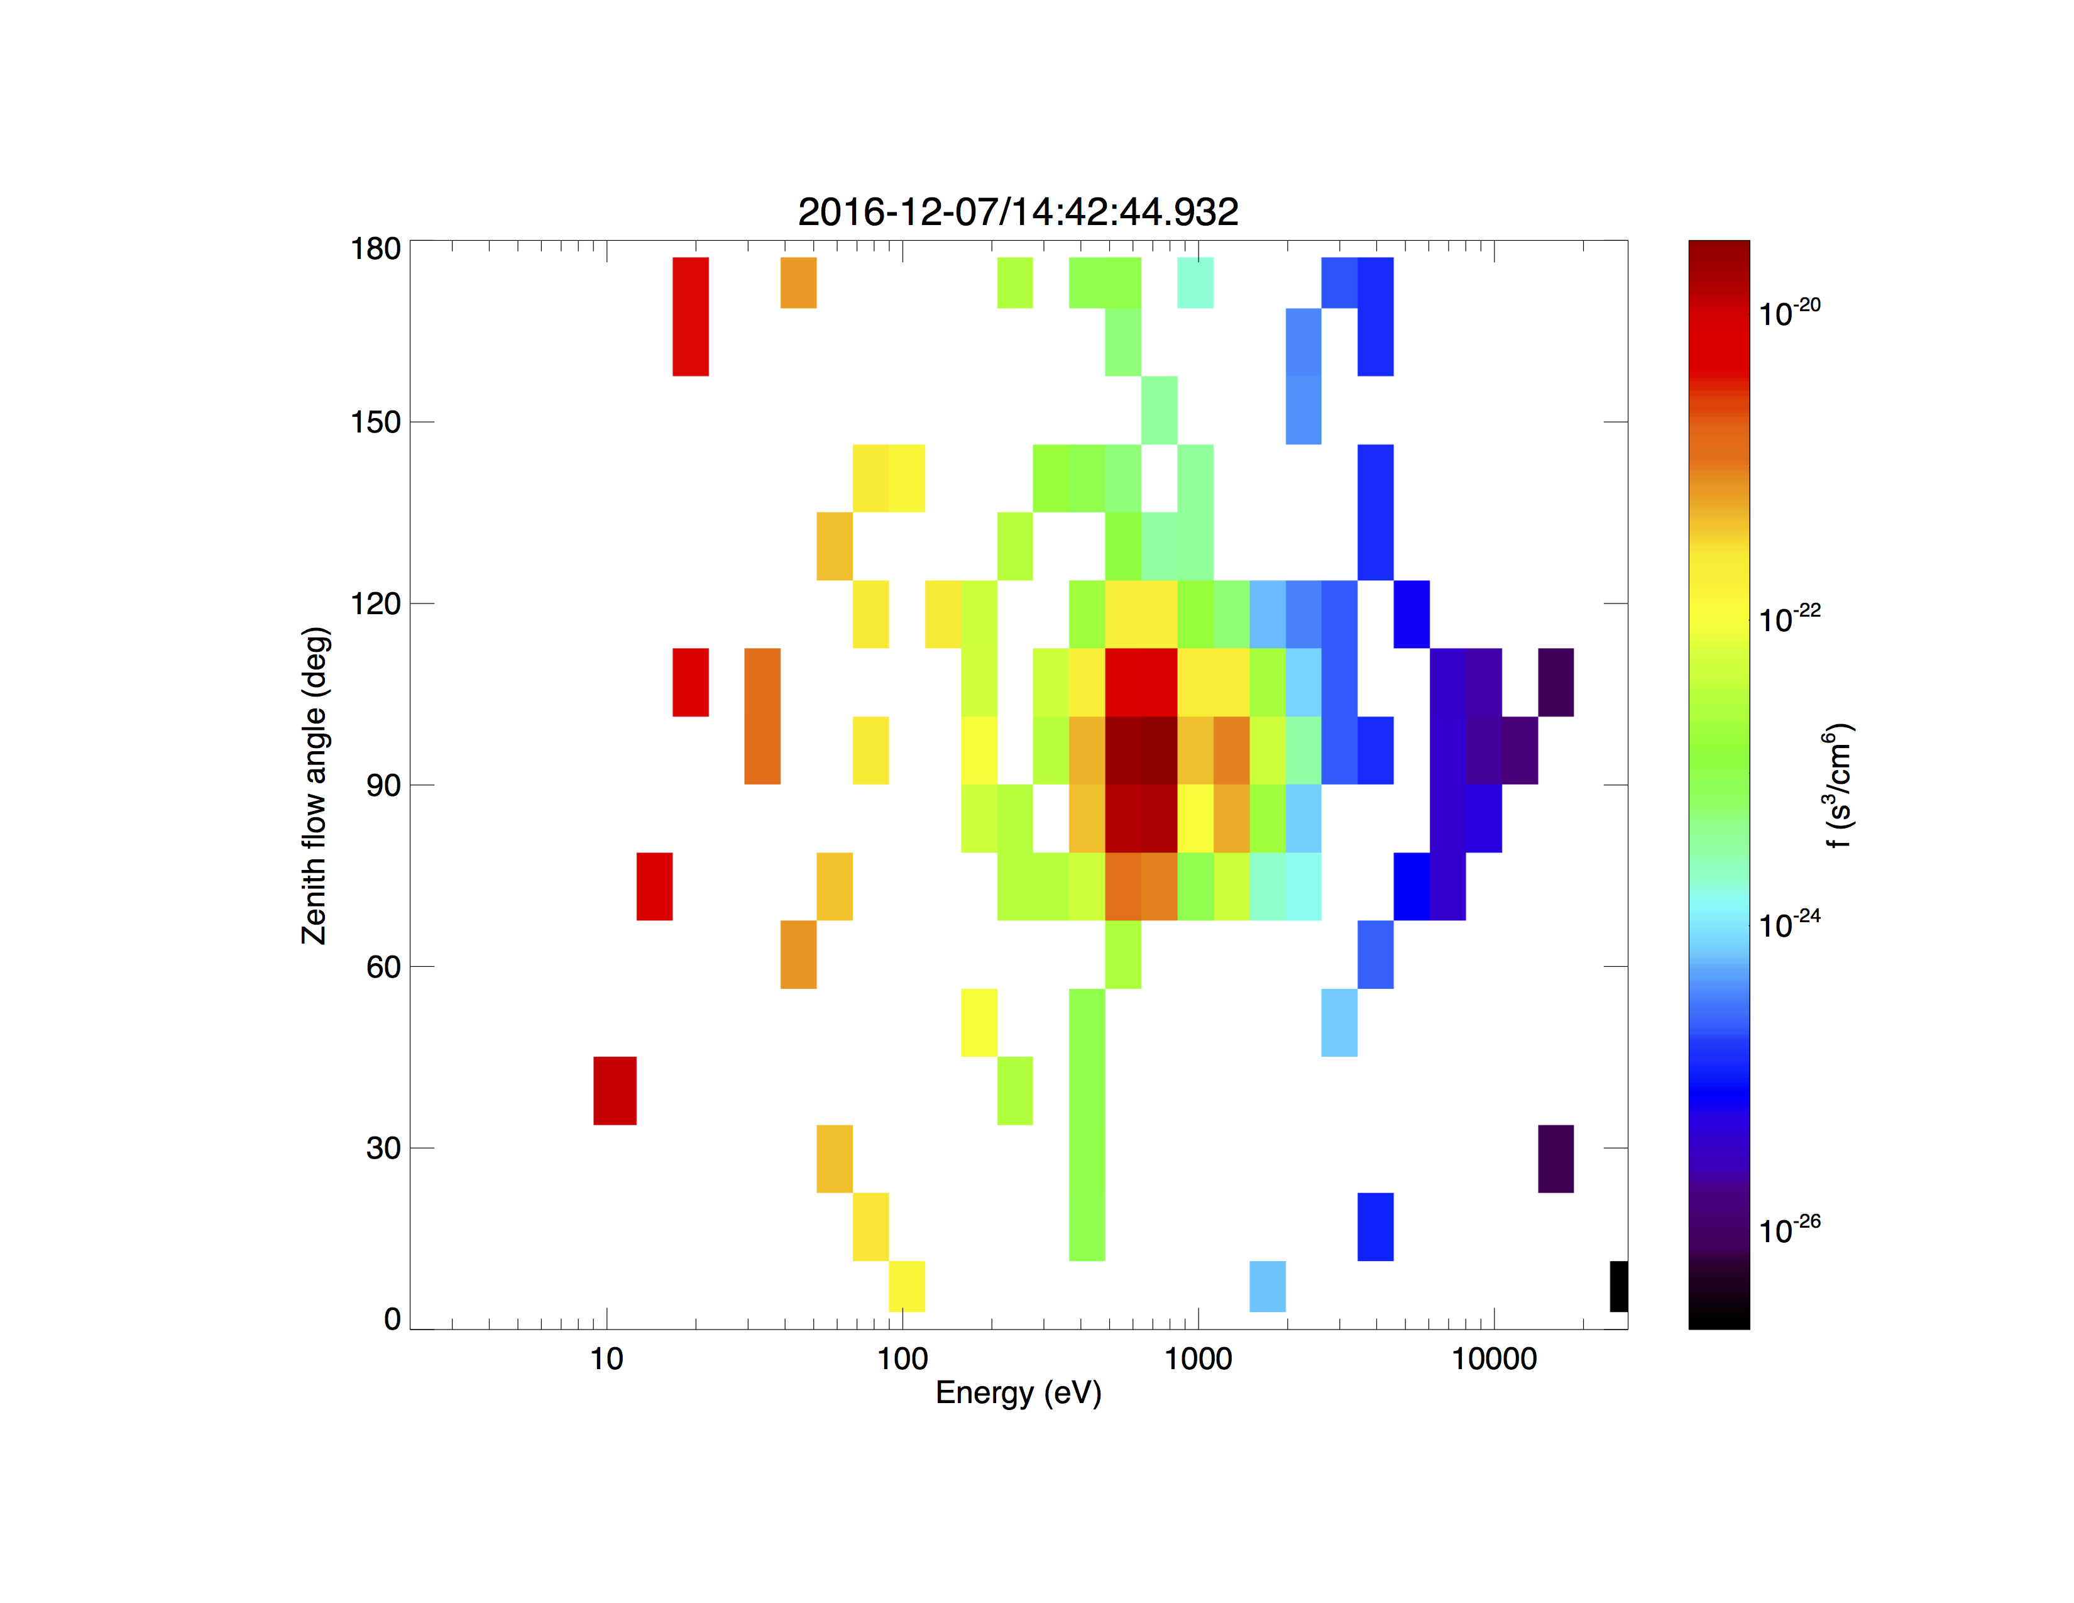
Getting Started
Loading and Plotting Data
Analysis Tools
Examples
Getting Help
MMS FPI angle-energy Plots
/projects/mms/examples/basic/mms_fpi_angle_angle_crib.pro
mms_fpi_ang_ang, '2016-12-07/14:42:45', species='i', data_rate='brst'

Slide 57
Getting Started
Loading and Plotting Data
Analysis Tools
Examples
Getting Help
MMS EIS angle-angle Plots
/projects/mms/examples/basic/mms_eis_angle_angle_crib.pro
; to plot the angle-angle plots for EIS, use the following tool
; developed by Ian Cohen and Joe Westlake at JHU/APL
eis_ang_ang, probe='1', trange=['2015-12-15/13:00', '2015-12-15/13:10'], energy_chan=[1, 2, 3, 4]

Slide 58
Getting Started
Loading and Plotting Data
Analysis Tools
Examples
Getting Help
MMS EIS angle-angle Plots
/projects/mms/examples/basic/mms_eis_angle_angle_crib.pro

Slide 59
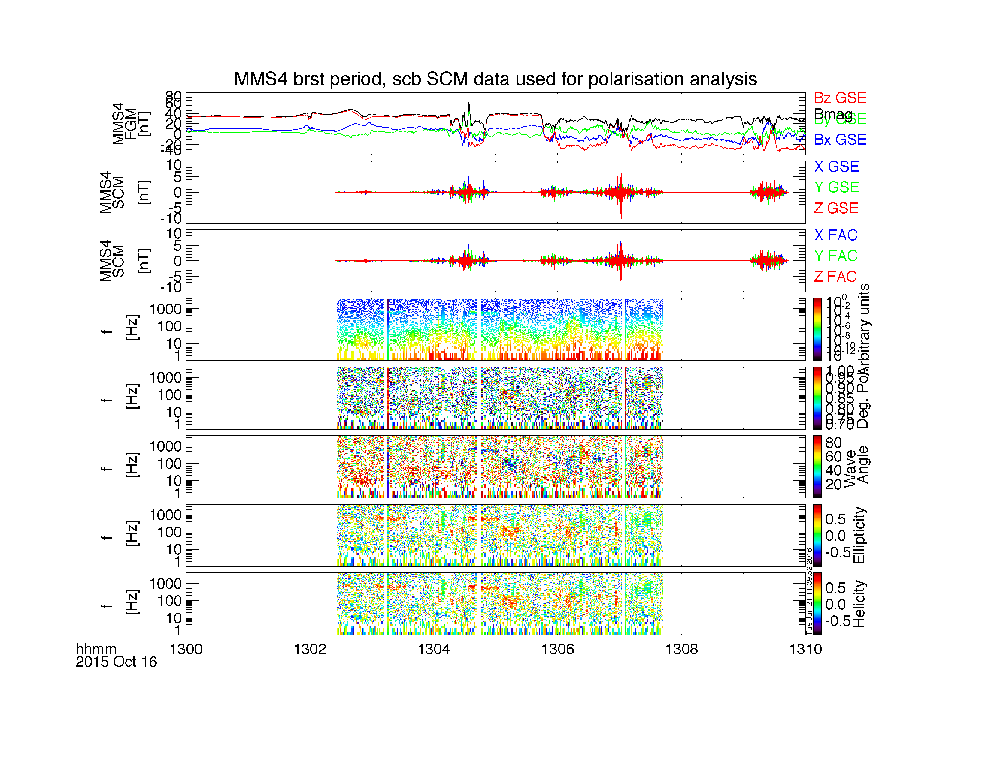
Getting Started
Loading and Plotting Data
Analysis Tools
Examples
Getting Help
MMS Wave Polarization Analysis
/projects/mms/examples/advanced/mms_wavpol_crib.pro

Slide 60
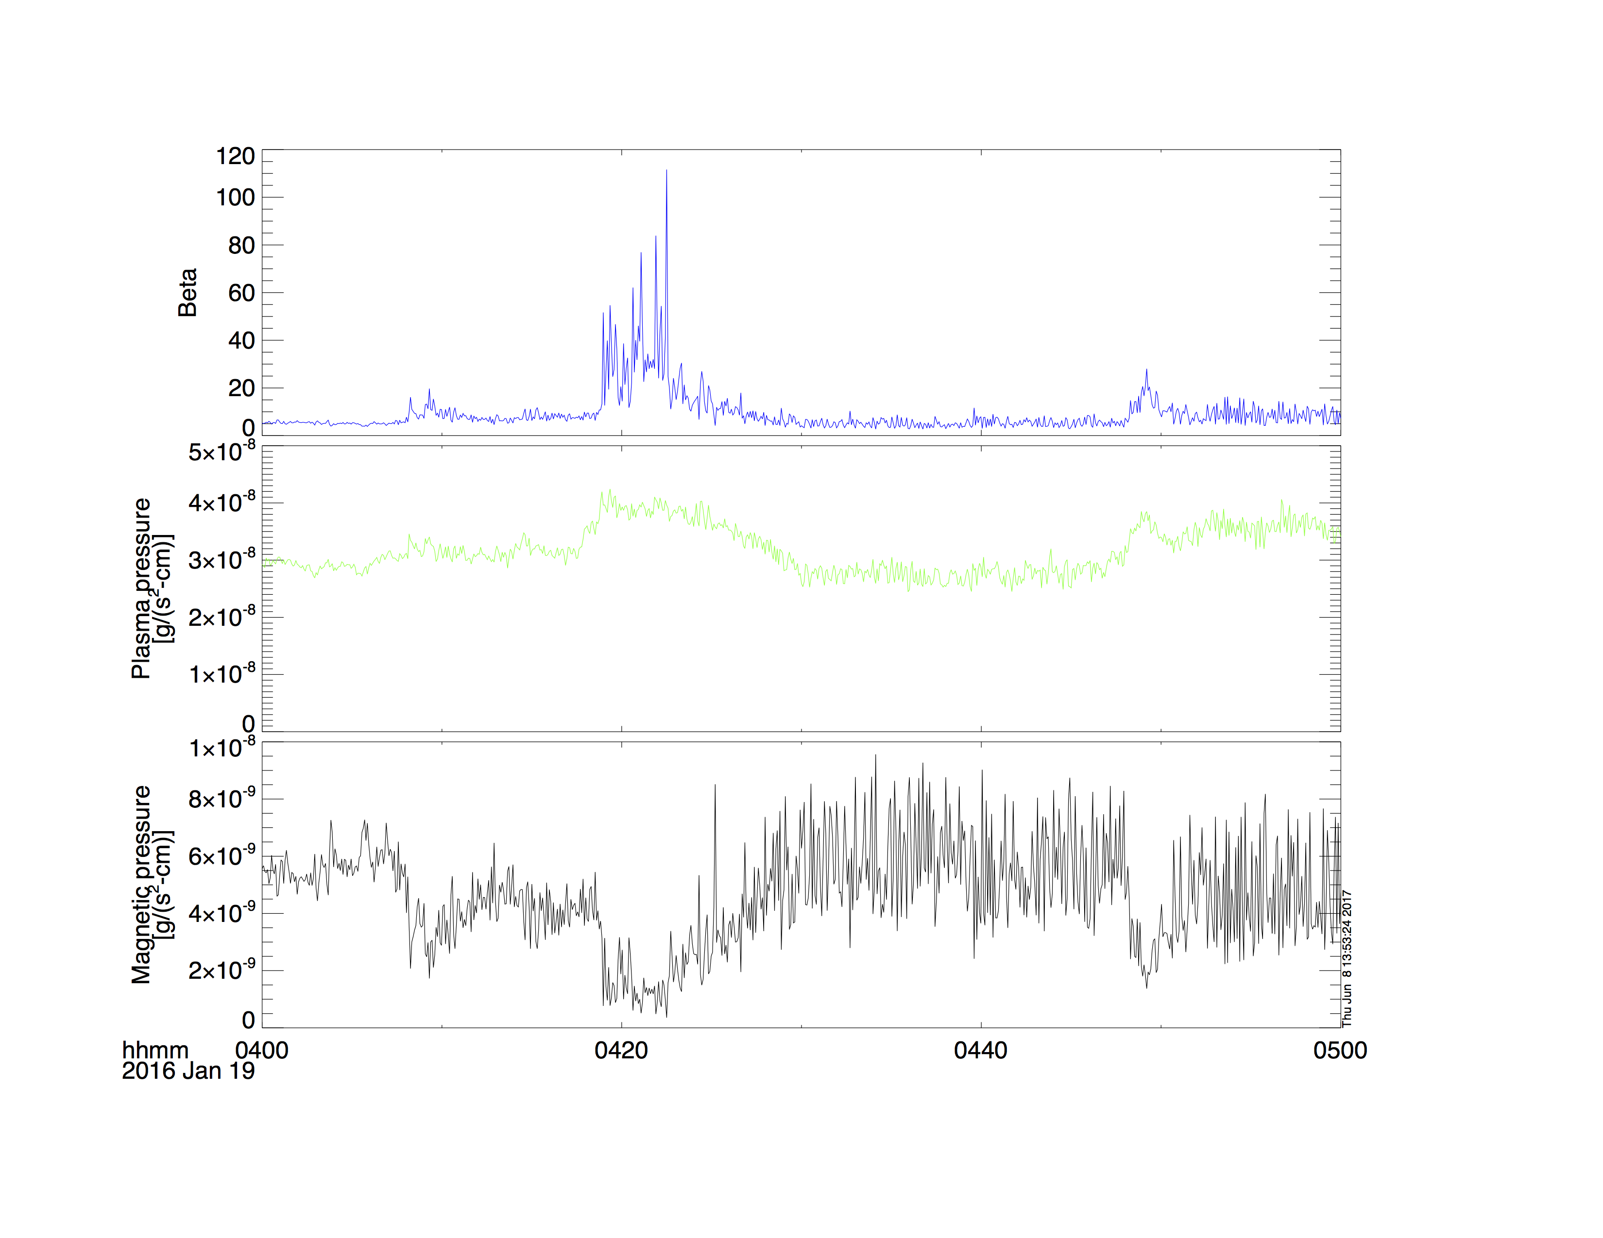
Getting Started
Loading and Plotting Data
Analysis Tools
Examples
Getting Help
MMS Plasma Beta Calculation
/projects/mms/examples/basic/mms_plasma_beta_crib.pro

Slide 61
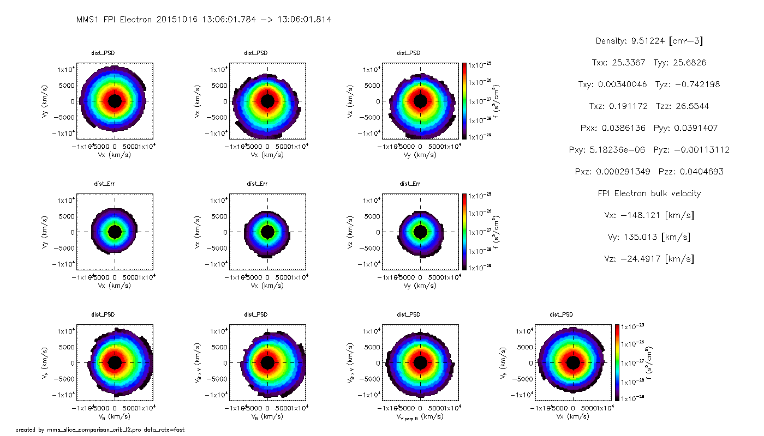
Getting Started
Loading and Plotting Data
Analysis Tools
Examples
Getting Help
MMS FPI Distribution Slices
/projects/mms/examples/advanced/mms_fpi_dist_slice_comparison_crib_l2.pro

Slide 62
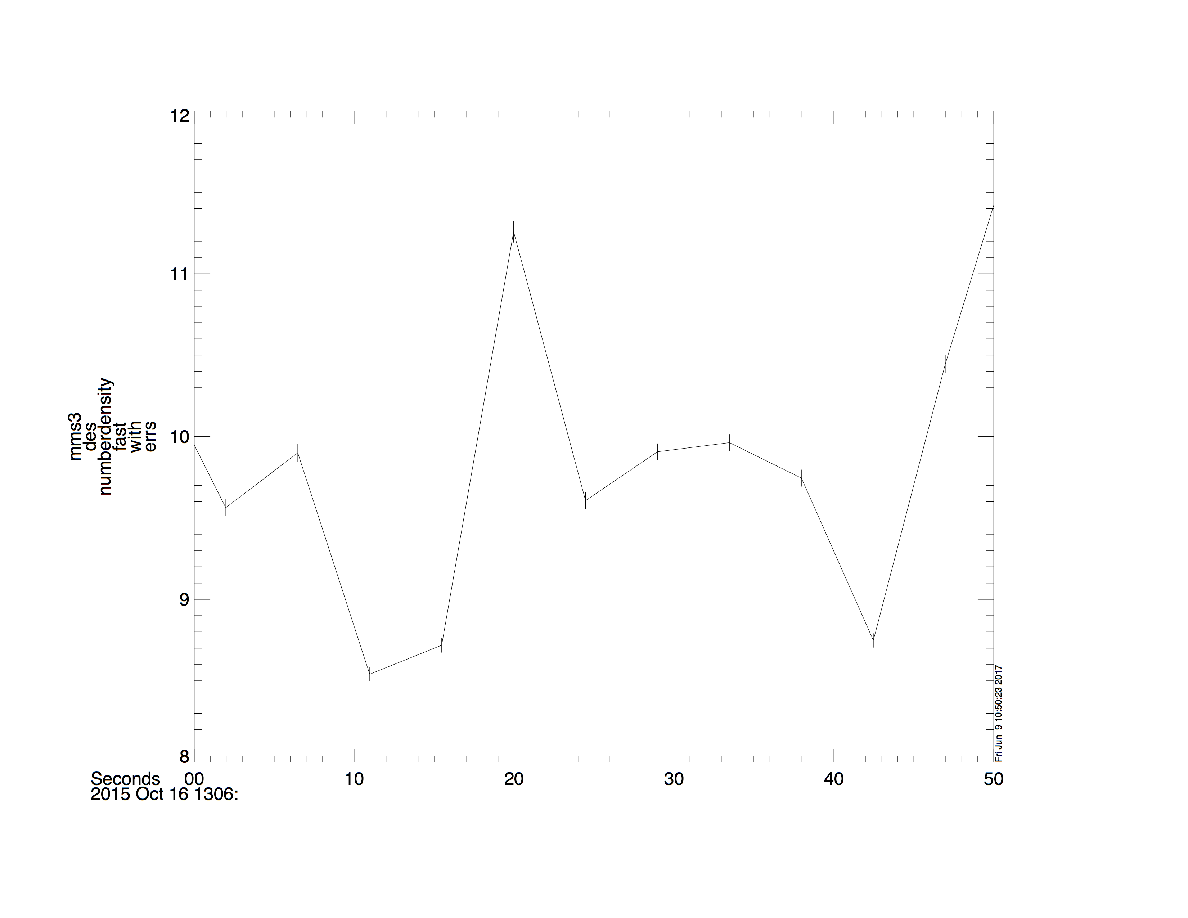
Getting Started
Loading and Plotting Data
Analysis Tools
Examples
Getting Help
MMS FPI Error Bars
/projects/mms/examples/basic/mms_error_bars_crib.pro

Slide 63
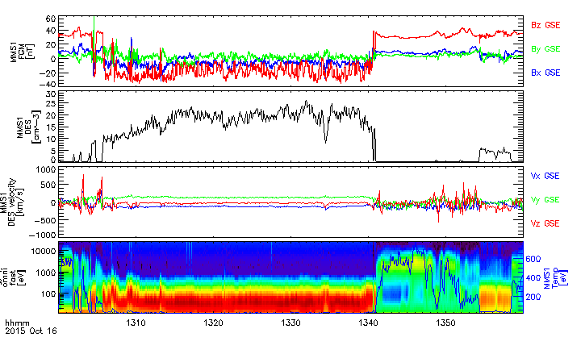
Getting Started
Loading and Plotting Data
Analysis Tools
Examples
Getting Help
MMS Multi-Axis Figures
/projects/mms/examples/advanced/mms_multi_axis_figure.pro

Slide 64
Getting Help
Getting Started
Loading and Plotting Data
Analysis Tools
Examples
Getting Help
SPEDAS Forum
SPEDAS Wiki
Ask Eric
https://groups.google.com/forum/#!forum/spedas
http://spedas.org/wiki/
egrimes@igpp.ucla.edu

Slide 65
Getting Help
Download
Getting Started
Loading and Plotting Data
Analysis Tools
Examples
Getting Help
Download this presentation:
http://spedas.org/mms/mms_gem_2017.pdf
Download the code in this presentation:
http://spedas.org/mms/mms_gem_2017.pro

Slide 66
SPEDAS
Other Useful Crib Sheets
Getting Started
Loading and Plotting Data
Analysis Tools
Examples
Getting Help
general/examples/crib_tplot.pro
general/examples/crib_tplot_annotation.pro
general/examples/crib_tplot_layout.pro
general/examples/crib_tplot_range.pro
general/examples/crib_tplot_ticks.pro
general/examples/crib_dproc.pro

