Slide 1
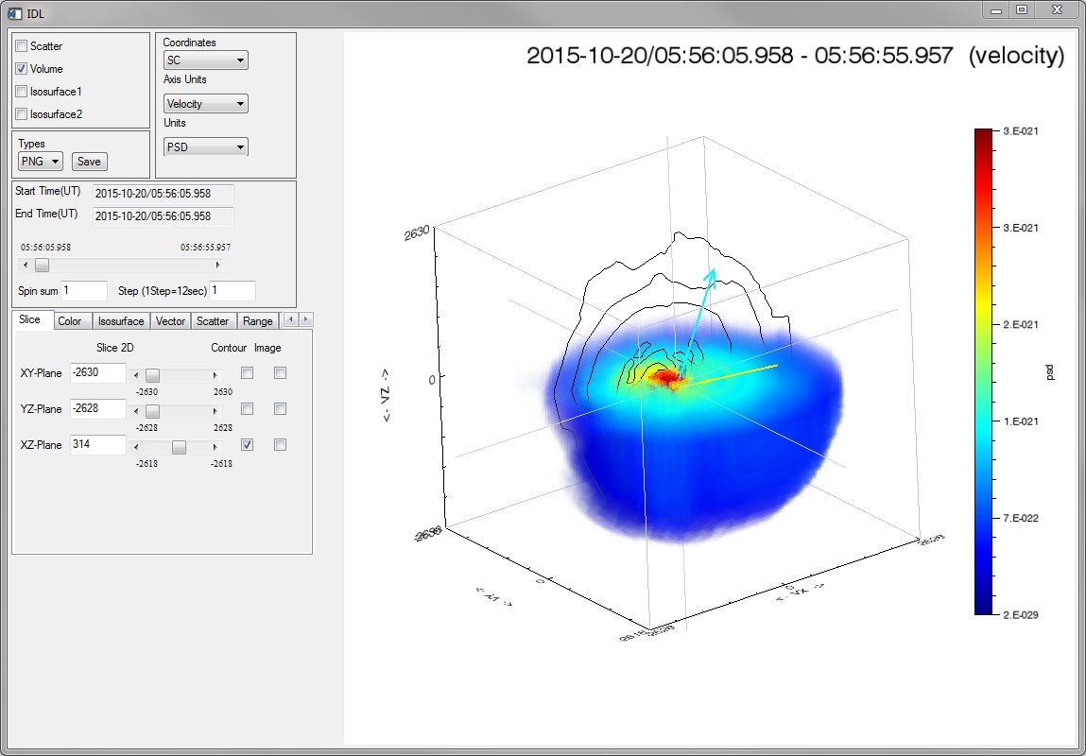
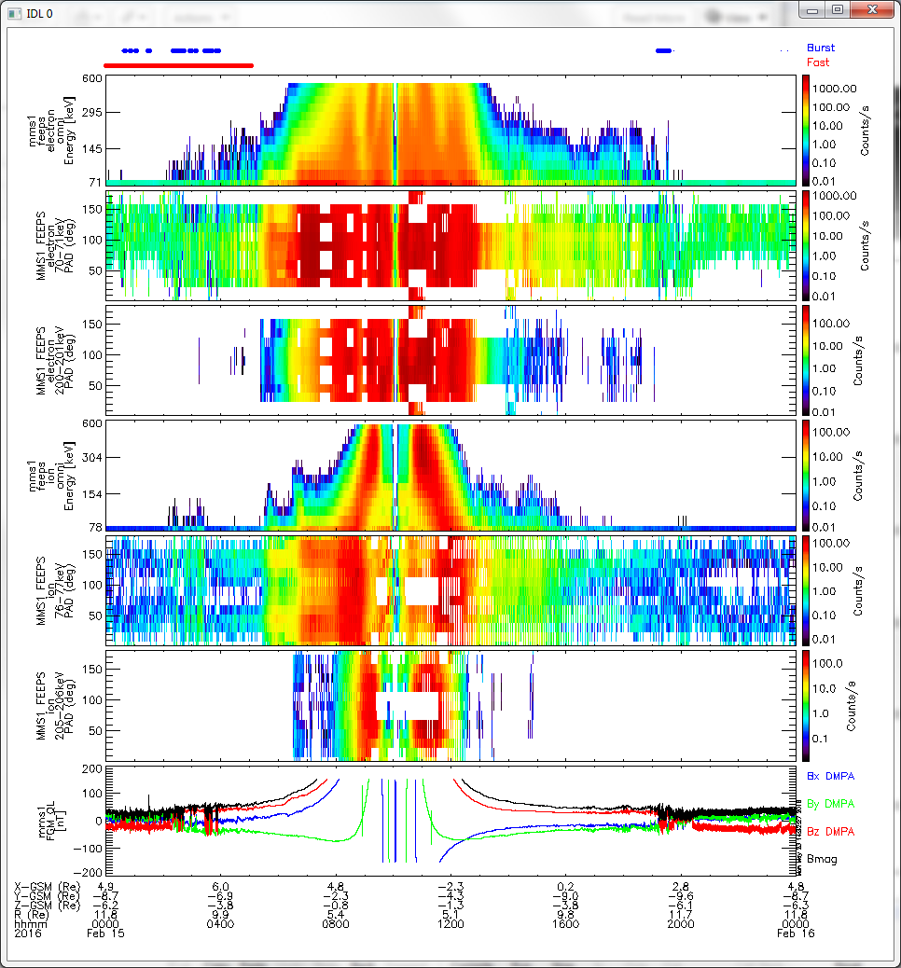
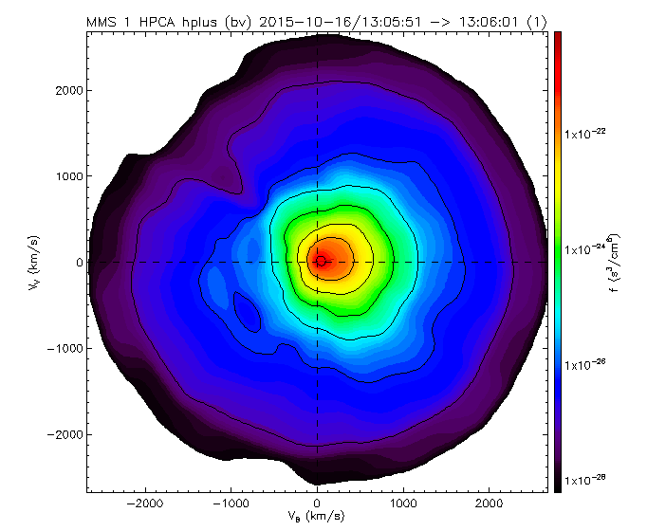
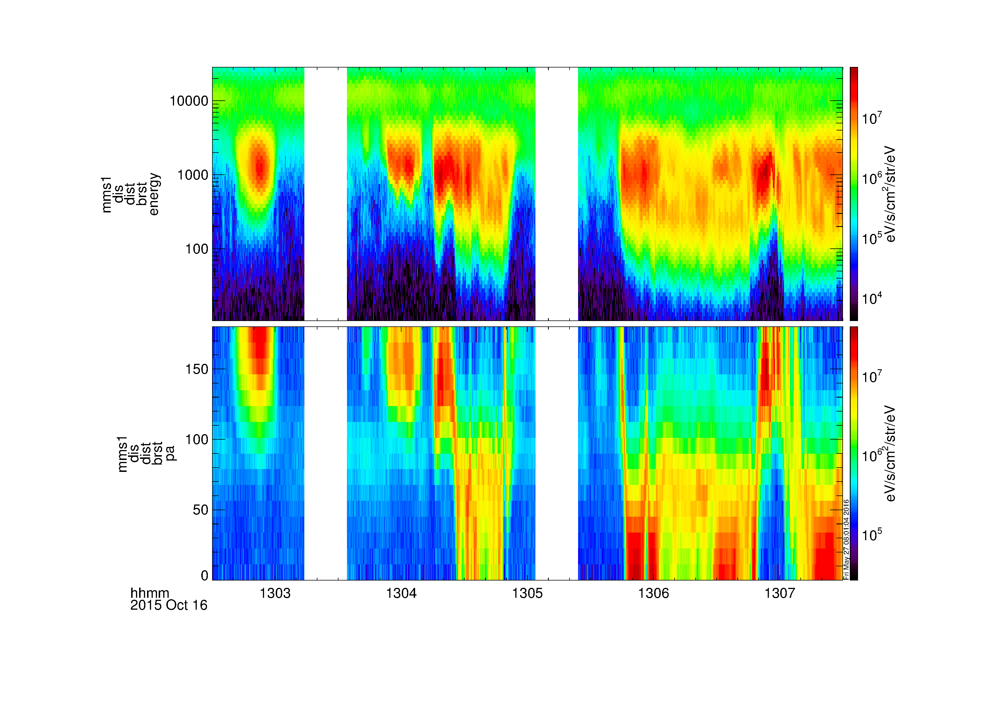
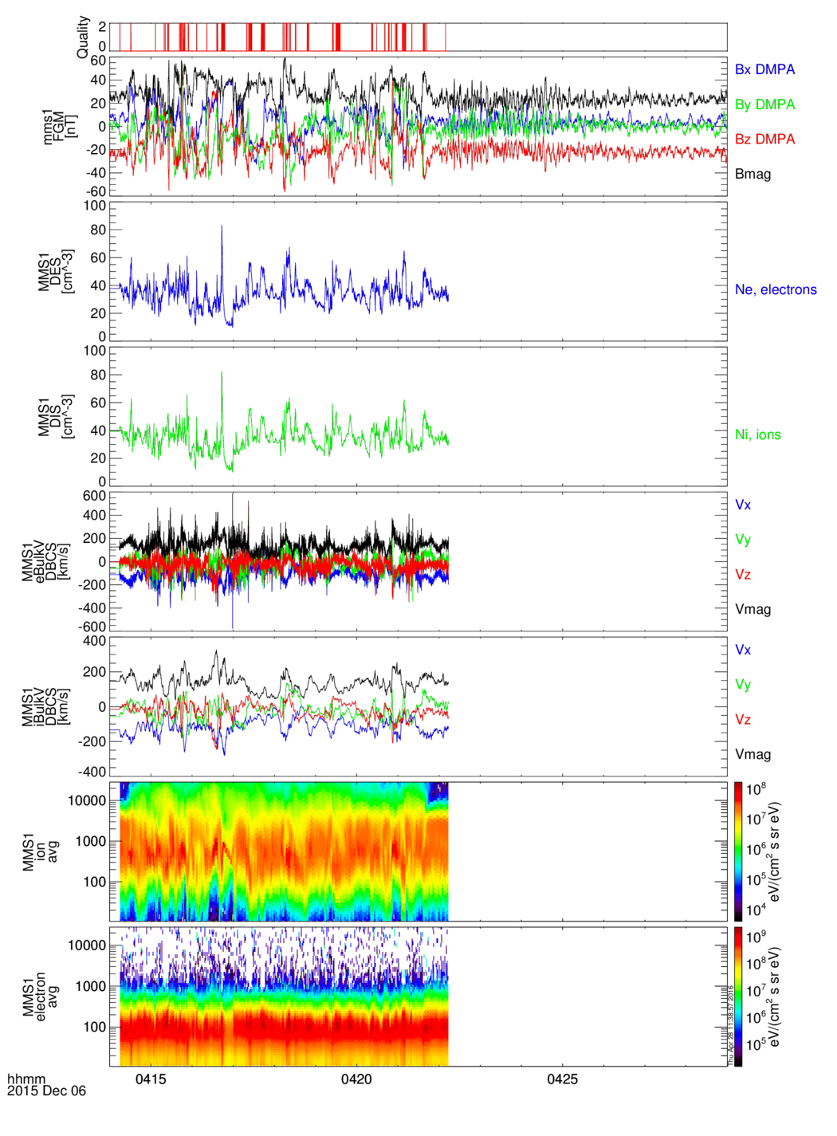
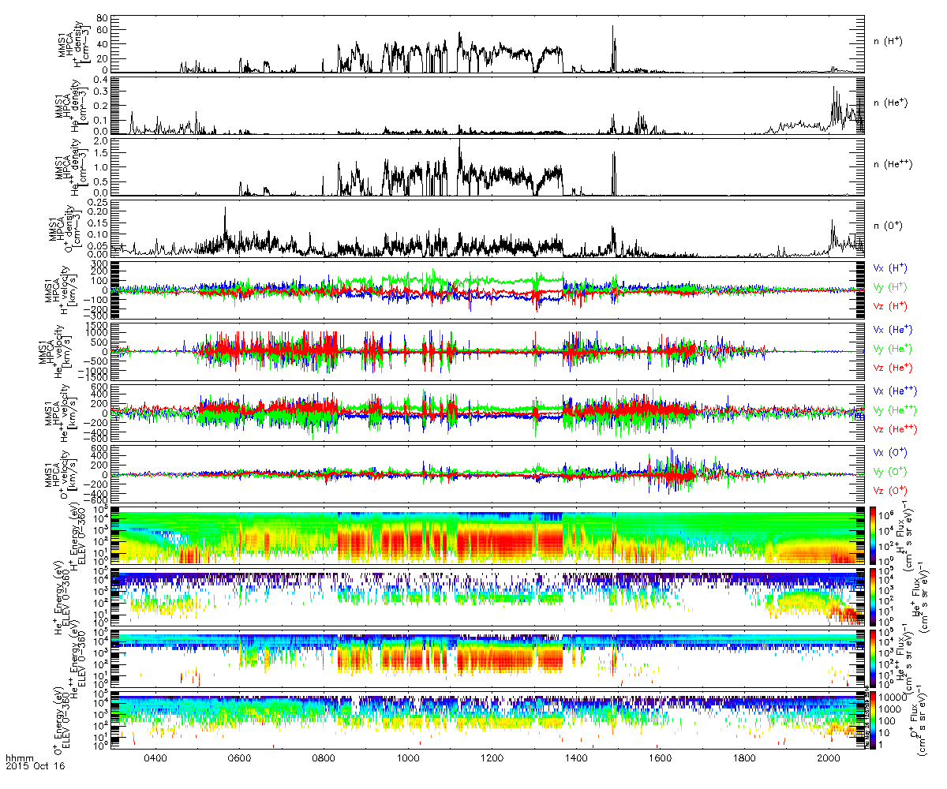
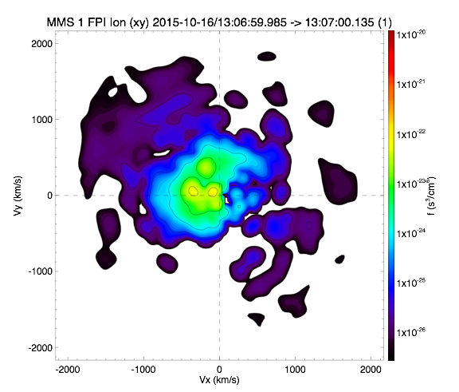
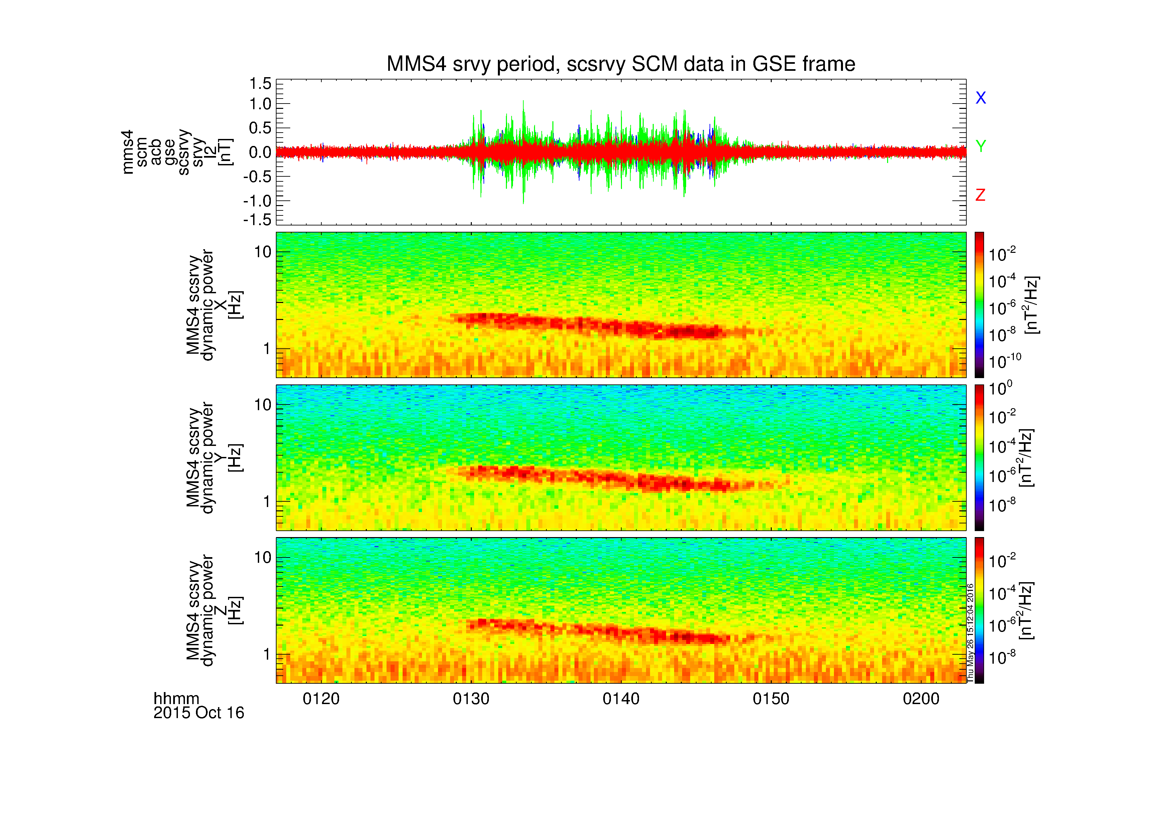
MMS plug-ins for SPEDAS
Access, analysis and visualization, in
conjunction with other Heliophysics assets

Slide 2
MMS plug-ins for SPEDAS
Introduction
Examples
The Graphical User Interface (GUI)
Getting Help

Slide 3
Introduction
Requirements
Windows, Linux, OS X, or Solaris
IDL 8.2.3+
IDL CDF Library 3.6+
Installation
http://spedas.org/wiki/index.php?title=Downloads_and_Installation
Documentation
http://spedas.org/ (click “SPEDAS wiki”)

Slide 4
Introduction
mms_load_fgm | Fluxgate Magnetometer
mms_load_scm | Search-coil Magnetometer
mms_load_mec | Ephemeris and Coordinates
mms_load_fpi | Fast Plasma Investigation
mms_load_hpca | Hot Plasma Composition Analyzer
mms_load_eis | Energetic Ion Spectrometer
mms_load_feeps | Fly’s Eye Energetic Particle Sensor
mms_load_edp | Electric-field Double Probe
mms_load_edi | Electron Drift Instrument
mms_load_dsp | Digital Signal Processor
mms_load_aspoc | Active Spacecraft Potential Control
mms_load_tetrahedron_qf | Tetrahedron Quality Factor
mms_load_brst_segments | Burst intervals
mms_load_fast_segments | Fast intervals
See folder: /projects/mms/

Slide 5
Introduction
Keywords
trange
probes
level
data_rate
datatype
trange=['2015-10-16', '2015-10-17']
probes=[1, 2, 3, 4]
level='l2'
data_rate='srvy'
datatype=['des-moms', 'dis-moms']
See top of each file for more keyword documentation

Slide 6
Introduction
Keywords
suffix
time_clip
no_update
spdf
tplotnames
center_measurement (FPI and HPCA)
suffix='_burst_mode'
/time_clip
/no_update
/spdf
tplotnames=tvarnames
/center
See top of each file for more keyword documentation

Slide 7
Introduction
Keywords
available
cdf_filenames
cdf_version
min_version
latest_version
versions (in bleeding edge)
/available
cdf_filenames=data_file_list
cdf_version='3.0.0'
min_version='3.0.0'
/latest_version
versions=file_versions
See top of each file for more keyword documentation

Slide 8
Examples
See folder: /projects/mms/examples/
“basic” subfolder: scripts that show basic functionality
“advanced” subfolder: scripts that show more advanced functionality (includes many scripts that generate multi-instrument figures)
“quicklook” subfolder: scripts that generate the same QL plots that can be found at the SDC (requires MMS team access to the SDC)

Slide 9
Basic Examples
mms_load_fgm_burst_crib.pro
mms_load_fgm_crib.pro
mms_load_fpi_burst_crib.pro
mms_load_fpi_burst_crib_v3.pro
mms_load_fpi_crib.pro
mms_load_fpi_crib_v3.pro
mms_load_aspoc_crib.pro
mms_load_hpca_burst_crib.pro
mms_load_dsp_crib.pro
mms_load_hpca_crib.pro
mms_load_edi_crib.pro
mms_load_scm_crib.pro
mms_load_edp_crib.pro
mms_load_state_crib.pro
mms_load_eis_burst_crib.pro
mms_load_eis_crib.pro
mms_load_feeps_crib.pro
spd_mms_load_bss_crib.pro
mms_feeps_sectspec_crib.pro
mms_cotrans_crib.pro
mms_qcotrans_crib.pro
mms_formation_crib.pro
mms_find_burst_intervals_crib.pro

Slide 10
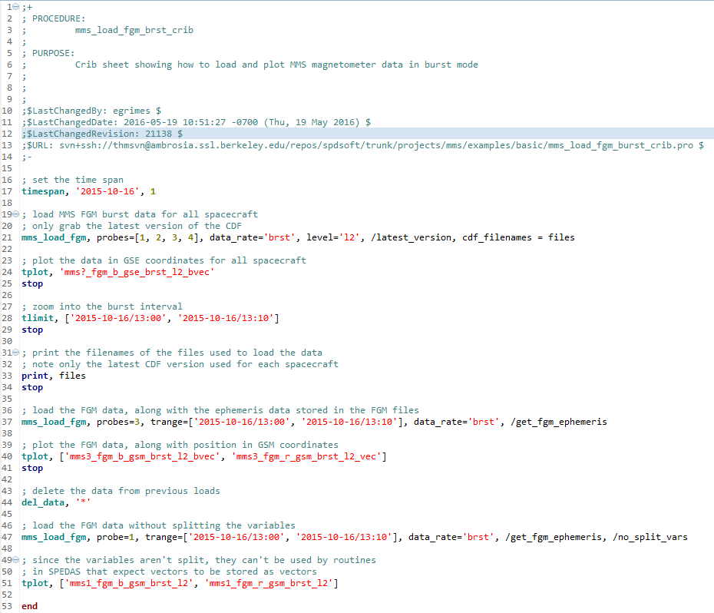
Basic Example

Slide 11
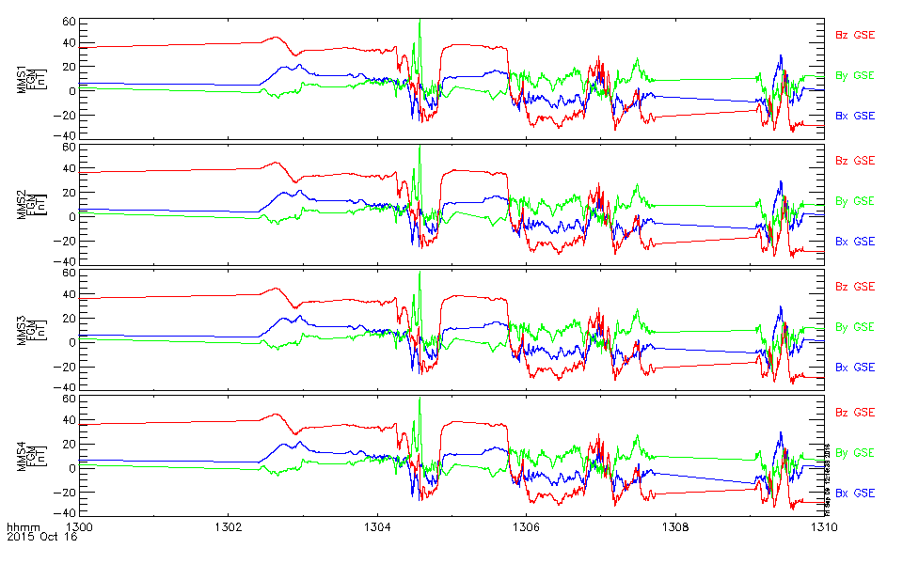
Basic Example

Slide 12
Advanced Examples
crib_master
mms_basic_dayside.pro
mms_basic_dayside_v3.pro
mms_fpi_dist_slice_comparison_crib_l2.pro
mms_fpi_dist_slice_comparison_crib_v3.pro
mms_isee_3d_crib.pro
mms_isee_3d_crib_basic.pro
mms_load_fpi_summary_crib.pro
mms_load_fpi_summary_crib_v3.pro
mms_multi_axis_figure.pro
mms_mva_crib.pro
mms_neutral_sheet_crib.pro
mms_part_products_crib.pro
mms_part_products_crib_v3.pro
mms_slice2d_fpi_crib.pro
mms_slice2d_fpi_crib_v3.pro
mms_slice2d_hpca_crib.pro
mms_wavpol_crib.pro

Slide 13
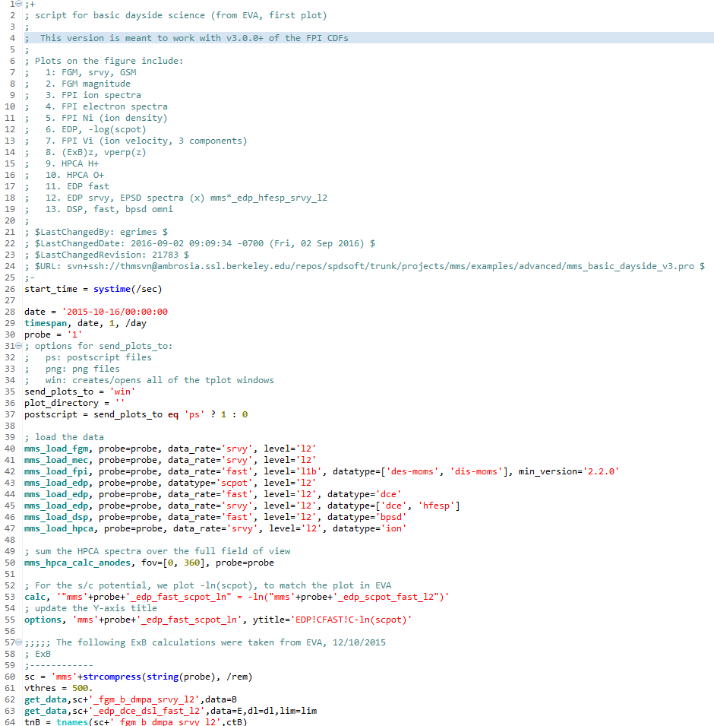
Advanced Example

Slide 14
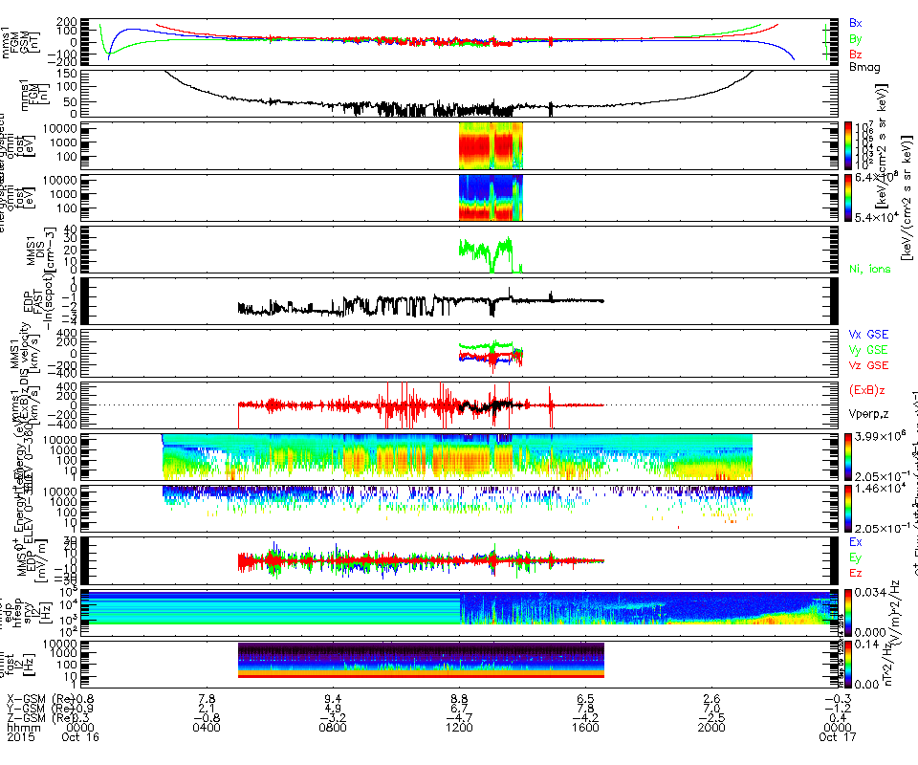
Advanced Example

Slide 15
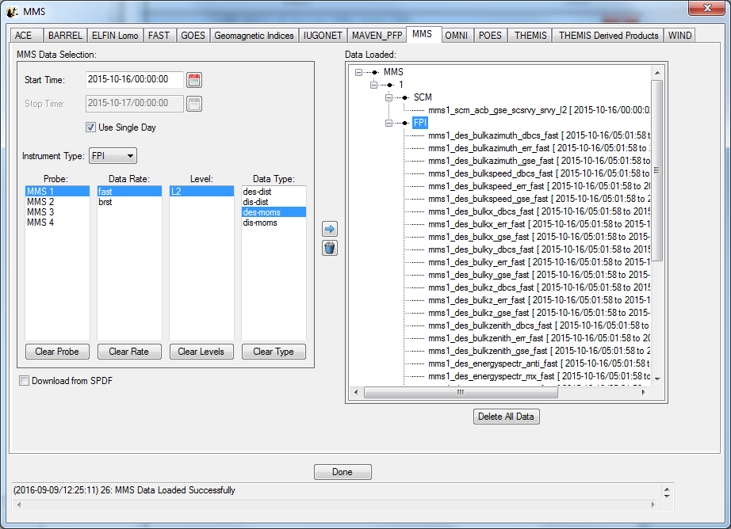
The GUI
spd_gui -> File -> Load Data

Slide 16
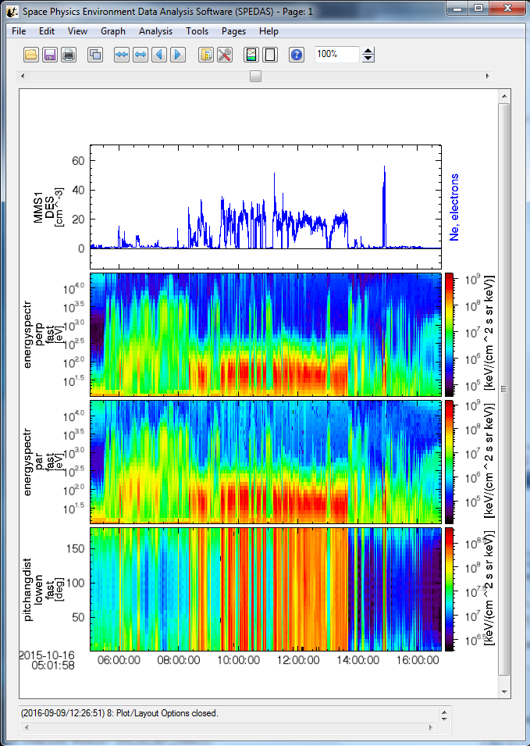
The GUI

Slide 17
Getting Help
spedas.org
egrimes@igpp.ucla.edu (email me any time)
https://groups.google.com/forum/#!forum/spedas
2016 GEM Tutorial - http://spedas.org/mms/mms_gem_2016.pdf (many command line examples)
This presentation - http://spedas.org/mms/mms_ucla_2016.pdf

Slide 18
Getting Help
Browse the data at the SDC:
https://lasp.colorado.edu/mms/sdc/public/data/
QL plots at the SDC:
https://lasp.colorado.edu/mms/sdc/public/quicklook/
More info on MMS data at the SDC:
https://lasp.colorado.edu/mms/sdc/public/datasets/

