Slide 1
Getting Started with PySPEDAS
Jim Lewis
jwl@ssl.Berkeley.edu

Slide 2
Tutorial agenda
Motivation for developing and using PySPEDAS
Setting up a Python environment
Installing PySPEDAS
Some PySPEDAS core concepts
Some simple PySPEDAS examples
Q & A
Time permitting: live demo

Slide 3
PySPEDAS features and capabilities
Load data from many different providers and formats into a common environment
Support for directly loading data from 30+ missions (including THEMIS, MMS, ERG/Arase, RBSP/Van Allen probes, Parker Solar Probe, FAST, WIND, many others)
Load via CDAWeb web service
Load via HAPI
Analysis and Modeling tools
Interface to native Python geopack package
Field-aligned coordinates, minimum variance analysis, wave polarization, etc
Plotting tools
Line plots
Spectrograms
Being worked on: interactive plots (zoom in on specific time ranges, see time/data values at cursor, etc)
Also coming soon: 3-D particle distribution interactive visualization tools (courtesy of ERG/Arase team, similar to IDL ISEE-3D tool)

Slide 4
Future development plans
More missions and datasets
Improved modeling tools (e.g. additional GEOPACK models, field line tracing)
More interactivity with plots (e.g. mousing over to get times and data values)
More wrappers for working with particle datasets for additional missions (e.g. THEMIS)

Slide 5
How to get help
Documentation wiki: http://spedas.org/wiki
Also: https://pyspedas.readthedocs.io
Github issue tracker: https://github.com/spedas/pyspedas/issues
Email questions and problem reports: Themis_Science_Support@ssl.Berkeley.edu

Slide 6
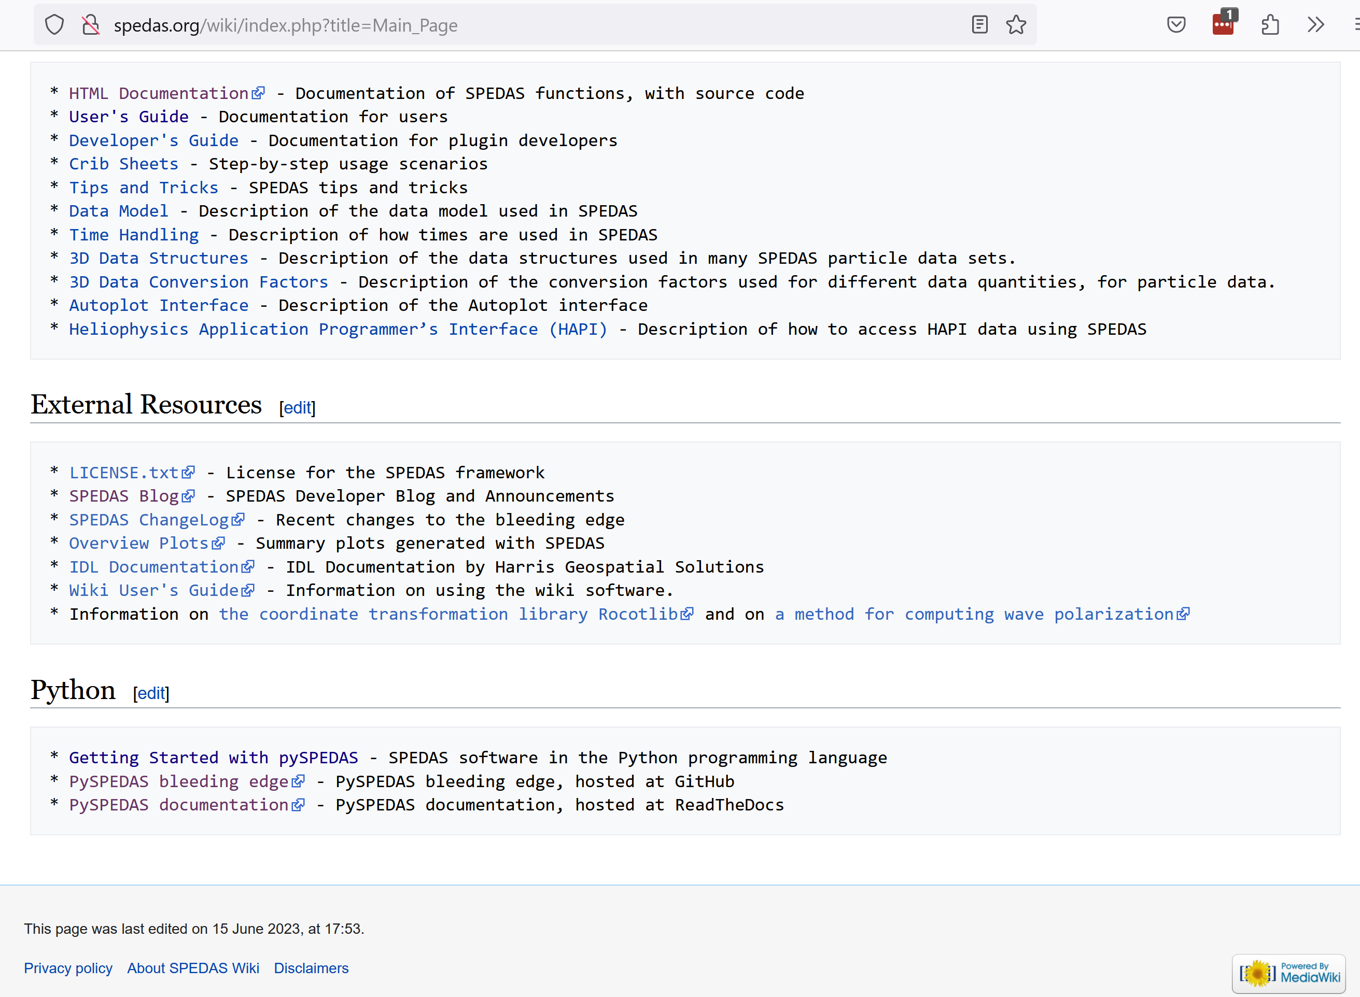

Slide 7
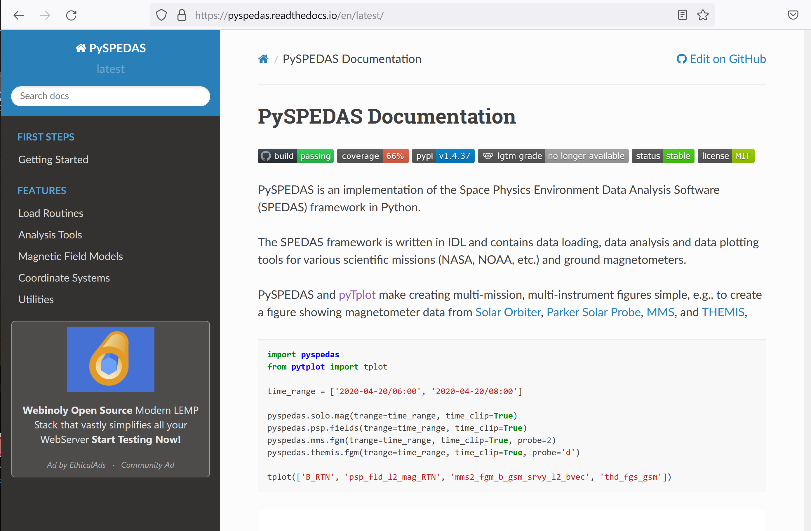

Slide 8
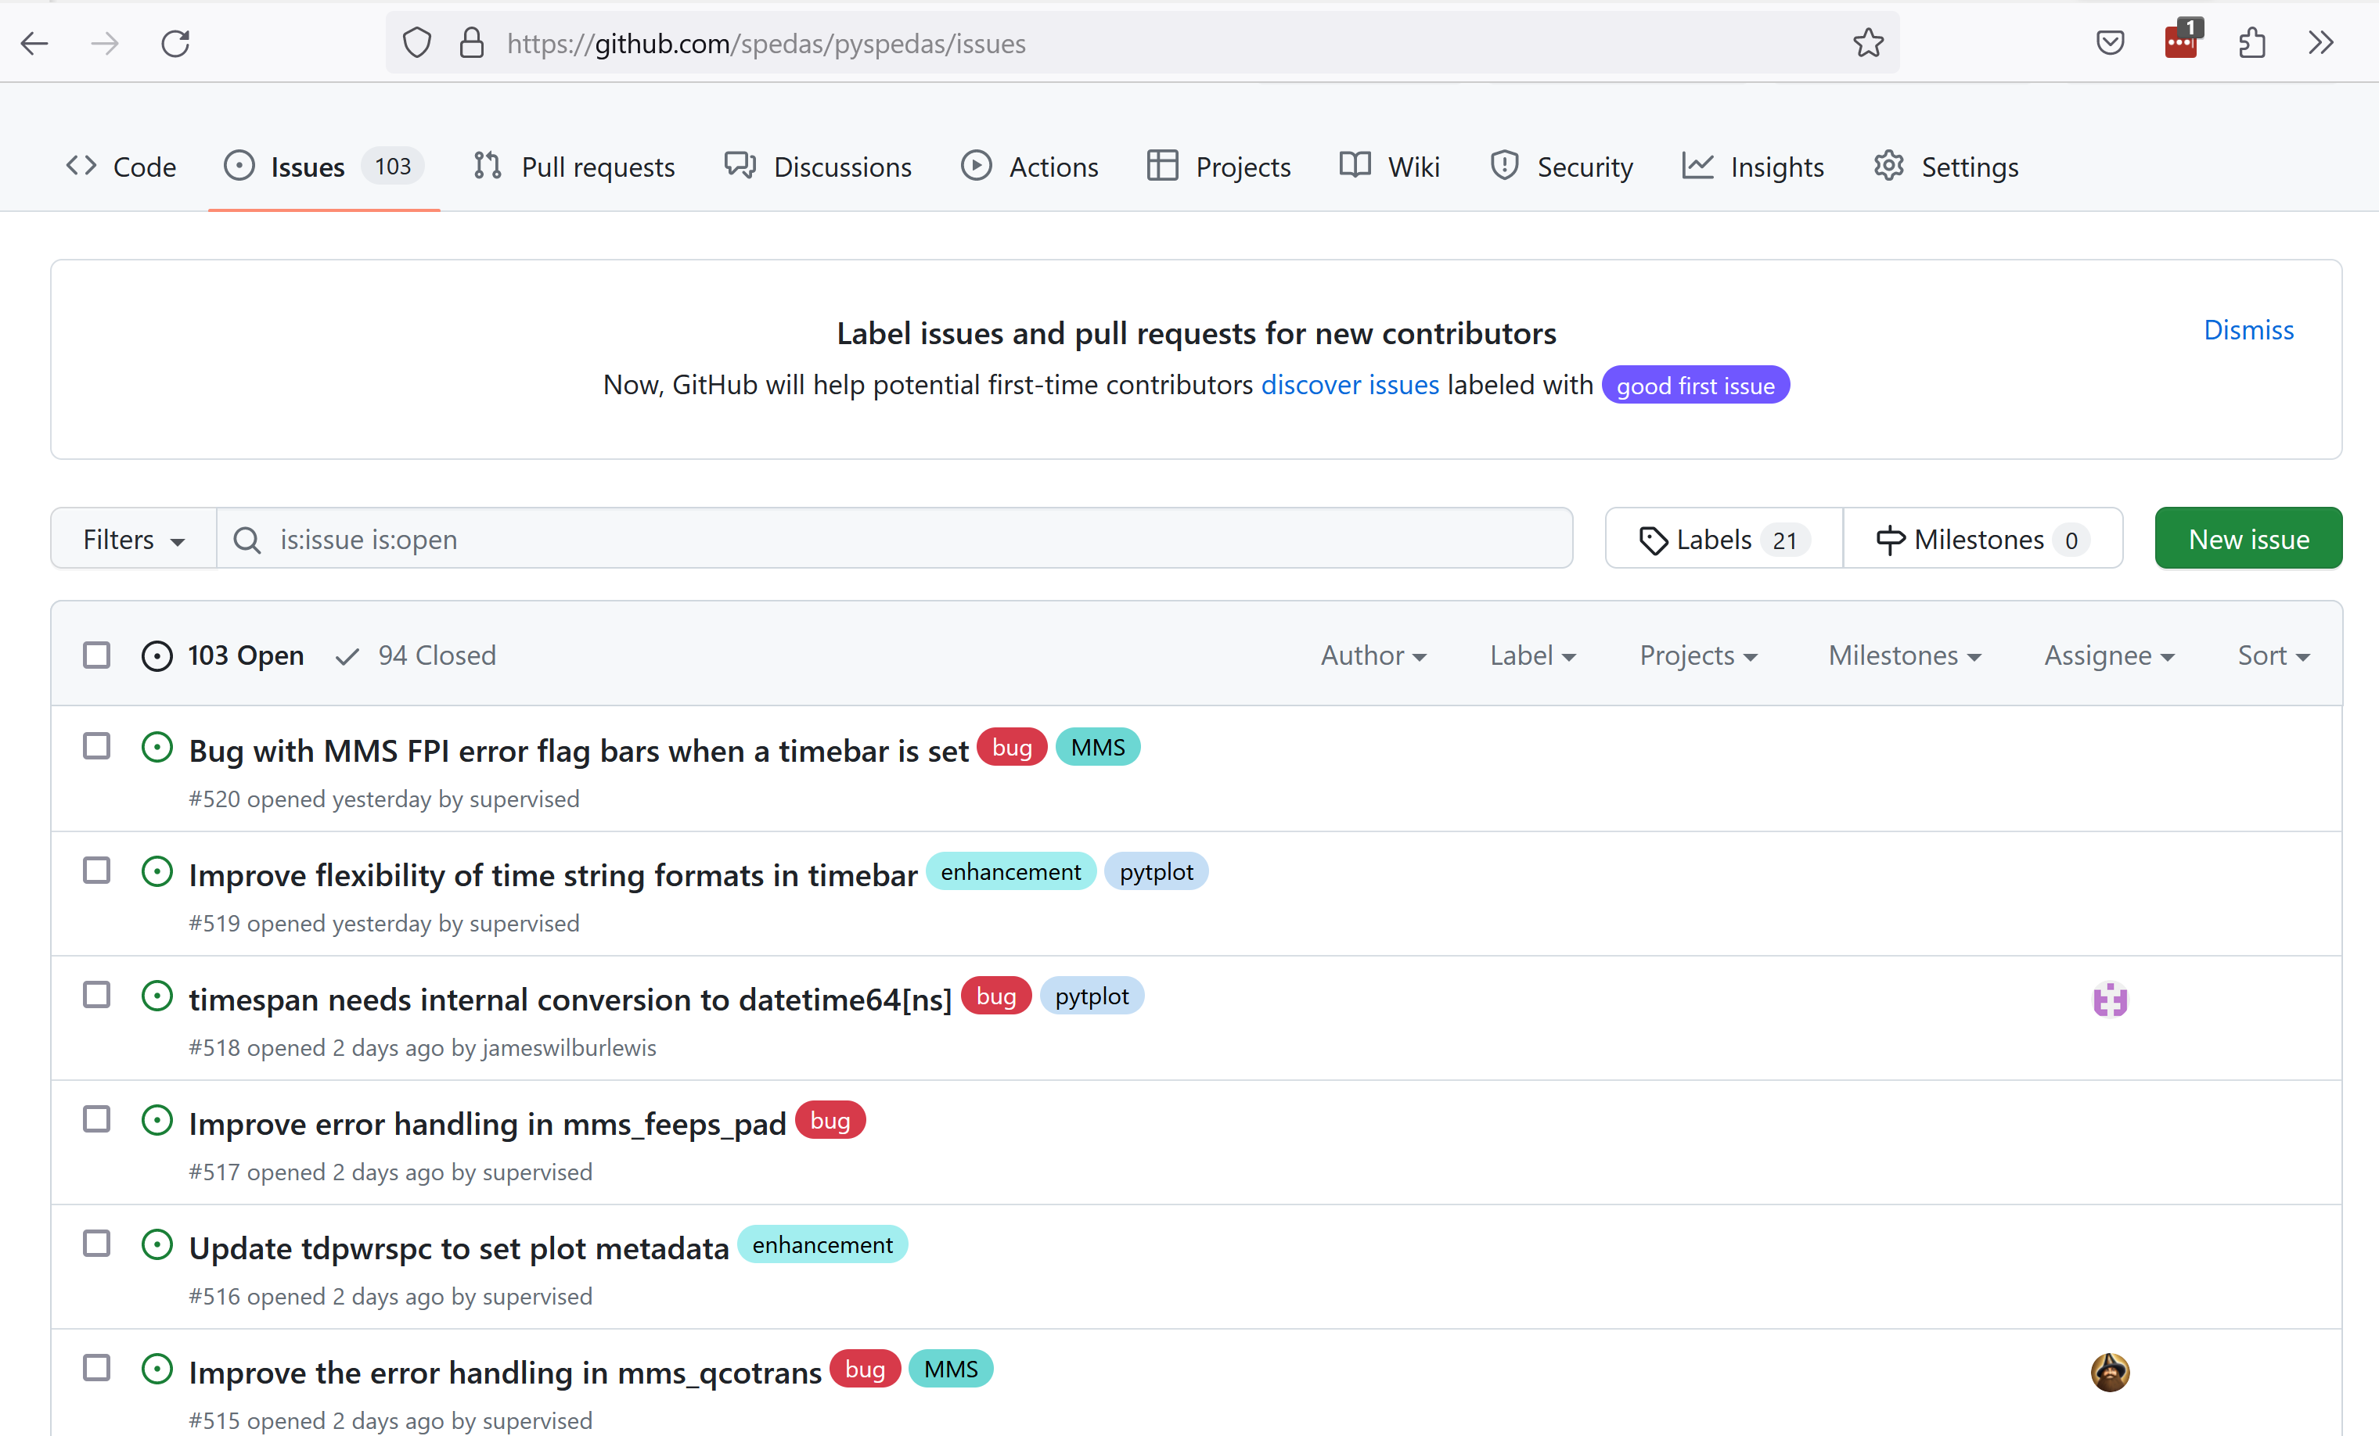

Slide 9
Getting Python
Python 3.8 or later is required (current version is 3.11.4)
Some packages that PySPEDAS depends on may not be compatible or well-tested with 3.11; 3.10 might be a safer choice
python.org is a great place to start: downloads & installation instructions, documentation, beginner’s guide
Another option (even if you already have a suitable Python installation!) is Anaconda (anaconda.com), which bundles the Python interpreter with additional scientific Python packages and other tools (including interactive development environments: highly recommended!)
It is fine to have multiple Python versions installed on the same system.

Slide 10
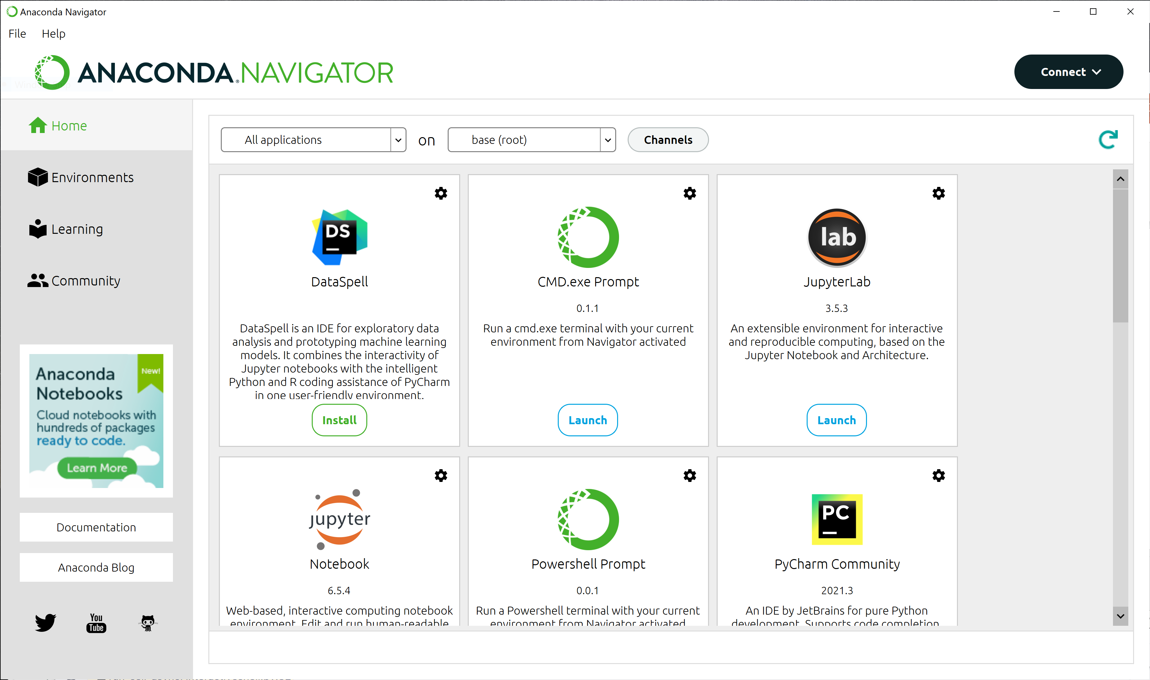

Slide 11
Python IDEs (interactive development environments
An IDE is not strictly needed – you could get by with just a text editor and a command line. But you’ll probably want one.
Hover or click on function names to see documentation, parameter hints, etc
Jump from a function call point to the function definition
Integration with version control systems (git, svn, etc)
See potential problems while coding
Run scripts and tests easily and see results without leaving the IDE
Debugging: set breakpoints, step through code and inspect variable values
The Spyder IDE is bundled with Anaconda (anaconda.org); PyCharm (www.jetbrains.com/pycharm) and Visual Studio Code (code.visualstudio.com) are some other popular free IDEs.

Slide 12
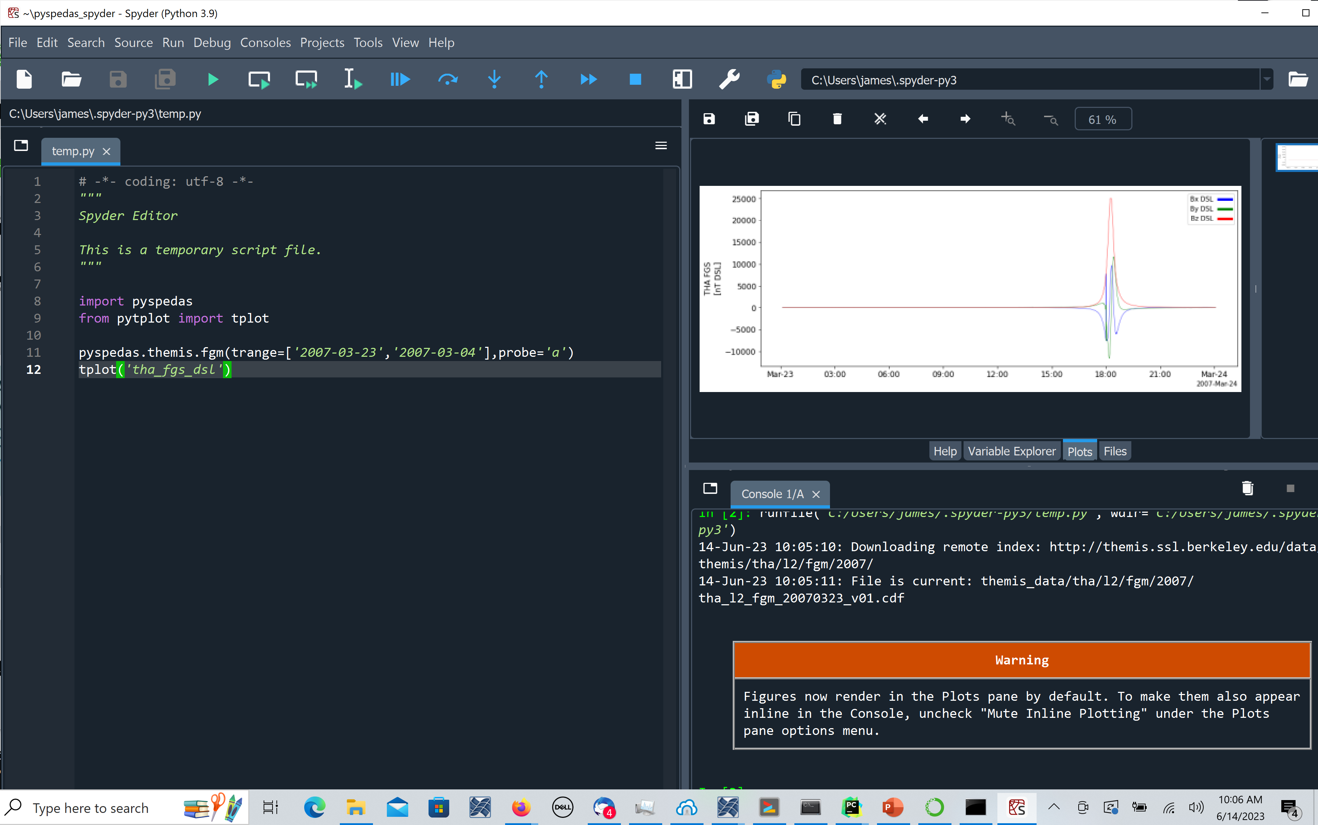

Slide 13
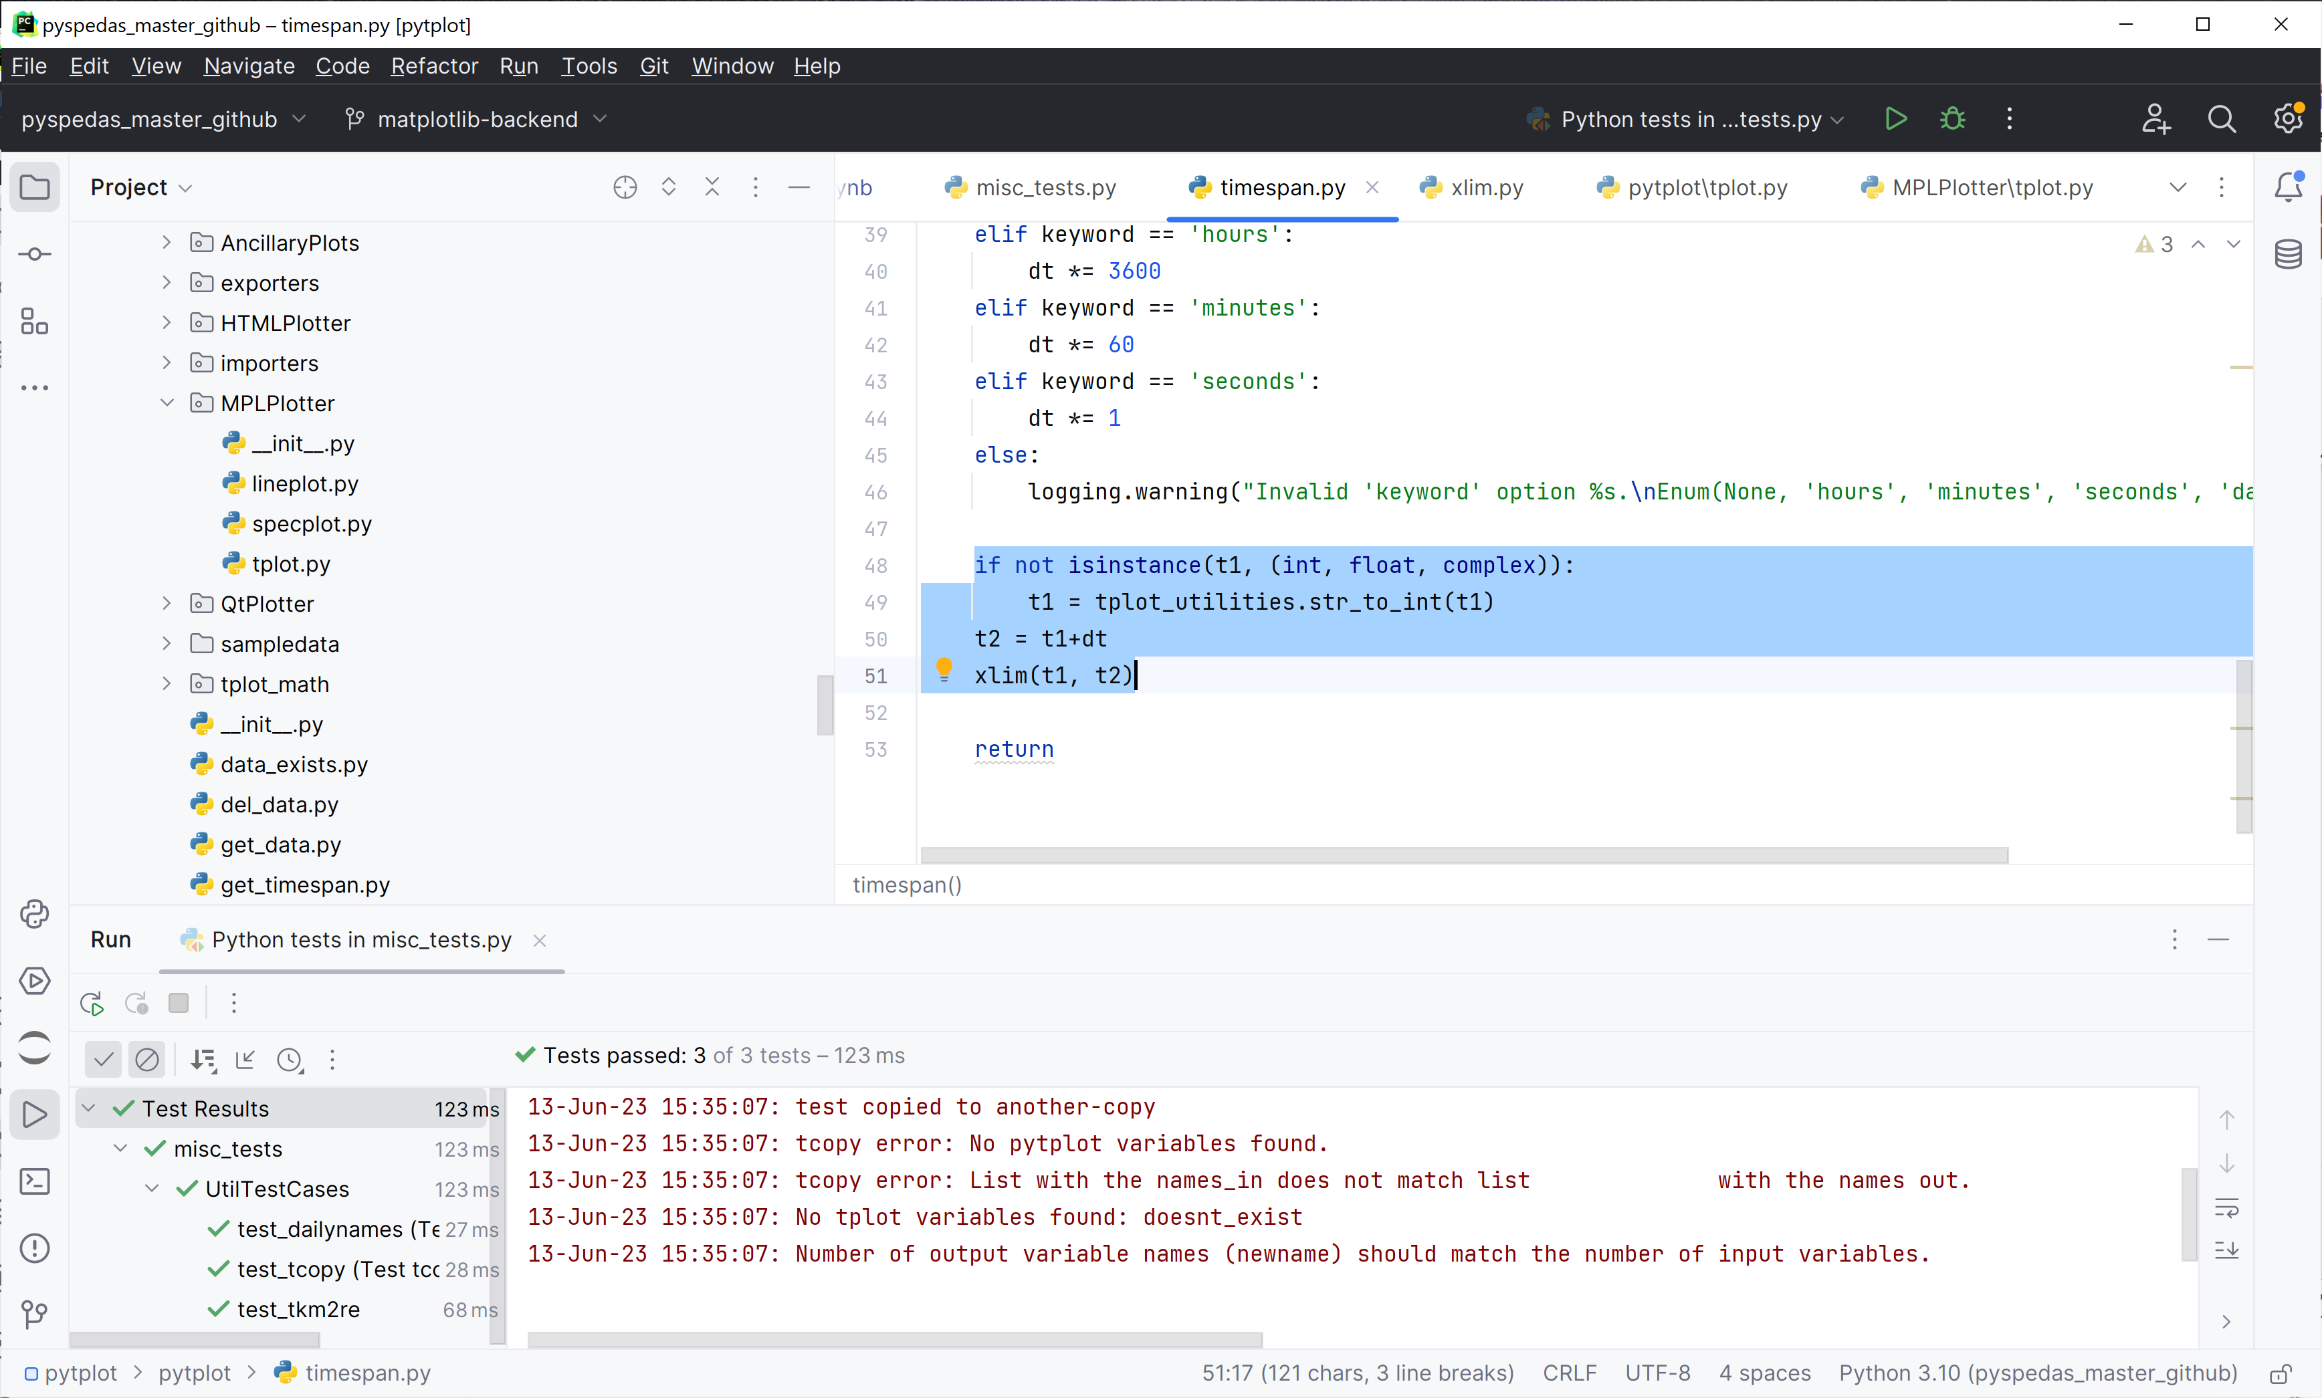

Slide 14
Python virtual environments and package management
Unlike IDL, the Python ecosystem is heavily dependent on open-source packages to provide functionality beyond the core language.
numpy for numerical algorithms, PyQt or matplotlib for graphics, CDF and NetCDF libraries, etc.
It is typical for a Python package (like PySPEDAS) to depend on several other packages, sometimes with specific versioning requirements.
The more packages installed in a single environment, the greater the potential for versioning conflicts
Python provides for “virtual environments”, which allow different environments for different purposes to coexist on the same system, rather than installing all packages under the main Python installation.

Slide 15
Python virtual environments and package management
We highly recommend installing PySPEDAS in a dedicated virtual environment.
Anaconda virtual environments can be managed via Anaconda Navigator, or using the command line: conda create --name my_new_environment
Your IDE may offer the option to create a virtual environment when creating a new project.
Python can create a new virtual environment for you, with the command line: python -m venv /path/to/new/virtual/environment

Slide 16
Python virtual environments and package management
There are two styles of package management commonly used in the Python community:
conda (if using an Anaconda python distribution): conda install package-name
pip (Pip Installs Packages): pip install package-name
Each system has its own repository of Python packages and ways of tracking locally installed packages. (So conda is not aware of packages installed via pip, and vice versa).
Many packages are available via both methods, but PySPEDAS is only available via pip (for now).

Slide 17
How to get PySPEDAS
Installing for the first time: pip install pyspedas
Upgrading an existing installation: pip install --upgrade pyspedas
This installs (or updates) the latest released version of the PySPEDAS source code, along with all the other packages it depends on.
Another method (for example, if you’re interested in modifying or contributing to PySPEDAS) is to get the source code directly from our GitHub repository. Your IDE might be able to create a project directly from Github, or you can use the command:
git clone https://github.com/spedas/pyspedas.git /path/to/pyspedas

Slide 18
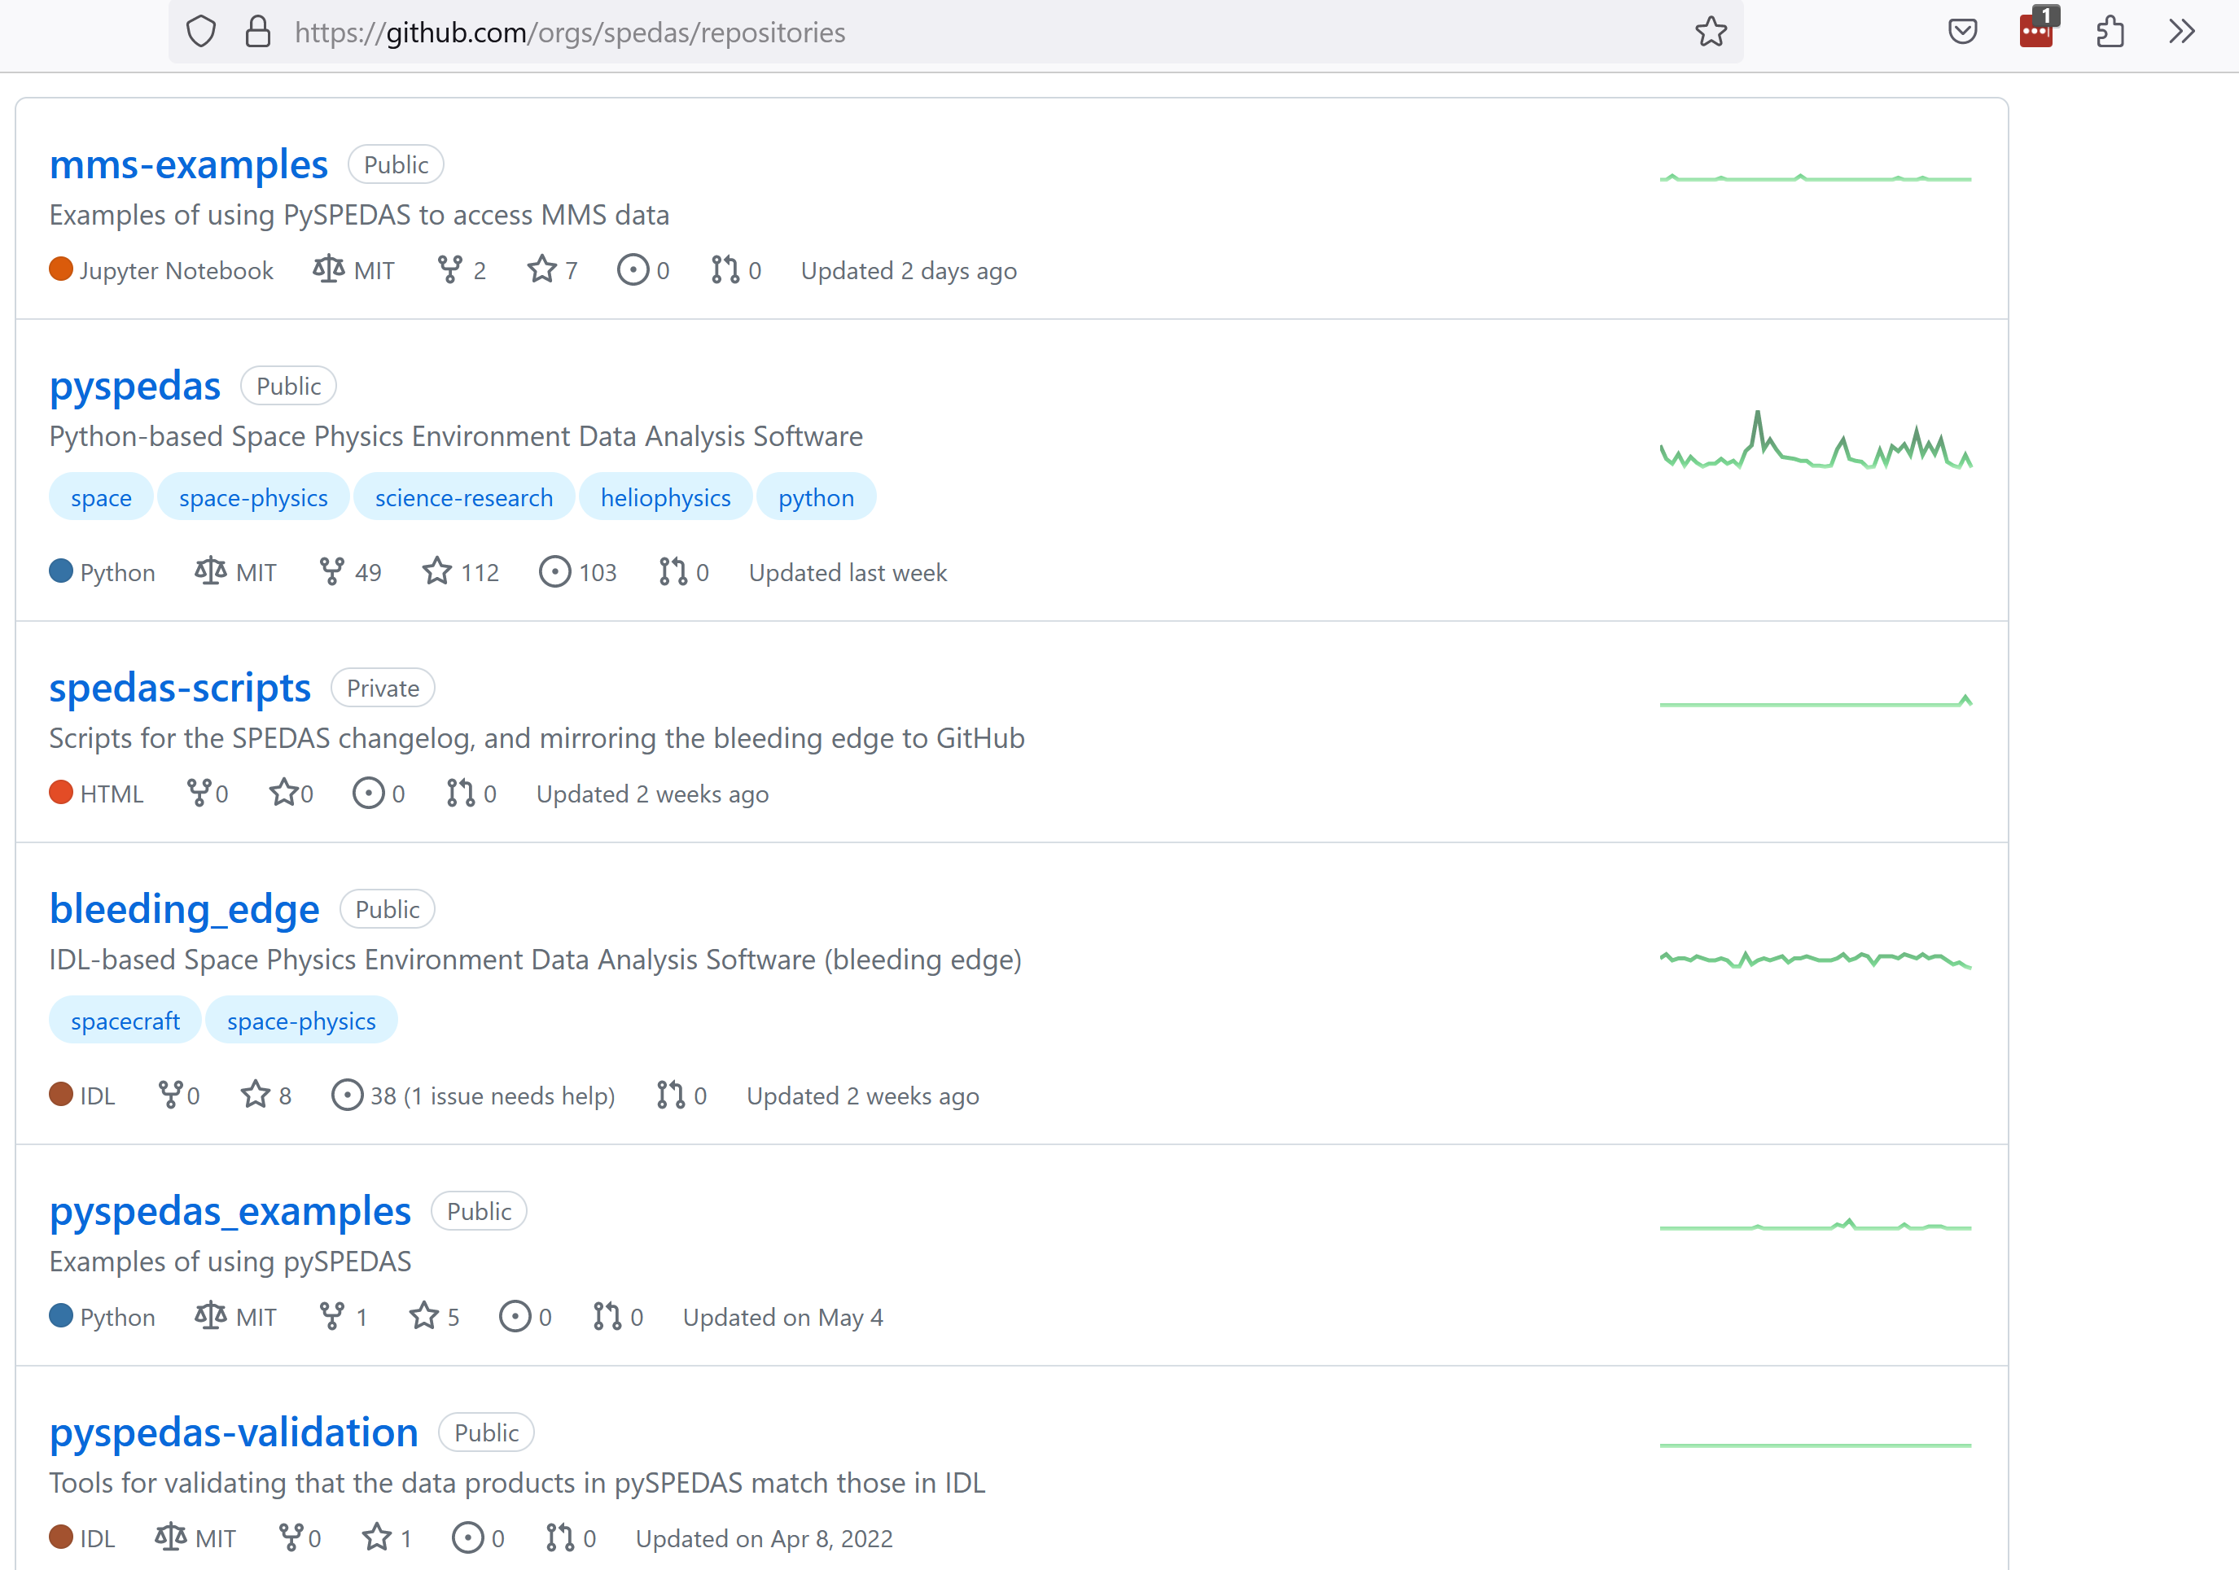

Slide 19
PySPEDAS Concepts
Load routines: Download data from mission-specific or multi-mission archives (e.g. THEMIS, MMS, SPDF), maintain local cache of downloaded data files, convert CDF or NetCDF data to tplot variables.
Tplot variables: Basic data structure on which SPEDAS and PySPEDAS are built. Maps strings (tplot variable names) to time series data arrays and metadata
Metadata: Information that describes important data attributes needed by plotting and analysis tools (e.g. units, coordinate systems, plot labels, energy channel values for spectra, etc.)
Plotting tools: “tplot” routine for creating line plots or spectrograms of tplot variables, helper routines for setting per-variable or per-plot options. Based on matplotlib package.
Analysis tools: Manipulate tplot variables in various ways. PySPEDAS includes many tools for performing arithmetic operations, interpolation, and coordinate transformations. Also includes more complicated tasks such as generation of plasma moments from 3-D particle distributions, or wave polarization analysis. Many tools are implemented using the numpy library.

Slide 20
Using Load Routines
Use python ‘import’ statements to make load routines available in your program. “import pyspedas” makes all the supported mission namespaces available. Many missions follow a naming convention like pyspedas.MISSION.INSTRUMENT() to access their load routines.
Commonly supported load routine parameters:
trange : Specify a time range for data to be loaded (array of start and end times, represented as string-valued timestamps or double precision Unix times)
probe: For missions that support multiple probes, specify one or more probes to load data for
level: Missions typically publish data at various calibration levels, e.g. level=‘l1’ (for raw, uncalibrated data), level=‘l2’ (calibrated data in engineering units and geophysical coordinates), to l3 and above (highly processed/key parameter data)
datatype: Specify a subset of available variables in the requested dataset to be loaded
get_support_data: A flag (True/False) commonly used to request loading ancillary data that may be needed for downstream analysis tools

Slide 21
Example 1: Load and plot THEMIS FGM data

Slide 22
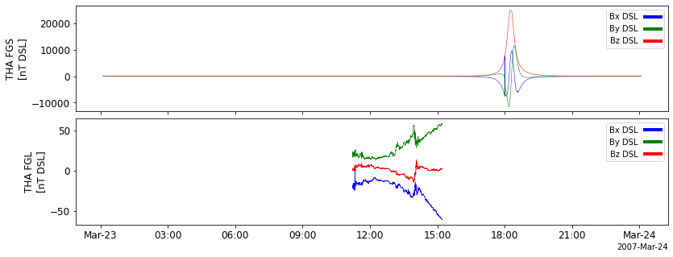
Example 1, PySPEDAS plot output

Slide 23
Working with tplot variables
The pytplot package contains several routines for listing, creating, or extracting information from tplot variables. To use specific routines, import them from pytplot, e.g:
from pytplot import get_data, store_data, tplot_names
tplot_names(pattern) prints tplot names currently loaded and matching the given wildcard pattern
Many missions follow a naming convention like PROBE_MISSION_INSTRUMENT_DATATYPE for their variable names. There may also be suffixes to indicate data levels, units, or coordinate systems
get_data(‘tplot_variable_name’) is used to retrieve the timestamps, data values, or metadata for a given variable as normal Python data structures.

Slide 24
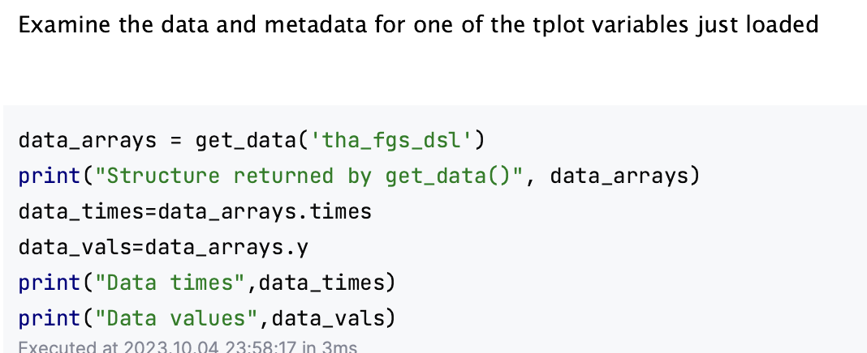
Example 1A, tplot variables

Slide 25
Example 1A, console output

Slide 26
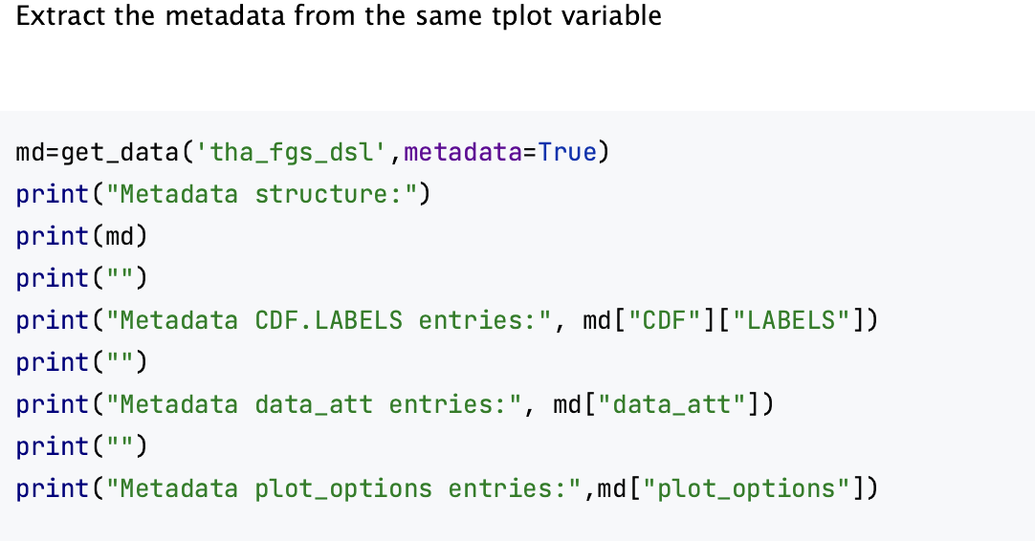
Example 1A, getting tplot variable metadata

Slide 27
Example 1A, metadata console output

Slide 28
Example 2, MMS FGM data

Slide 29
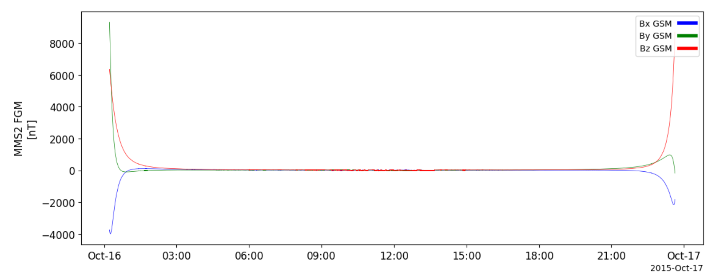
Example 2, PySPEDAS plot output

Slide 30
Example 3, MMS FEEPS data and spectrogram

Slide 31
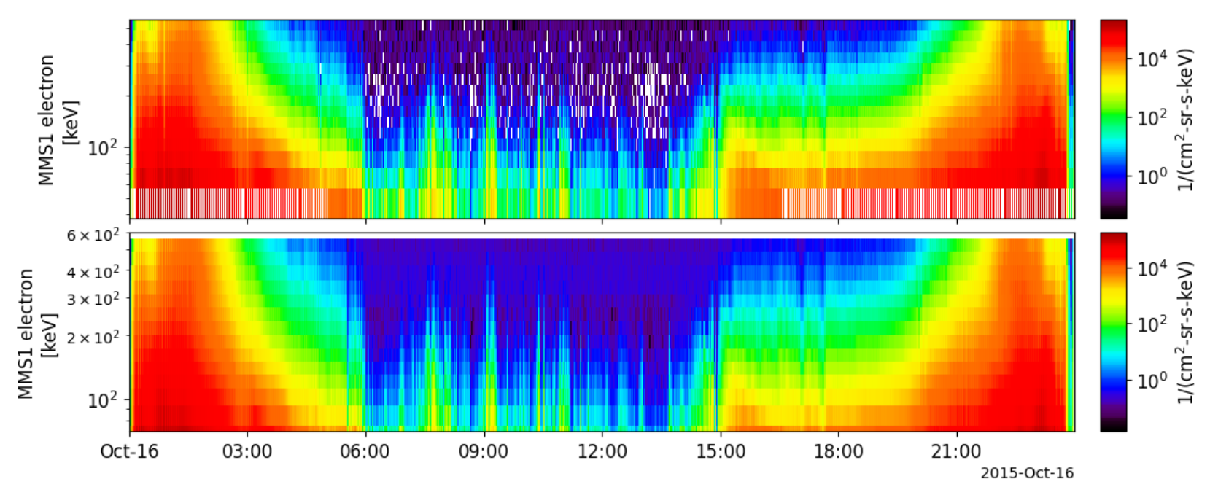
Example 3, PySPEDAS spectrogram plot

Slide 32
Analysis tools: coordinate transformations

Slide 33
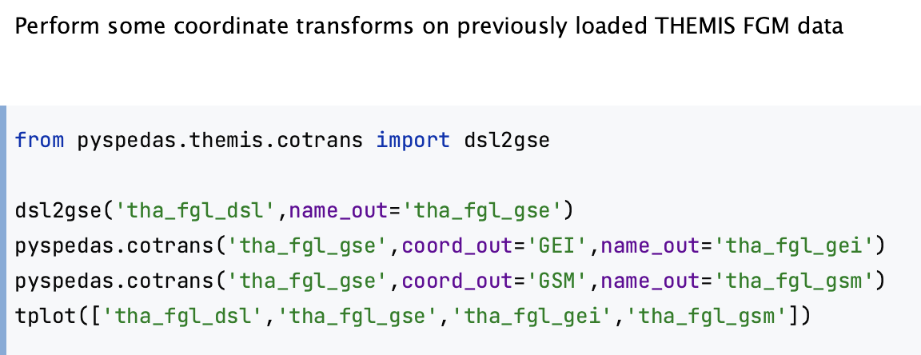
Example 4: Coordinate transforms

Slide 34
Example 4: console output

Slide 35
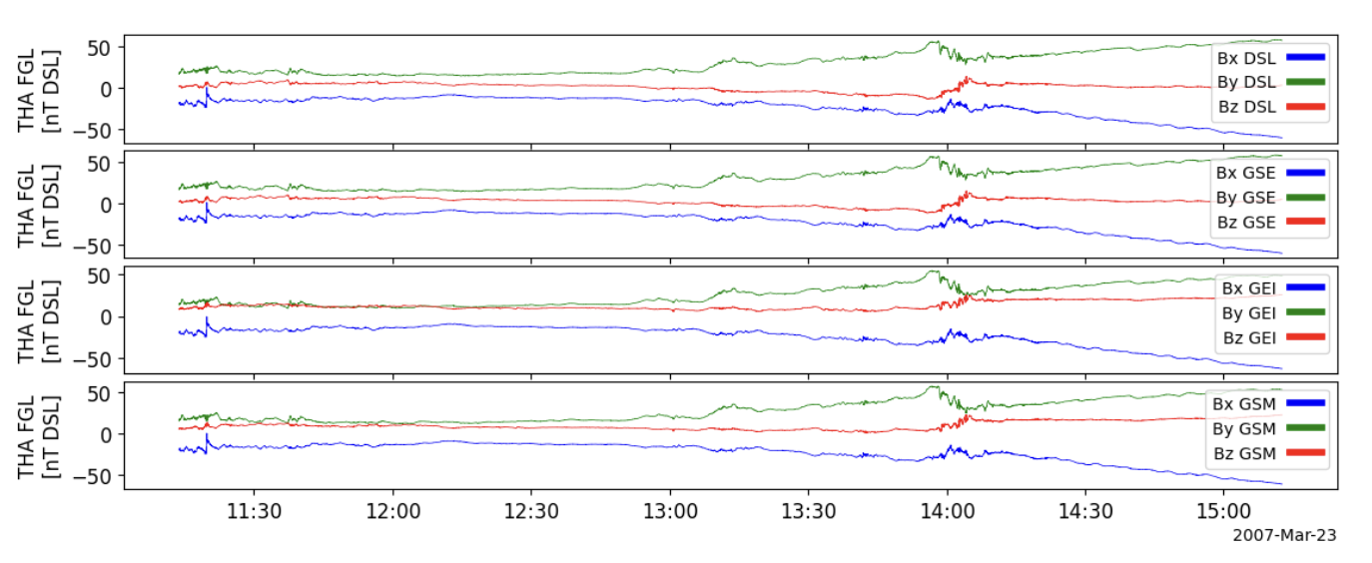
Example 4: PySPEDAS plots

Slide 36
Other analysis tools
Wavelet transforms
Wave polarization analysis
2-D slices of 3-D particle distributions

Slide 37
Jupyter notebooks
For PySPEDAS, we mainly use Jupyter notebooks for tutorial examples.
Jupyter notebooks run in an interactive Python process, with code and results displayed in a browser window.
Each code fragment lives in its own “cell” (but they all run in a common environment).
There are also annotation cells, which can contain rich content – embedded images, styled text, live web links, etc. So they are much more versatile than inline code comments.

Slide 38
Running Jupyter notebooks
You will probably need to install the jupyter package in the virtual environment you’re using: “pip install jupyter”
The command “jupyter notebook” will open a page in your browser. From there, you should be able to navigate to the notebook you’re interested in, open it and start running.
Another option, which doesn’t require a Python installation at all, is to use “Google Colab”. A notebook can be uploaded to a Google Drive page (with a few extra commands in the notebook to install the required packages). Opening the notebook will spin up a Python session in the cloud and let you run the notebook there, and display the results in your browser.

Slide 39
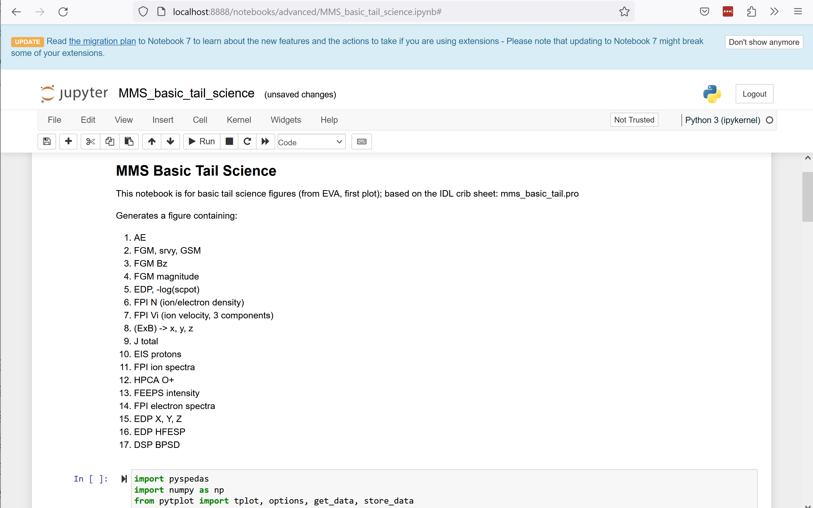
Jupyter notebook

Slide 40
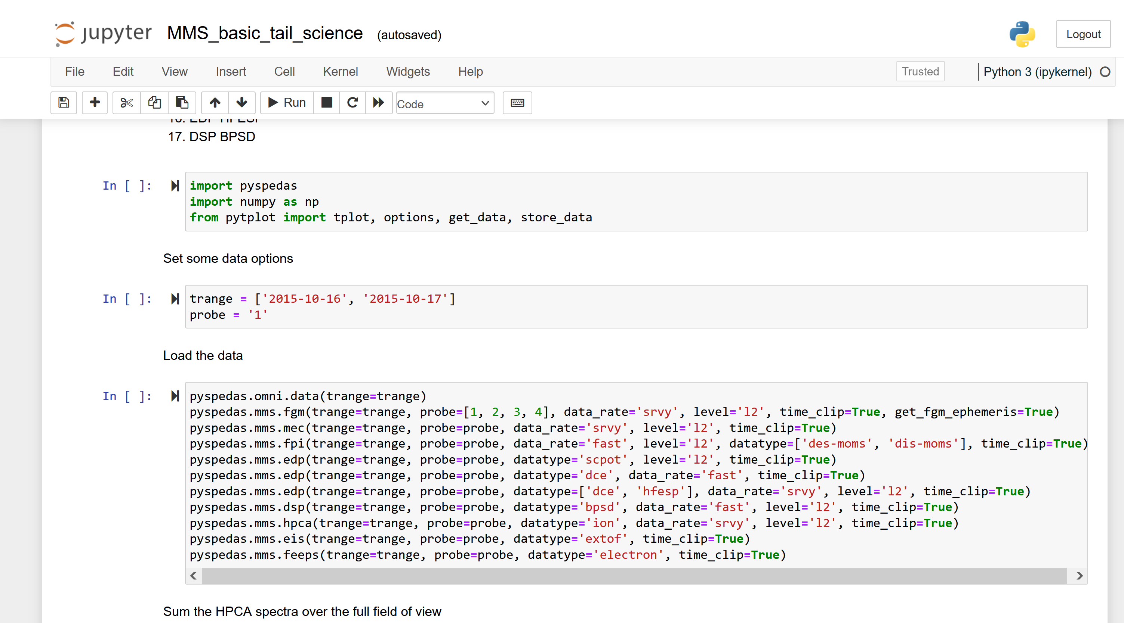

Slide 41
Additional PySPEDAS example notebooks
On Github, we have several repositories containing quite a few Jupyter notebooks:
PyTplot and other tools: https://github.com/spedas/pyspedas-examples
MMS examples: https://github.com/spedas/mms-examples
THEMIS examples: https://github.com/spedas/themis-examples
You can navigate to individual notebooks in the Github pages and download them – you don’t need to use Git or install the whole repository.

Slide 42
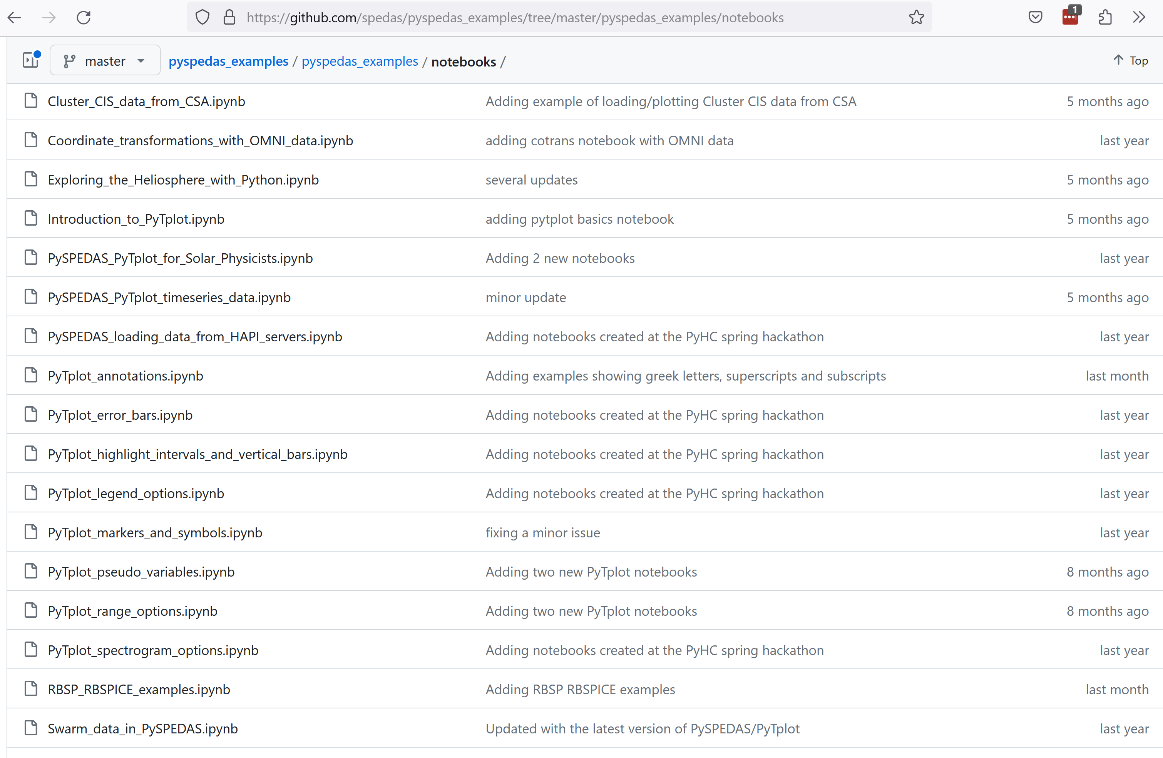

Slide 43
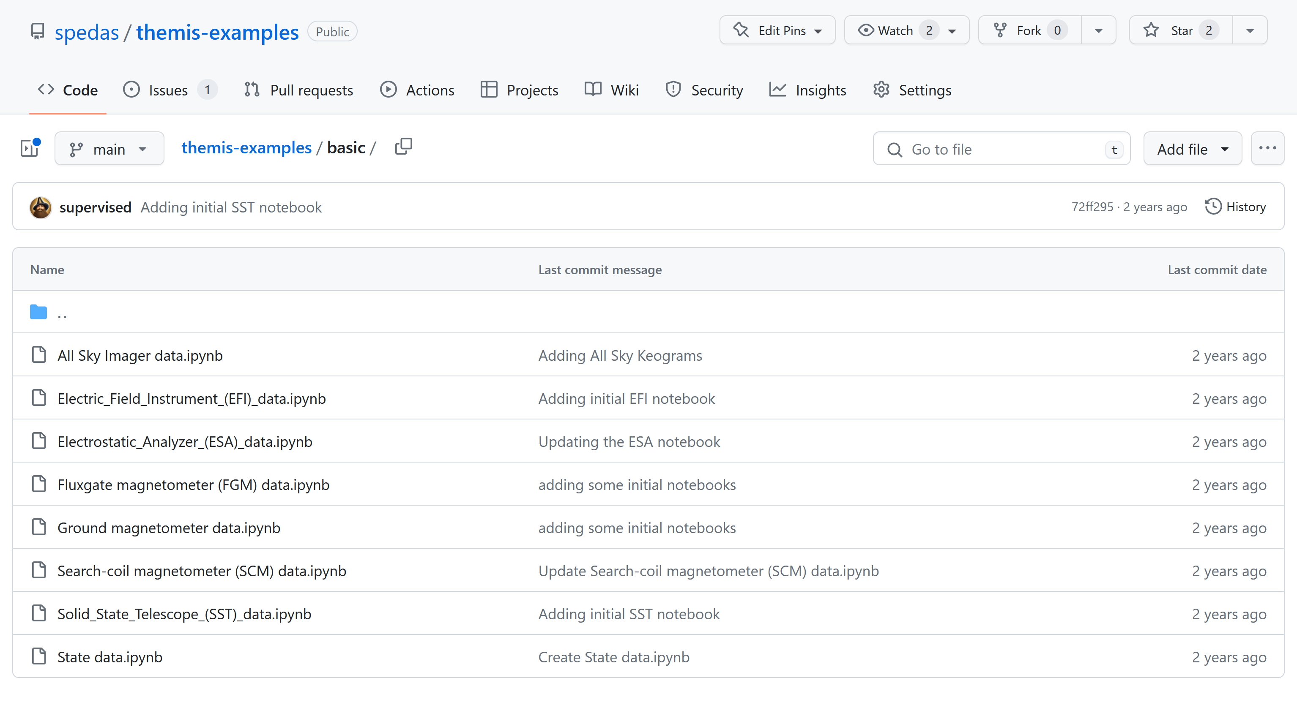

Slide 44
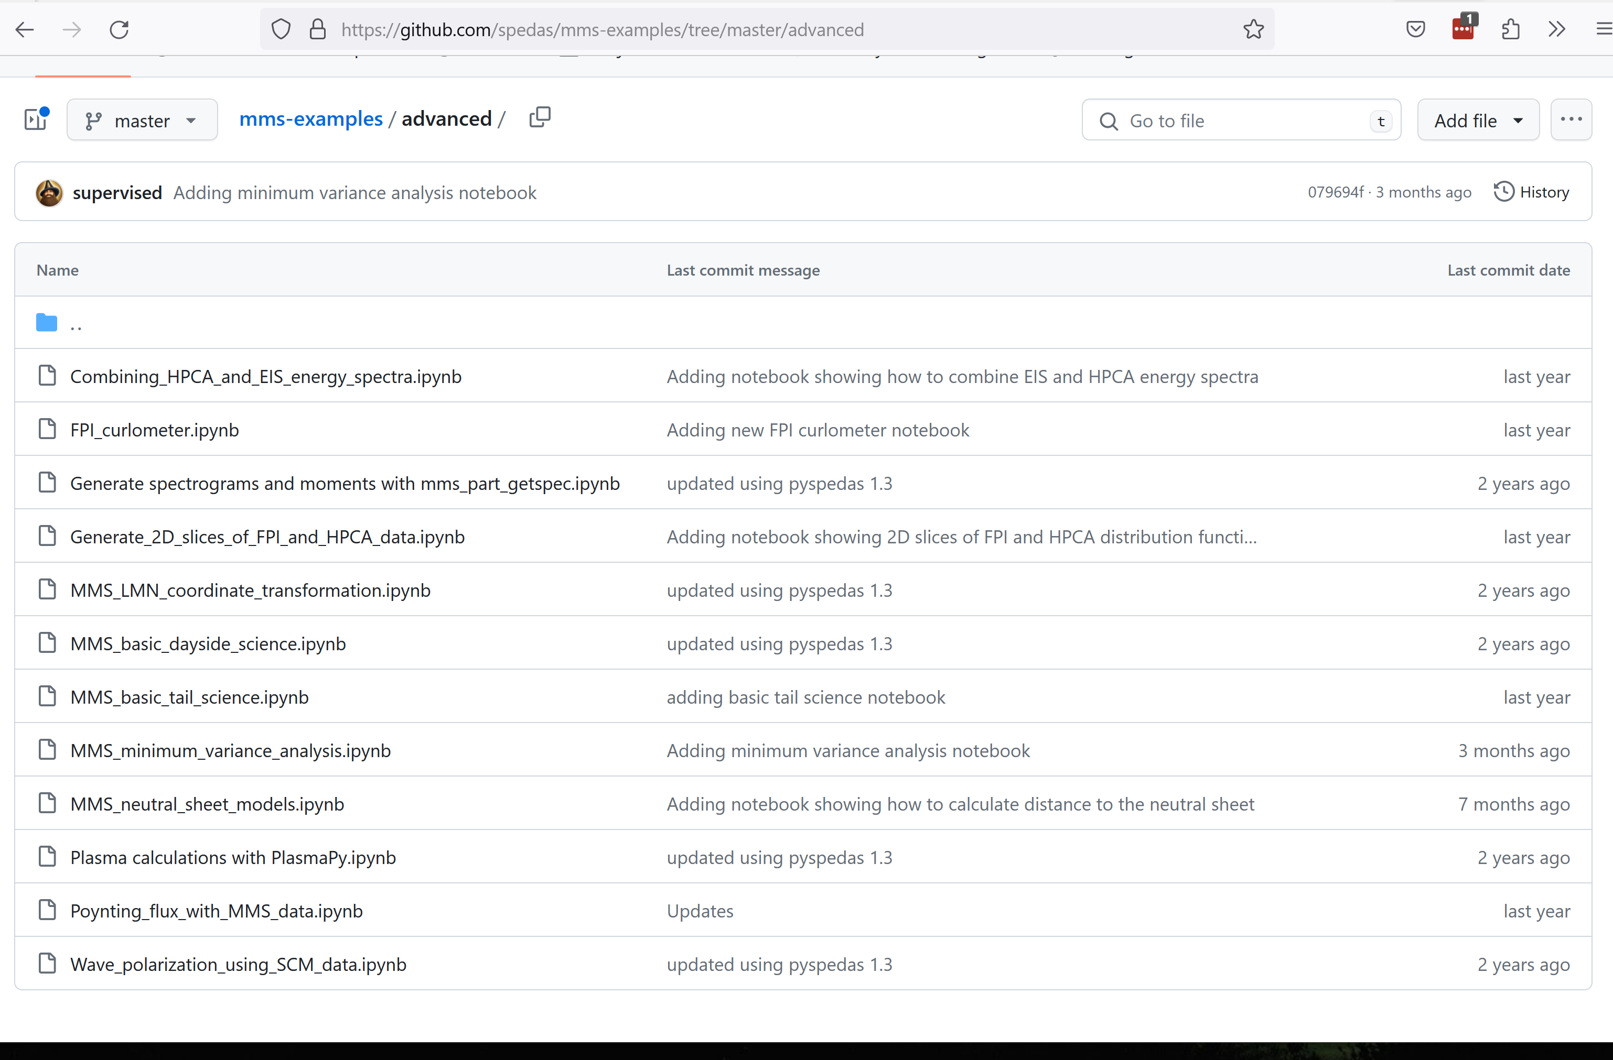

Slide 45
How to get help
Documentation wiki: http://spedas.org/wiki
Also: https://pyspedas.readthedocs.io
Github issue tracker: https://github.com/spedas/pyspedas/issues
Email questions and problem reports: Themis_Science_Support@ssl.Berkeley.edu

Slide 46
Q & A, live demo(?)

